Slide 1
Pint of Science Festival 14-16th May 2018 Alcohol use: How risky is risky? Nadine Hendrie & Rosa Vass Dr Catherine Marchand Professor Simon Coulton Professor Dorothy Newbury-Birch
Notes:
Welcome ….

Slide 2
Who are we?
Nadine & Rosa
The Team
Twitter
@RISKIT_CJS
@pintofscience
Notes:
Nadine and Rosa introduce themselves and roles within the project. The Team overview ….
Invite audience to view the poster (on display) and view our Twitter page and tweet using @RISKIT_CJS @pintofscience
Acknowledge the irony of talking about alcohol in a pub …..and that we are talking about risky/hazardous drinking only.
By the way ….we are going to be delivering a very interactive session so we may pinpoint a few of you …please don’t be shy and take part

Slide 3
What is Risk ?
Risk probability event damage event
Risk risky drinkingevent consequenceevent
Notes:
NH: First bit of Interaction …. Ask audience for a few definitions of Risk ?
Tell them there are many definitions of risk but we liked this one to highlight our talk ‘how risky is risky’ …a Technical objectivistic definition of risk ( Zinn, 2008).
RV: Interaction: Ask the audience to suggest what are the risks associated with alcohol in general ?
Then specifically for YP and then we can cover any not mentioned rather than listing them (increasing interaction)
NH: ‘ Alcohol: how risky is risky’ ? …. Hopefully you can see that we are discussing alcohol use and risk taking behaviour which can lead to adverse consequences or harms. For young people: the’ damage’ or harm is often increased due to their vulnerabilities. Possible escalation ….
Give an example – sexual health and alcohol ?
DOTS Paper :
The evidence confirms that alcohol consumption is associated with:
• not using a condom during a young person’s first sexual encounter
• an increased likelihood of having sex and at a younger age
• unprotected sex
• teenage pregnancy
• the likelihood of contracting sexually transmitted diseases …
RV: This is a personal example of RISK but the evidence tells us there are wider social issues relating to our trials population Next slide introduce RISKIT-CJS YP’s in the CJS

Slide 4
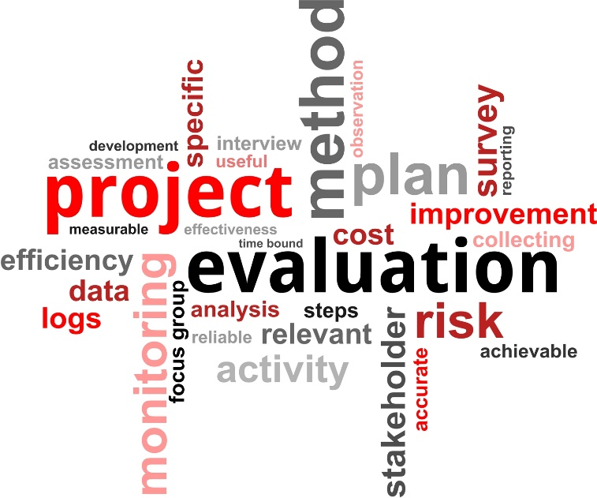
What are we doing and why ?
RISKIT-CJS is a pragmatic randomised control trial.
Mixed method, two-arm randomized controlled trial to evaluate the effectiveness and cost-effectiveness of the RISKIT-CJS intervention in reducing substance use in young people in criminal justice settings
Notes:
RV: Intro to the trial
WHAT are we doing and WHY
Read the trial description ..highlighting the population is YPS in the Criminal Justice System
Then run through the elements of the trial description using the animations/pictures …be brief and no technical terms …all layman’s
RCT - Gold standard
The people = Control and Intervention group
Why= To evaluate the Intervention
Why ?
Young people who offend are more likely to experience a range of inequalities in later life, for example poorer physical health [9], early pregnancy in females [12] and higher rates of tobacco use and drug and alcohol dependence [5, 10, 11], reduced employment chances and economic hardship [13].
There is widespread agreement that young people who offend are at increased risk of health and social problems making them one of the most vulnerable and often ‘hard to reach’ populations in the UK [14], which has one of the highest youth custody populations in western Europe [15].
RISKIT-CJS aims to reduce risk-taking behaviour among young people within the criminal justice system. Developed alongside adolescents, this intervention aims to address underlying issues around risk behaviour. RISKIT uses both small groups and tailored one-to-one sessions to target those most vulnerable to negative consequences of alcohol and drugs.

Slide 5
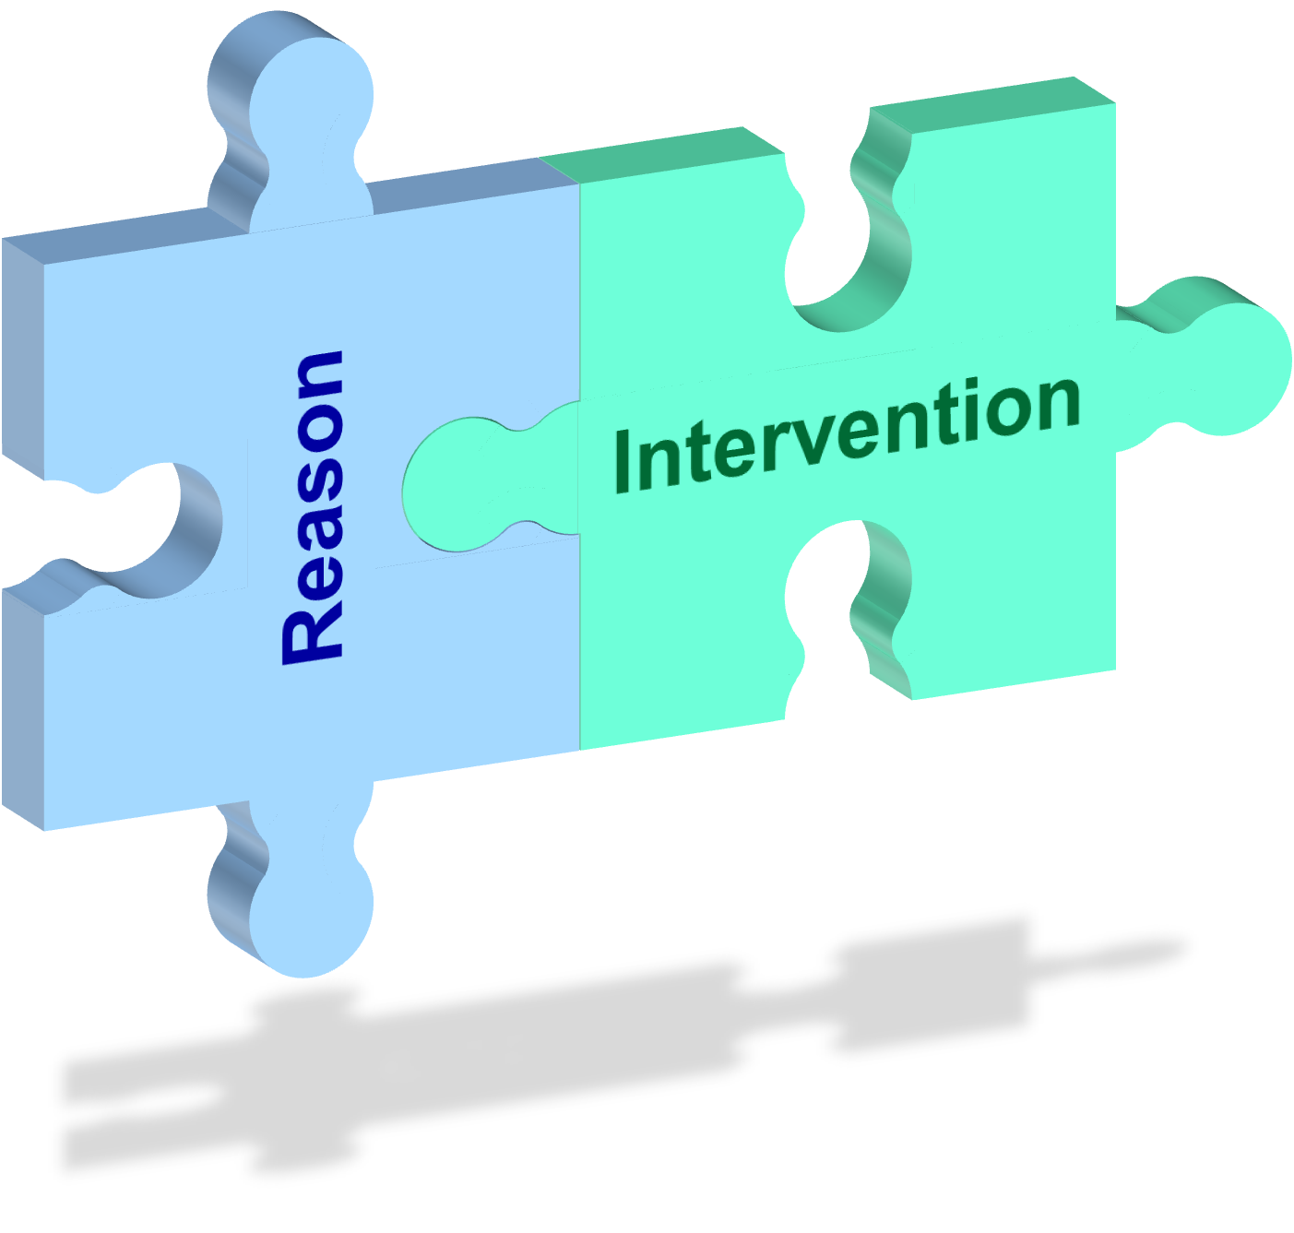
What is the Intervention and why should we evaluate it ?
What do we mean by intervention?
The RISKIT - CJS Intervention
What is it ?
Why evaluate it ?
Notes:
NH: Interaction
Ask audience …what is an Intervention? Invite audience to offer suggestions
RISKIT_CJS Intervention is a Kent based Intervention that has been developed specifically for this population (MI CBT and Psycho education)
RISKIT-CJS –consists of 1-1 sessions and two 3-4 hour group sessions.
We are visiting YOTs as well as other settings seeing YP who use substances and engage in risk taking behaviour.
Intervention
Discuss current substance use, risk-taking behaviour, and support for behaviour change and enhance motivation to engage with the
intervention.
Addresses a number of key issues involving both psycho-education and skill development including; understanding substance use and associated harms, understanding triggers of substance use behaviour, strategies for managing and minimizing risk and sexual health awareness.
Focusses on communication strategies and assertiveness training, managing anger and mindfulness and planning for the future.
Address any barriers to change, managing expectancy and enhancing self-efficacy to change. Self-efficacy refers to the Yps belief in their ability to succeed.
Until now there has been no formal evaluation on substance use Interventions with YP’s in CJS ….this means there is no evidence that interventions work or don’t work !!!
At the moment there is a call from PHE that all services should be delivering evidence based treatment/Interventions.

Slide 6
Start date: 01/09/2016
Duration: 36 Months
Funder: NIHR Public Health Research
Funding:
Nearly £1million
Notes:
RV: So who's funding it ?
Brief – 30 seconds
University of in collaboration with the above University's and organisations
It is NIHR Public health research started in September 2016 and with a duration of 36 months.
First project of its kind (the population) to receive NIHR funding
Proud it is Kent lead ….Prof Coulton
Kent based Intervention etc

Slide 7
Notes:
RV: You are going to now see how we collect the data so we can evaluate the RISKIT-CJS Intervention

Slide 8
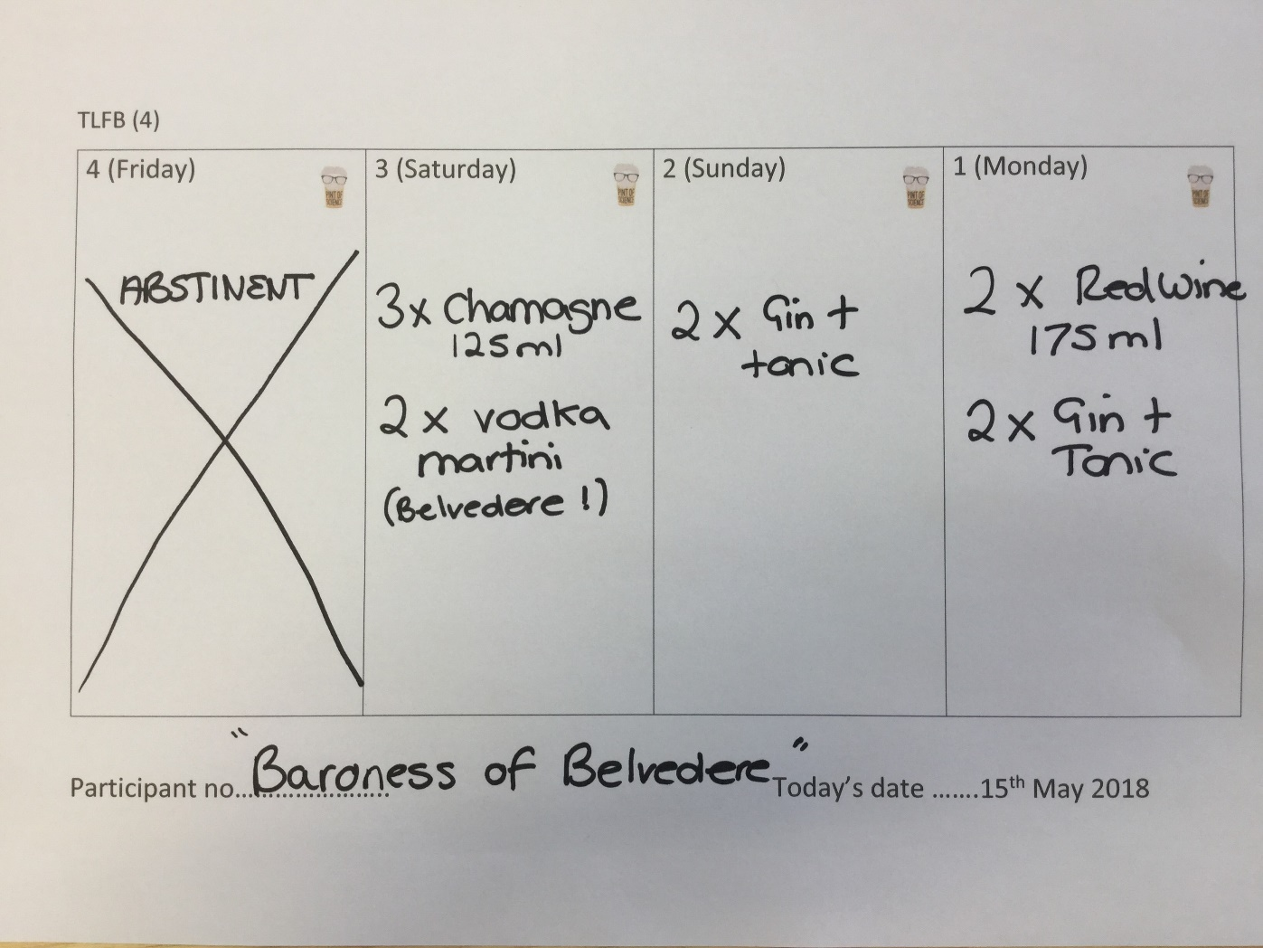
Lets introduce you to a really ‘sciencey’ evaluation tool ?
Countdown Clock
Notes:
Interaction:
NH:
Ok ….Lets introduce you to a really ‘sciencey’ evaluation tool
What you have in front of you is the tool we are using in the trial called the Time Line Follow Back to collect data for the primary outcome which is percent days abstinent from substance use and alcohol in the 28-days. :
TLFB is a validated and reliable tool for assessing the quantity and frequency of substance use over time periods.
Main points:
Here you can see an example which has been created for the past four days by the “Baroness of Belvedere”! (expensive Vodka brand)
Just to point out – whilst the RISKIT-CJS study focuses on all substances, the focus for today is alcohol not drugs ( we wouldn’t want to get people to possibly disclose drug use and feel uncomfortable)
RV:
In small groups 2-3 we would like you to use the TLBF template we have provided to complete any alcohol use for the past 4 days - It can be a hypothetical TLFB / average reflection of those in your group – as you can see we have completed an example – best name get a prize! You have 3 minutes to complete this
When 30 seconds left start the countdown clock …..
Ask for names to be shouted out……. Throw pack of sweets out to best name… beer shaped cola bottles ?

Slide 9
Notes:
These three slides to be on a loop during the Interactive TLFB
Alcohol in the adult population:
10.8 million adults in England are drinking at levels that pose some risk to their health.
1.6 million may have some level of alcohol dependence
29% of adults in treatment were seeking help for alcohol misuse

Slide 12
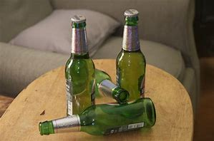
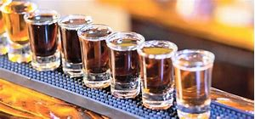
How many units ?
The five minute barperson ?
Notes:
Standing behind the bar
Interactive :
RV: Standardised drink….. Units – so this is how we measure how much we are drinking – but do we all really know how much a unit is…?
NH: Interactive – get a volunteer to be the five minute bartender ( come to the bar )
Can you pour me one unit of “wine” and a unit of spirit and a unit of beer please ? – testing unit knowledge –
Prepare the correct amounts before and bring them out to compare….show how free pouring is often more
12% Wine = 83.3ml
40% Spirit = 25ml
4% Beer = 250ml
Then look at the standardised drink amount ….often people free pour nearly double what they should meaning they may unintentionally exceed the daily unit guidelines.
RV:
Interactive : Ask audience to tell us how many units they think for each of the age groups below:
General government guidelines
Units not to exceed for adults – 14 units
Units not to exceed 15-17- 2-3
Units not to exceed for under 15- 0
Briefly mention the 3 points below….
To keep health risks from alcohol to a low level, the UK Chief Medical Officers’ advise it is safest not to drink more than 14 units a week on a regular basis.
If you regularly drink as much as 14 units per week, it's best to spread your drinking evenly over three or more days.
If you want to cut down the amount you drink, a good way to achieve this is to have several drink-free days each week.

Slide 13
Notes:
Just have in the background whilst doing the bartender bit

Slide 14
Back to your TLFB Now add up the units ?
Total 17.1 units
https://www.drinkaware.co.uk/understand-your-drinking/unit-calculator
Notes:
RV: Interaction
Ask them to return to their TLFB and calculate the units and ask if anyone is brave enough to share how many – keen that this exercise could give them a tool to use outside of the event
Talk about online calculators i.e. Drink aware or Bupa
as you can see our example has totalled 17.1 units in 3 days , 3.1 over the weekly recommended guidelines in 4 days

Slide 15
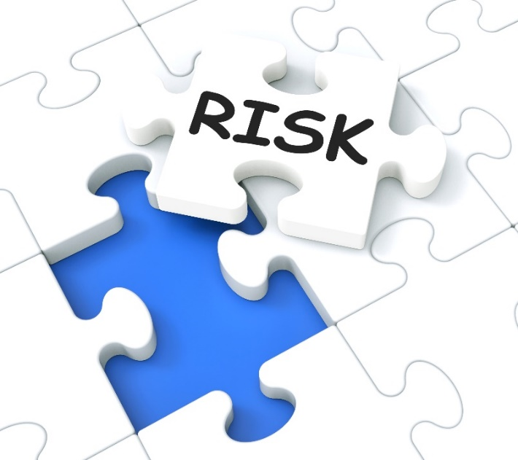
Alcohol: How risky is risky?
Notes:
NH: ADULT RISKS …….
So we talking and thinking about risk – obviously some of the public health stats have highlighted the health risks for example exceeding 35 units per week can increase risk of cancer. There are other health risks (short and long term) for adults associated with alcohol use. Dependence, psorosis etc.
Then there are the more general risks …..
DUI…even the next day ….if job depends on driving risk of unemployment
Victim of crime….assault, robbery etc
Perps of crime
Loss of relationships etc

Slide 16
Young people?
Notes:
RV:
Focus young people
Previously discussed potential consequences for YP’s and sexual health. Like the adult population they are also at risk of being victims of crime and at risk of being perpetrators of violent crime.
Health related risks …
The brain is still developing and simply put, alcohol damages crucial development therefore the risks are different compared with adult populations:
• adolescents are likely to be more vulnerable than adults to both subtle brain damage and long lasting cognitive deficits
the existing evidence shows that there are associations between alcohol consumption and subsequent risk taking behaviour with peers and friends
there is a relationship between adolescent alcohol use and mental health problems is established – YP are also more likely to sustain and injury.
YP More at risk of being a victim and a perpetrator of violence – increasingly likelihood of contact with CJS
Low educational attainment/exclusion…….this reduces likelihood of higher education , employment and career potential .

Slide 17
Alcohol and the developing brain
Notes:
NH:
Interactive : Please discuss amongst yourselves the areas of the brain/functions that may effected by alcohol – just a few minutes
Young people are much more vulnerable than adults to the adverse effects of substance use due to a range of physical and psychological factors that often interact and the differential impact of substances on the developing brain
Why is it different for young people ?
While there are several parts of the brain affected by alcohol during the teenage years there are two areas of the brain that are particularly sensitive to alcohol during this period.
Hippocampus
The hippocampus is responsible for memory and learning.
Studies of adolescents show that heavy and extended alcohol use is associated with a 10% reduction in the size of the hippocampus. It also shows that the function of the hippocampus is uniquely sensitive to alcohol at this time and that alcohol may be poisonous to the nerve cells of the hippocampus causing them to be damaged or destroyed.³
Prefrontal lobe
The prefrontal lobe is important for planning, judgement, decision making, impulse control and language.
This area of the brain changes the most during the teenage years. Research with heavy drinking adolescents’ shows that these young people have smaller prefrontal lobes than young people of the same age who do not drink.3 http://alcoholthinkagain.com.au/Parents-Young-People/Alcohol-and-the-Developing-Brain/Impact-of-Alcohol-on-the-developing-brain
Dots paper http://dera.ioe.ac.uk/11355/1/DCSF-RR067.pdf
To clarify …the takeaway information here is….
alcohol abuse in adolescence, during a developmentally sensitive poses a particular danger to the emerging brain faculties of executive functioning and long term memory
adolescents are likely to be more vulnerable than adults to both subtle brain damage and long lasting cognitive deficits following alcohol exposure period,
there is a relationship between adolescent alcohol use and mental health problems, so it is important that all young people with alcohol problems should have a mental health assessment
alcohol may increase feelings of depression
Therefore alcohol consumption can have a detrimental effect on young people’s short term educational performance

Slide 18
Alcohol consumption amongst adolescents aged 10 - 17 years is estimated to be responsible for 80,640 violent offences per year & costing in excess of £5million per year for criminal activity to the Criminal Justice System
Young people in the CJS
81% of the young offenders were identified as experiencing alcohol-related risk or harm
Nearly 50% of young people in treatment were seeking help for alcohol misuse
(general population)
Notes:
NH & RV
Interactive : Stand up sit down
RV: We shall be using you to represent some examples of youth justice/alcohol statistics
Stand up to statistics
Cards etc
Can half the room with green paper on their seats stand up :
Nearly 50% of young people in treatment were seeking help for alcohol misuse (50% of YP stat is for general pop not CJS so maybe needs to have a header above saying in the general population…)
NH: Yellow paper join those standing : 80% of room to stand up :11-17-year-old offenders The majority (81 per cent) of the young offenders were identified as experiencing alcohol-related health risk or harm
A shocking statistic …….Alcohol directly linked to youth violence! - estimated to be responsible for over 80,000 violent offences per year.
Last point : http://www.antoniocasella.eu/restorative/Newbury-Birch_2015.pdf

Slide 19
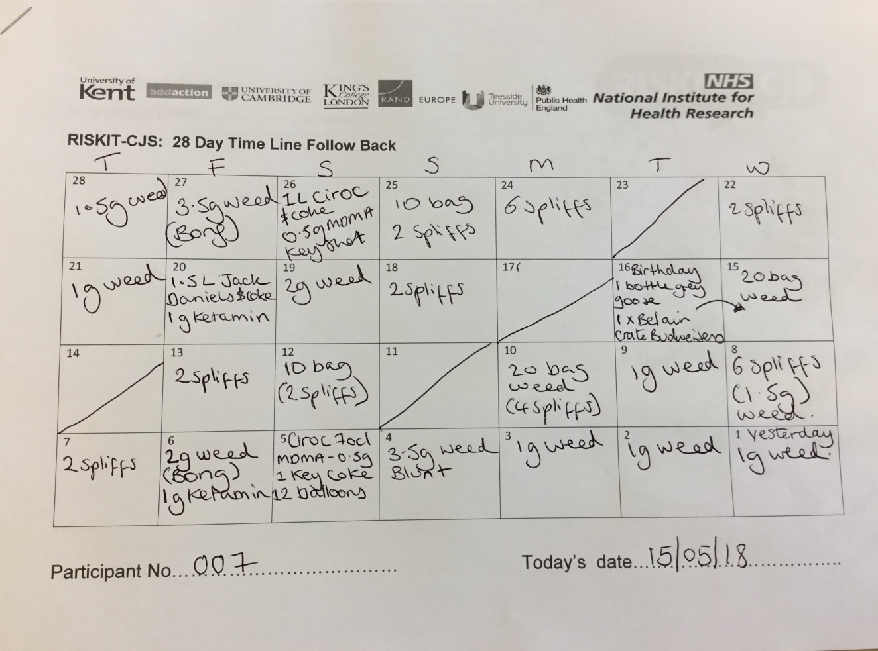
So… a possible example of a RISKIT-CJS young persons TLFB ?
20.5g of Cannabis
165.4 unit of Alcohol
2g of Ketamine
1g of MDMA
0.2g of Cocaine
12 balloons
Average 33 units per binge
Notes:
RV:
So we have talked about risk in both the adult and YP population ……
Now we refocus on the YP we meet in the RISKIT-CJS trial using a hypothetical example of what a YP TLFB may look like.
NH: Our participant 007 is just an example, we have based this hypothetical example upon TLFBs we see in YP’s in both criminal justice and school settings. This is by no means an extreme example with regards to alcohol units – we also see YP’s with very low substance use …often only a few units of alcohol a month.
Earlier we learnt that the recommended safe limit for 15-17 year olds is 2-3 units per week – using this guideline we then expect to see 8-12 units in the past 28 days. However, in this example what we see is 165.4 across just 5 days which equates to over 33 units in one binge session. An example of risky drinking !
RV:
So considering the vulnerability of young people, in particular our trial population YP’s in the CJS ,when asking how risky is risky ? The risk is potentially higher due to the multiple vulnerabilities which we have previously discussed.
It’s important to note that whilst this trial focuses on YP at risk of criminality, the issues around risky and hazardous drinking are for all young people .
Take a moment to consider the young people in your lives …..
What can you take from today’s session to reduce the risks associated with risky drinking ?

Slide 20
And finally …..lets be positive !
Evidence of previous research
Positive young people
Evaluation
Better services going forward
Notes:
NH: Acknowledge it can be all sound a bit negative….
1.Evidence of past research - RISKIT 34% drinking at baseline were abstinent 6 months after to highlight the potential impact of what we are evaluating
2.Positive young people . During recruitment the YP have been really positive and keen to take part in the study…interested in their experiences being used. 3.Evaluation – This is something to get excited about …1st time evidence in this area . That the research will have policy impact for commissioned services in this area.
4. Better services-That YP in CJS receive better going services going forward.
End on a positive

Slide 21
Information
RISKIT-CJS Protocol paper: https://bmcpublichealth.biomedcentral.com/track/pdf/10.1186/s12889-017-4170-6?site=bmcpublichealth.biomedcentral.com
RISKIT-CJS YJB Research Map: https://yjresourcehub.uk/effective-practice/research-map/items/item/412-riskit-cjs-pragmatic-randomised-controlled-trial-to-evaluate-the-effectiveness-and-cost-effectiveness-of-a-multi-component-intervention-to-reduce-substance-use-and-risk-taking-behaviour-in-adolescents-involved-in-the-criminal-justice-system.htmliomedcentral.com
RISKIT Summary of outcomes 2016- Available on request
For more specific trial detail please contact: s.coulton@kent.ac.uk

