Slide 1








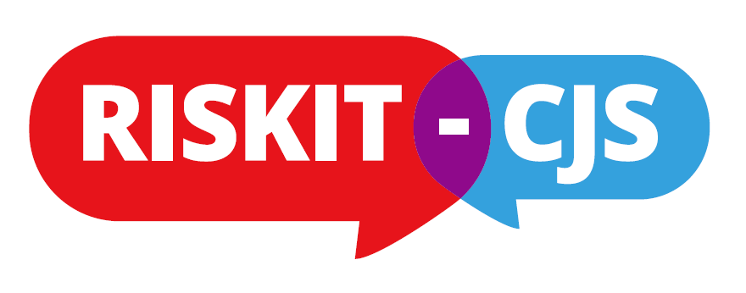
Facilitators and Barriers to Early Recruitment: Observations from the RISKIT-CJS Pragmatic Randomised Control Trial
Nadine Hendrie
Dr Catherine Marchand
Dr Grant McGeechan
Notes:
Grant

Slide 2

Agenda
Context
Facilitators and barriers to recruitment theoretical models
Collaborative and relational network with multiple stakeholders
Observations from RISKIT-CJS
Early recommendations
Notes:
Grant

Slide 3
Context - Pragmatic RCTS
High quality evaluative research of interventions in real-life settings.
Recognised
  as complex,
  costly, and
  Recruitment process is often challenging (Newbury-Birch et al (2014) & (McDonald et al, 2006)
However, the findings and outcomes of such research can have important implications for the study population
  Help develop and inform policy
  Give alternative treatments to the studied population
  Illustrate to the end user (i.e. participants, professionals) a realistic vision of their context
Notes:
Grant

Slide 4
Facilitators and Barriers to recruitment
Little evidence on how to successfully recruit young participants for a Pragmatic RCT in a criminal justice setting.
Evidence in:
  Primary Care: Patients
  RCTs (general): recruitment of health professionals
  Evaluation of youth drug services
Key points are
  Phase 1 recruitment (centre or senior management: agreement in principle) easier process, phase 2 recruitment of the participant is a complex process because of the gatekeeping process (Bower et al 2009)
  Recruitment is difficult in RCTs: less than a 1/3 achieve the original recruitment target and 53% were awarded an extension. Overall start to recruitment is often delayed 41% . Early recruitment problems were identified in 63%. Inter-relationship between trial features and recruitment success was complex (McDonald et al 2006).
  Differences in structural and perceptual barriers Staff, parents and YP in adolescent drug treatment (Wisdom et al 2011).
Notes:
Grant

Slide 5
RISKIT-CJS: A Pragmatic RCT
Project information
  Chief Investigator: Professor Simon Coulton, University of Kent
  North East Lead: Professor Dorothy Newbury- Birch, Teesside University
  London Lead: Professor Colin Drummond & Dr Paulo Deluca
  Senior trial manager: Dr Catherine Marchand
  Start date: 01/09/2016
  Duration: 36 Months
  Funder: NIHR Public Health Research
Notes:
Nadine

Slide 6
RISKIT-CJS: The intervention
Aim: Mixed method, two-arm randomized controlled trial to evaluate the effectiveness and cost-effectiveness of the RISKIT-CJS intervention in reducing substance use in young people in criminal justice settings
Setting: Youth offending teams across three geographical locations; South East England, London, North East England.
Participants: Adolescents aged 13-17 years engaged with youth offending teams who score 2 or more for substance use on the Asset or Asset Plus equivalent.
Intervention: RISKIT-CJS is a multi-component intervention that addresses substance use and risk-taking behaviour including both group and individual work components
RISKIT-CJS is delivered in four steps consisting of two one-to-one sessions and two half-day group sessions.
Follow up: 6 Month and 12 Month
Notes:
Nadine

Slide 7
Collaborative and relational network with multiple stakeholders: Trial perspective
Research team
Phase 1: YOT recruitment
YOT Managers
Young person
Assigned person who will work with the interventionists, identifying the YP
Phase 2: YP recruitment
Intervention provider “RISKIT-CJS Interventionists”
Notes:
Catherine

Slide 8
Collaborative and relational network with multiple stakeholders: Trial perspective
Research team
Public Health Director
Head of Youth Services
Head of Youth Justice
District manager of Youth Services
Phase 1: YOT recruitment
YOT Managers
Young person
Assigned person who will work with the interventionists, identifying the YP
Phase 2: YP recruitment
Intervention provider “RISKIT-CJS Interventionists”
Notes:
Catherine

Slide 9
Theoretical model in practice: Bower et al 2009
Theory
Local authority Youth Services and Local YOT management agreed to participate in principle
YOT practitioners agreed to assist in the recruitment process in principle
Gatekeeping:
YOT practitioners
Young person agreement to participate
To be continued…
Practice
Interventionists
Notes:
Catherine

Slide 10
Collaborative and relational network with multiple stakeholders: Project reality Ex. 1
Research team
Public Health Director
Head of Youth Services
Head of Youth Justice
Preliminary
Phase
District manager of Youth Services
Phase 1: YOT recruitment
YOT Managers
Phase 2a: Referral
CJS Practitioners
CAHMS / Commissioned services
YOT Social workers
Phase 2b: YP recruitment
YP
Intervention provider “RISKIT-CJS Interventionists”
Notes:
Nadine

Slide 11
Collaborative and relational network with multiple stakeholders: Project reality Ex. 2
Research team
Public Health Director
Head of Youth Services
Head of Youth Justice
X
District manager of Youth Services
YOT Managers
Consortium Lead
X
CJS Practitioners
CAHMS /
YOT Social workers
Commissioned service – drug treatment provider
YP
Intervention provider “RISKIT-CJS Interventionists”
Notes:
Nadine

Slide 12
Early Observations from RISKIT-CJS
Phase 1: Recruitment of YOTs and agreement in principle - Very successful in all regions
  Facilitators to the trial (i.e. consortium connection, who to talk to, local public health director involvement).
  Barriers for rural locations were identified, the research team were reassured by the motivation and interest from the senior management.
Phase 2: Recruitment of participants – Complex
  YOT
    ‘Shrinkage’ in Youth Justice (Bateman, 2017) - Diversion/Early help
    Gatekeeping and perceived perceptual and structural barriers (YOT1: leaflet & YOT5: When their YP not in the intervention group feelings of disappointment YOT 5
    Difference between management enthusiasm and the reality of the work environment (YOT13)
    (Structural barriers): example Chaotic environment not a critic of the people in the environment (example: no room for the YP and interventionist to meet (YOT24); working with staff who do not know why the interventionists are in YOT16)
  YP
    98% in the SE agreed to participate initially.
  YOT, Interventionists and Research team
    Collaboration and champion relationship between two gatekeeping systems
    Fluidity of delivery example (YOT4)
Notes:
Nadine

Slide 13
Early recommendations
Referral process dry-run
Communication with and identification of a YOT recruitment champion – going back to our first idea of one person helping us in the recruitment process
As for the interventionists, who are at every turn facilitating our work in recruiting participants and being motivated in a difficult context, a fixed term contract would increase their visibility in the team, reduce their anxiety and would allow them to be situated in a YOT team for a set period of time
Notes:
Catherine

Slide 14
Selected references
Bateman, (2017) The State of youth custody . London: NAYJ
Bower et al, (2009) Improving recruitment to health research in primary care. Family Practice 2009; 26: 391–397.
Coulton et al, (2017) Pragmatic randomised controlled trial to evaluate the effectiveness and cost effectiveness of a multi-component intervention to reduce substance use and risk-taking behaviour in adolescents involved in the criminal justice system: A trial protocol (RISKIT-CJS) BMC open 17:246
McDonald et al , (2006) What influences recruitment to randomised controlled trials? A review of trials funded by two UK funding agencies Bio Med Open, Trials Journal 2006 7:9
Newbury-Birch et al , (2014) Alcohol Screening and Brief Interventions for Offenders in the Probation Setting (SIPS Trial): a Pragmatic Multicentre Cluster Randomized Controlled Trial , Alcohol and Alcoholism pp. 1–9, 2014
Newbury- Birch et al (In press) “Climbing down the steps of the ivory tower: How UK academics and practioners need to work together on alcohol studies”
Wisdom et al (2011) Barriers and facilitators to adolescent drug treatment: Youth, family, and staff reports, Addiction Research & Theory, 19:2, 179-188,

