Slide 1

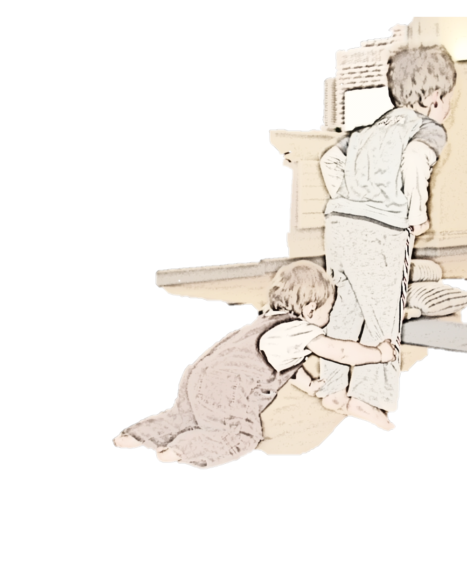
Touch, and parents of children with tactile defensiveness and autism
Jennifer Leigh and Julie Beadle-Brown
Background
Research has shown that parents of children with autism or autism spectrum disorder (ASD) are more likely to experience serious psychological distress than parents of children with other developmental disabilities. Although the symptoms that an individual has as part of their ASD vary from person to person, tactile defensiveness, is common. The lack of touch and positive feedback that the parent receives from their child may contribute to the stress, and potentially a lack of bonding between them, as touch is important to the psychological well-being of all people This pilot study will take a phenomenological approach to record the views and experiences of parents on their perceptions of touch and parenting their children with tactile defensiveness and ASD.
The project aims
The project will try and map the issues that parents identify to establish what form of intervention they would prefer given a choice, weighing up any potential positive outcomes, and additional burdens in terms of time and commitment.
Parent views on the type and structure of interventions to promote body awareness and positive experiences of touch will be asked. individual sessions for themselves, siblings, for their children with ASD, with their children, or within groups, or any combination of these This section of the study would link in directly to the larger project to follow, as it would determine the shape of an intervention to be offered to participants. Interventions would be designed to increase the quality of life for both parents and the children, and not to place additional burdens on the parents or carers.
Objective 1:
Parents’ experiences of bringing up a child with ASD and / or tactile defensiveness will be sought, along with any differences they have experienced between that child and neuro-typical children, and the perceived effects on their own subjective health and that of their child/children.
Objective 2:
This study is a pilot study. It has been designed to map the issues that parents may have on the type and structure of interventions that could be used to promote body awareness and positive experiences of touch. These views will then be used to design an intervention programme.
Participants
Two geographical clusters, in the south east and the south west (centred around Kent, London and Gloucestershire) have been identified for recruitment of participants.
Parents with at least one child with Autism Spectrum Disorder (ASD) and/or tactile defensiveness will be asked to participate.
The sample is an opportunistic sample in this pilot study, and would seek to include between 6 and 10 family units.
Method
Semi-structured interviews will be conducted, recorded digitally and transcribed for phenomenological analysis.
The sense of embodiment, or body awareness an individual has, and experiences of touch are often learnt through modelling as are other social interactions. Reflecting on experiences of touch and body awareness about themselves, and with their children, may provide clues as to which methods would have most impact on the quality of life for the parents and the children.
Questions include; parents’ perceptions on parenting a child with ASD, how they perceive tactile defensiveness and any issues with touch to have affected their day-to-day experiences of touch, bonding with their child, how their child interacts with their siblings, effects on any siblings and their perceptions of their child's body awareness.
They would be asked their opinions on interventions offered for a variety of family member and in a range of formats
Progress Report
The study is underway. 6 families have taken part to date, and preliminary analysis suggests that an intervention aimed at parents and / or siblings of the child with ASD in a workshop format would be the preferred shape of an intervention.

