Slide 1

THE OFFICE FOR SCHOLARLY COMMUNICATION/ Libchat

Slide 2
So… what do researchers actually do?
We talk a lot about supporting research and supporting researchers... but what do they actually do?
Kent Research
Alex, Rowan & Darcy
Where does IS support for research fit into the bigger picture?
How does IS help change the world?

Slide 3
Research, Teaching, Administration?
Teaching
Research
Admin

Slide 4
I say research... What do you hear?
REF
Data Security
Funder Compliance
Bibliometrics
Knowledge Transfer
Publishing
Finding out something new
Open Science
Data Management
Networking
Impact
Collaboration
Public engagement
Dissemination
Technical requirements

Slide 5
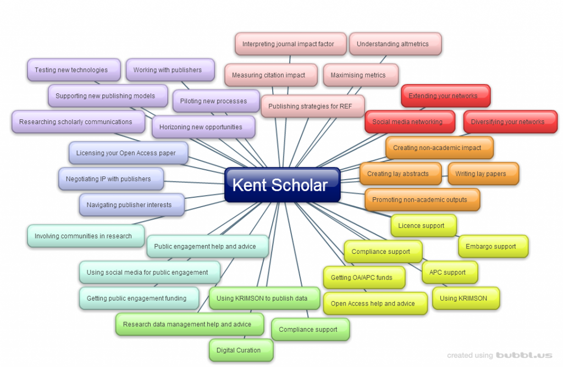
Yes, that Kent Scholar diagram

Slide 6
What does IS do?
When it is labelled as Research Support
Service catalogue
When it is seen as core function
When you don’t even realise you’re doing it
Underlying systems – research in an organisation with no internet access, data storage or books?
Implicit expertise – e.g. Liaison Librarians, Web Solutions

Slide 7
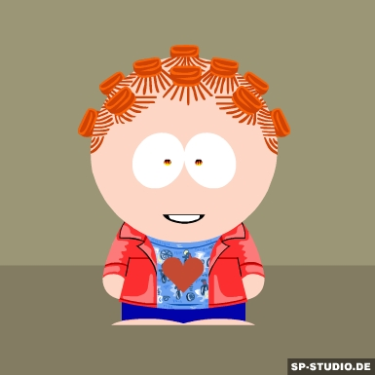
Researcher A... AKA Alex
Alex’s research is social-based. When you say research, Alex would think of interviews, focus groups and analysing responses to surveys – paper-based or through Social Media.
Research outputs take the form of policy recommendations, research reports, books and journal articles. Alex’s research is accessible for, and of interest to, the public.

Slide 8
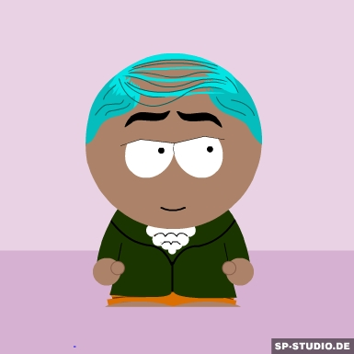
Researcher B... Rowan
A researcher in the Arts, Rowan makes considerable use of the books and archives available in the library as well as online resources. Staff expertise around literature searches and special collections have been invaluable.
Primary outputs are books and performances, with a small number of journal articles.

Slide 9

Researcher C... introducing Darcy
A lab-based researcher, Darcy works in the intersection between biological, medical and physical sciences. Past projects have been funded by the NHS and the MoD.
Primary research techniques include Dynamic light scattering (DLS), Single crystal X-ray diffraction, Infrared spectroscopy and Fluorenscence microscopy.

Slide 10
... and how does IS change the world?
Impact stories
Mary Rose : Protecting our Heritage through Chemistry
The first comprehensive theory-based treatment of firesetting
Using the Roman Family to Enhance the Value of Roman Culture in the Present
https://www.kent.ac.uk/research/downloads/kent-research-making-difference-2014.pdf
http://impact.ref.ac.uk/CaseStudies/Results.aspx?HEI=120

Slide 11
Notes:
This

