Slide 1
Online Networks and the Production of Value in Electronic Music
Anna Jordanous (School of Computing, University of Kent)
Byron Dueck (Department of Music, Open University)
Daniel Allington (Department of Applied Linguistics and English Language, Open University)

Slide 2
How do listeners, dancers, and (especially) other musicians demonstrate their appreciation for electronic dance music and musicians?
How do they value electronic music?
What role do valuing communities (communities of producers) play?

Slide 5
3. Methodology
(a) Quantitative
(b) Qualitative
(c) Bringing the two together

Slide 6
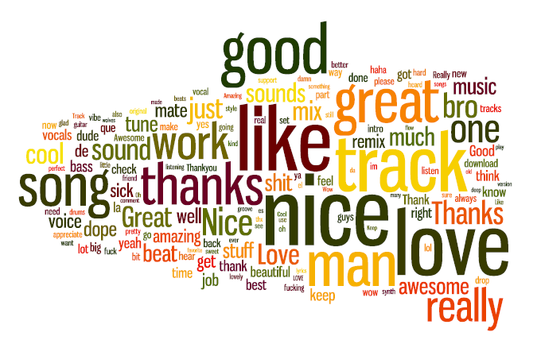

Slide 7
Analysing the valuing of music using social networks
What does activity on a social network reveal about how people value each other?
We asked the specific question:
How do musicians show their appreciation of each other’s work?
Quantitative work:
examine how musicians interact on the social network SoundCloud
(informed by qualitative research - interviews)
http://www.soundcloud.com
Notes:
As another example of using computers to carry out tasks which should require human knowledge, we can use computational analysis to study interactions in social networks and extrapolate information about how people treat each other and show their interest in other people. But what does activity on a social network reveal about what people really think about each other? Considering the recent research project Valuing Electronic Music (http://valuingelectronicmusic.org), I shall discuss how musicians interact on the social network SoundCloud and what this reveals of their opinions of each other’s music.

Slide 8
How users interact on SoundCloud
Follow other users
Like a track
Comment on a track
Add a track to a personal playlist
Join a group

Slide 9
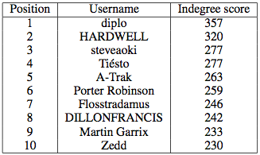
Initial quantitative findings...
Top-ranked x users
Visualising networks

Slide 10
But... mismatch with qualitative findings
Little interest in the ‘top x users’ across the whole group
More important: Relationships / personal networks
smaller networks of users
influenced by genres
geographically influenced
http://www.youtube.com/watch?v=G8iH8fPeJik

Slide 11
Identifying sub-networks
Grouping by e.g. musical genres, physical locations of musicians
Notes:
As another example of using computers to carry out tasks which should require human knowledge, we can use computational analysis to study interactions in social networks and extrapolate information about how people treat each other and show their interest in other people. But what does activity on a social network reveal about what people really think about each other? Considering the recent research project Valuing Electronic Music (http://valuingelectronicmusic.org), I shall discuss how musicians interact on the social network SoundCloud and what this reveals of their opinions of each other’s music.

Slide 12
Empirically analysing value/valuing
Can we ‘measure’ / analyse cultural value computationally?
Yes - if we look at the smaller pictures, not one bigger picture
As a proxy for value:
look for interactions between people linked together in subnetworks / ego networks / cliques
= evidence of interpersonal relationships
On SoundCloud, interactions tend to be ☺ (or spam)
Notes:
As another example of using computers to carry out tasks which should require human knowledge, we can use computational analysis to study interactions in social networks and extrapolate information about how people treat each other and show their interest in other people. But what does activity on a social network reveal about what people really think about each other? Considering the recent research project Valuing Electronic Music (http://valuingelectronicmusic.org), I shall discuss how musicians interact on the social network SoundCloud and what this reveals of their opinions of each other’s music.

Slide 13
Some findings
Follow relationships:
By countries, top 3 are US, UK, Germany
By cities, top 3 are London, NY, Berlin
People tend to follow people within same city
http://valuingelectronicmusic.org/2014/09/08/geography-soundcloud-following/
And people in same genre
By genre, top 3 are house, hip hop, techno
http://valuingelectronicmusic.org/2014/06/04/exploring-genre-on-soundcloud-part-i/
Vocabularies in different genres
Dubstep |  | Hip hop
keyness | keyword | keyness | keyword
424.31 | sick | 105.50 | dope
146.69 | tune | 93.15 | shit
133.43 | nice | 88.45 | beat
68.91 | big | 65.72 | leave
54.68 | mix | 58.95 | song
37.00 | heavy | 53.20 | comment
32.20 | massive | 52.25 | hard
29.96 | dubstep | 50.00 | check
29.31 | wicked | 43.79 | brah
28.56 | real | 39.91 | bro
Notes:
As another example of using computers to carry out tasks which should require human knowledge, we can use computational analysis to study interactions in social networks and extrapolate information about how people treat each other and show their interest in other people. But what does activity on a social network reveal about what people really think about each other? Considering the recent research project Valuing Electronic Music (http://valuingelectronicmusic.org), I shall discuss how musicians interact on the social network SoundCloud and what this reveals of their opinions of each other’s music.

Slide 14
Comments: typically very positive

Slide 15
Empirical analysis of Scottish users
Using commenting as a valuing activity
# chars of comments on a track = proxy to measure value?
calvinharris (electro-pop, house)
the-nibelheim-incident (Daryl Constance) (dubstep)
middleschoolfrown (John Kevin, electronic pop),
davecruickshank (techno),
jasegallacher (techno)
Early days… current work

Slide 16
Conclusions (so far)
You can study cultural value computationally by studying social network activity
But – look at the smaller pictures, not the whole
To understand how people express value for each other’s work:
look for relationships between people
Some activities hold more value than others,
work out which ones…
This holds for electronic music – where else?

Slide 17
http://valuingelectronicmusic.org

Slide 18
Future proposals (1)
Model links between musicians via concerts
(case study: new music concerts in London)
Notes:
As another example of using computers to carry out tasks which should require human knowledge, we can use computational analysis to study interactions in social networks and extrapolate information about how people treat each other and show their interest in other people. But what does activity on a social network reveal about what people really think about each other? Considering the recent research project Valuing Electronic Music (http://valuingelectronicmusic.org), I shall discuss how musicians interact on the social network SoundCloud and what this reveals of their opinions of each other’s music.

Slide 19
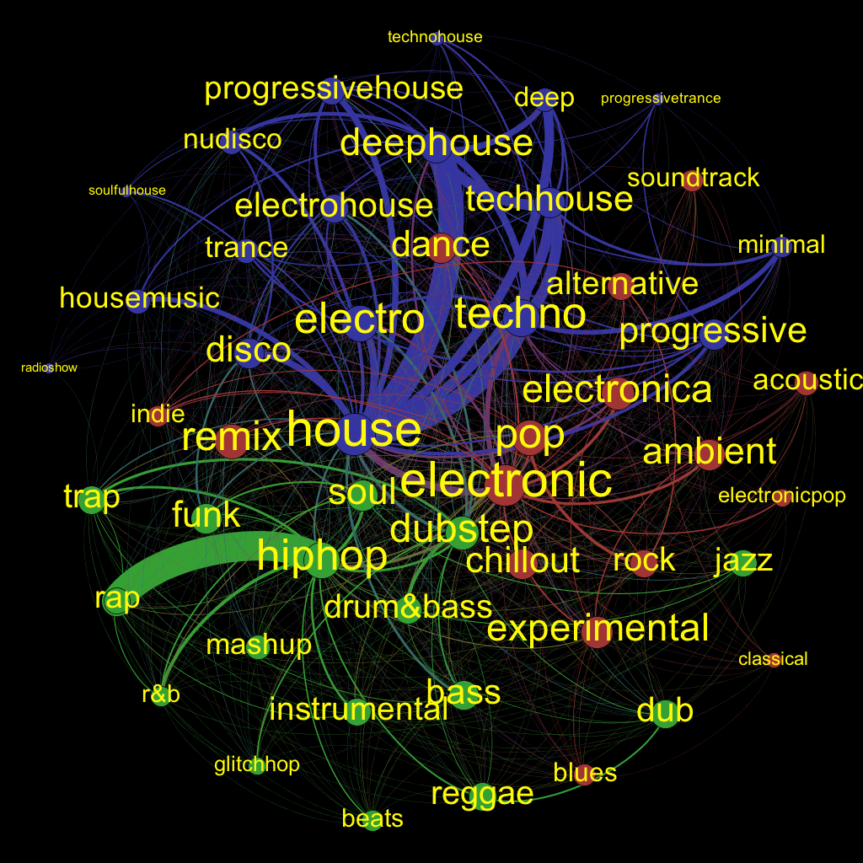
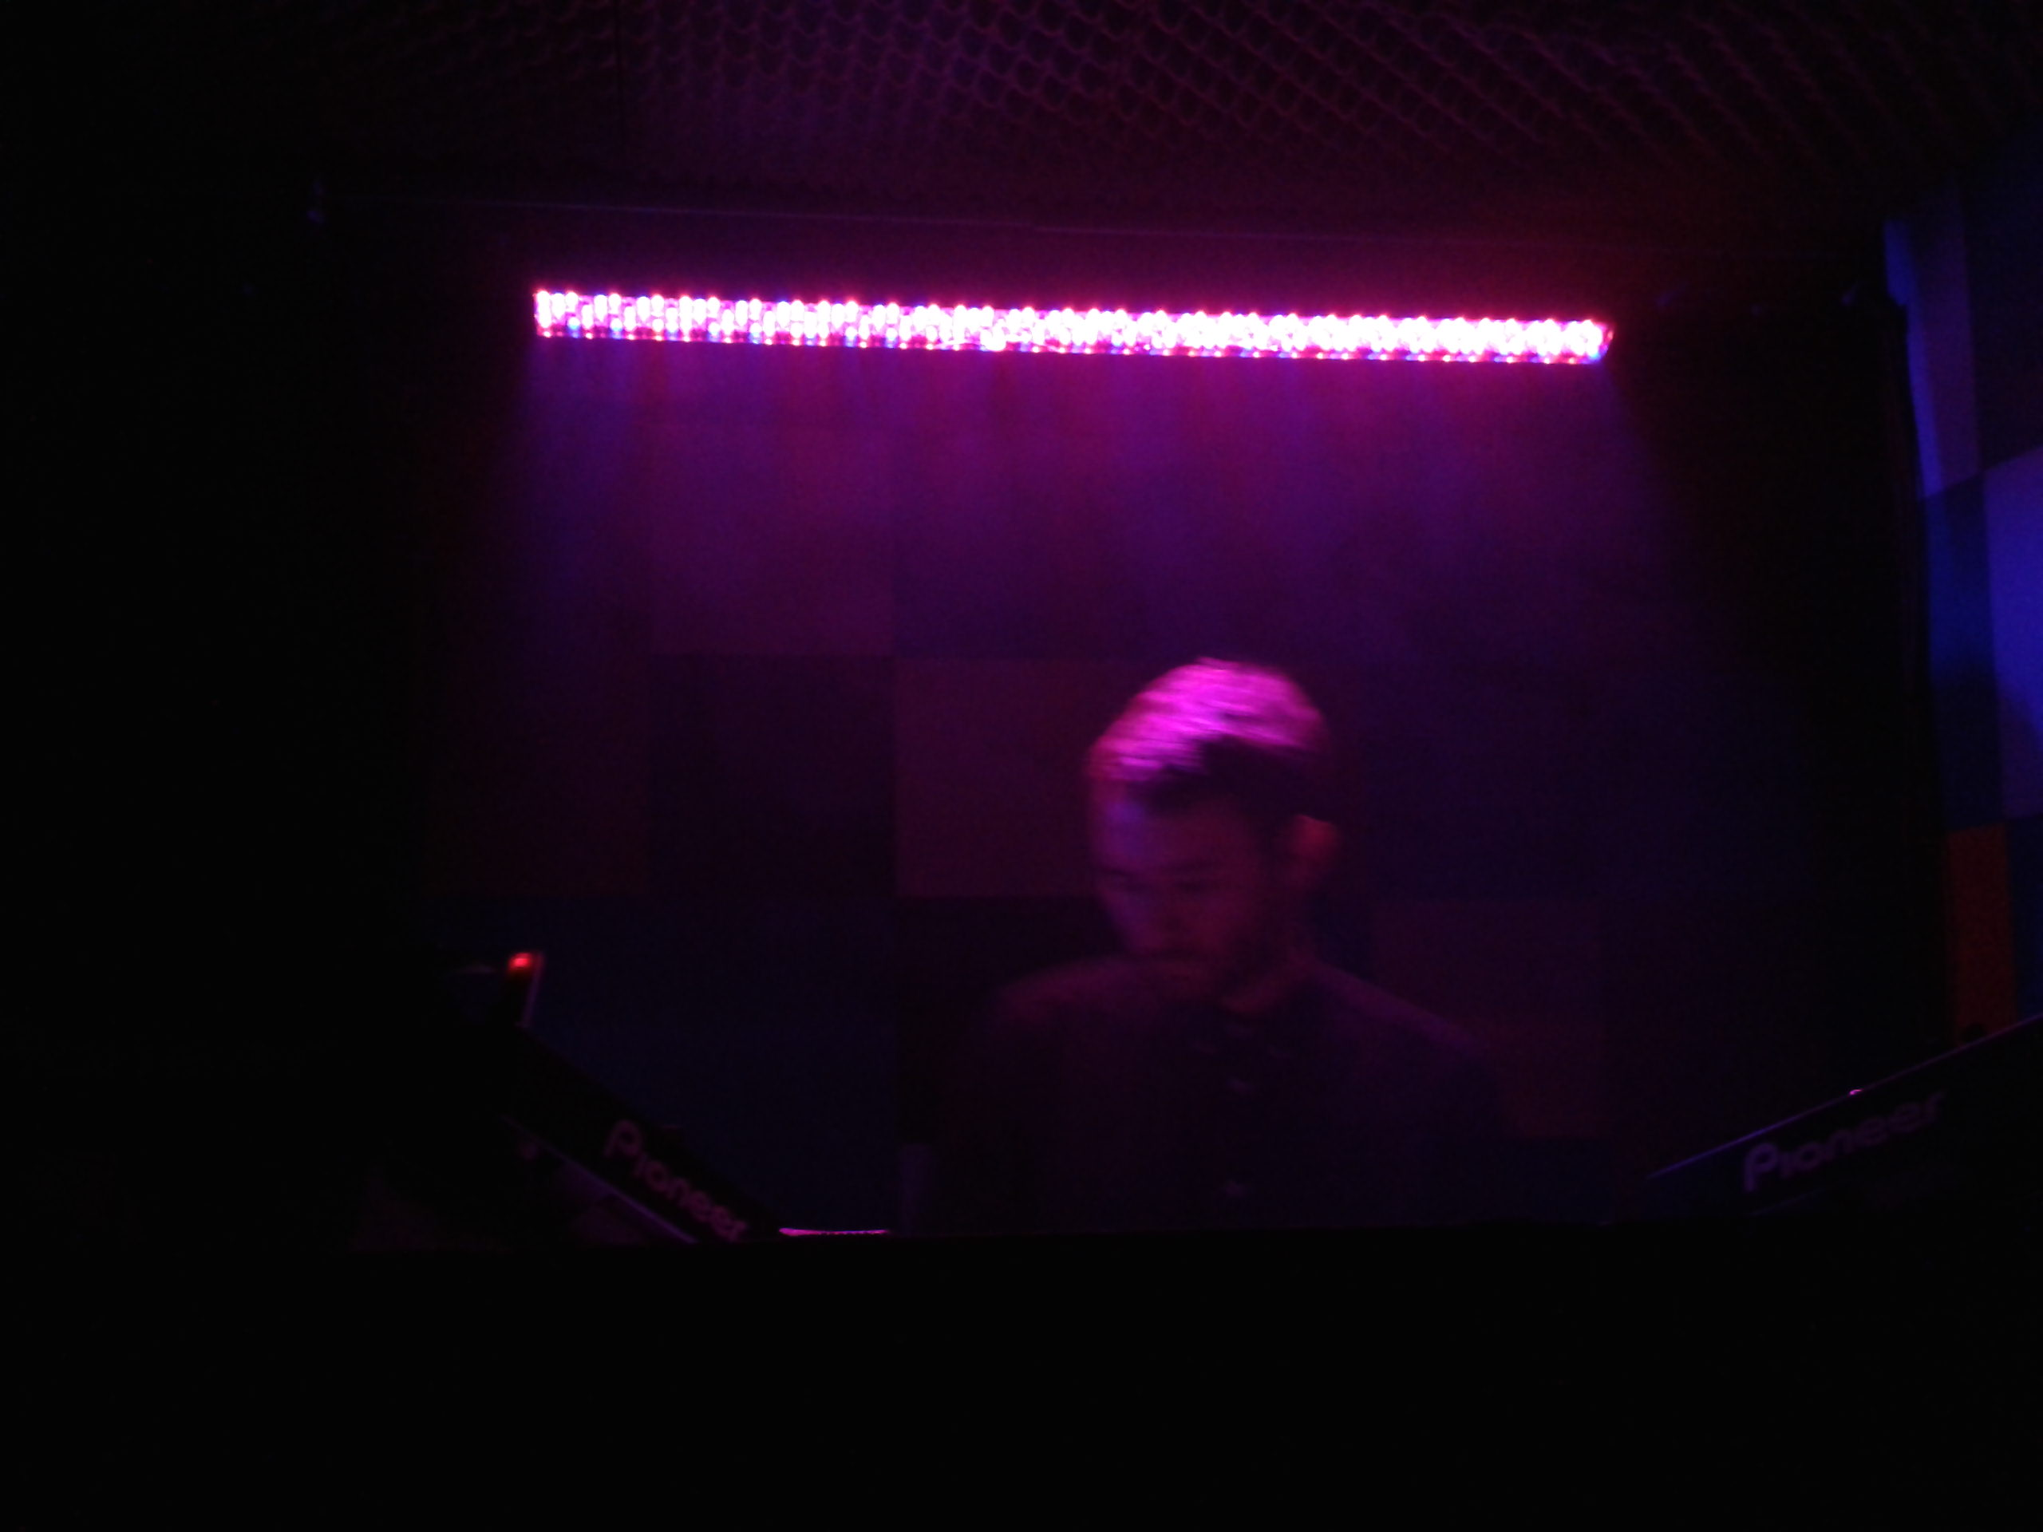
Future proposals (2)
DJs show they value a track by playing it…
(Case study - analysis of dj sets in grime & rap)
Notes:
As another example of using computers to carry out tasks which should require human knowledge, we can use computational analysis to study interactions in social networks and extrapolate information about how people treat each other and show their interest in other people. But what does activity on a social network reveal about what people really think about each other? Considering the recent research project Valuing Electronic Music (http://valuingelectronicmusic.org), I shall discuss how musicians interact on the social network SoundCloud and what this reveals of their opinions of each other’s music.

