Slide 1

THE OFFICE FOR SCHOLARLY COMMUNICATION/ Canterbury Christ Church University

Slide 2
So… what is the OSC?
“The aim of an Office for Scholarly Communication (OSC) is to provide a one-stop shop for supporting academic staff and researchers in maximising the impact, in the widest sense, of their work. It includes information about academic and non-academic outlets, open access, research data, social media, public engagement, and alternative publishing platforms.” (https://blogs.kent.ac.uk/isnews/office-of-scholarly-communications/)
“Kent’s Office for Scholarly Communication will create conditions for expanding global research networks, boosting Kent academic citations and increasing research profile and impact.” (IS newsletter)

Slide 3
A little bit of history
IS research Support
  KAR
  KDR
  Impact & sharing
Research Services
  Funding
  Grant Management
  Research Excellence
KIE
  Funding
  Knowledge Transfer
Departmental Research Administration
&&&&....

Slide 4
What do we cover?
The Office for Scholarly Communication is a one-stop-shop that will support academics to routinely extend profile and impact from their research through expert advice and service provision in the areas of:
Advice on journal (and other outlets) esteem and metrics,
Metrics, altmetrics and maximising academic impact
Developing academic and non-academic networks through evidence based information
Promoting and achieving non-academic impact from publication
Supporting best practice in open access
Supporting best practice in research data management
Supporting best practice in public engagement with research
Supporting best practice in social media to promote research and research outputs
Enabling publication strategies and workflows that meet all funder requirements
Enabling researchers to make informed decisions about intellectual property and publication
Inspiring and initiating disruptive innovation in scholarly communication
Leading and promoting new activities such as a Kent University Press

Slide 5
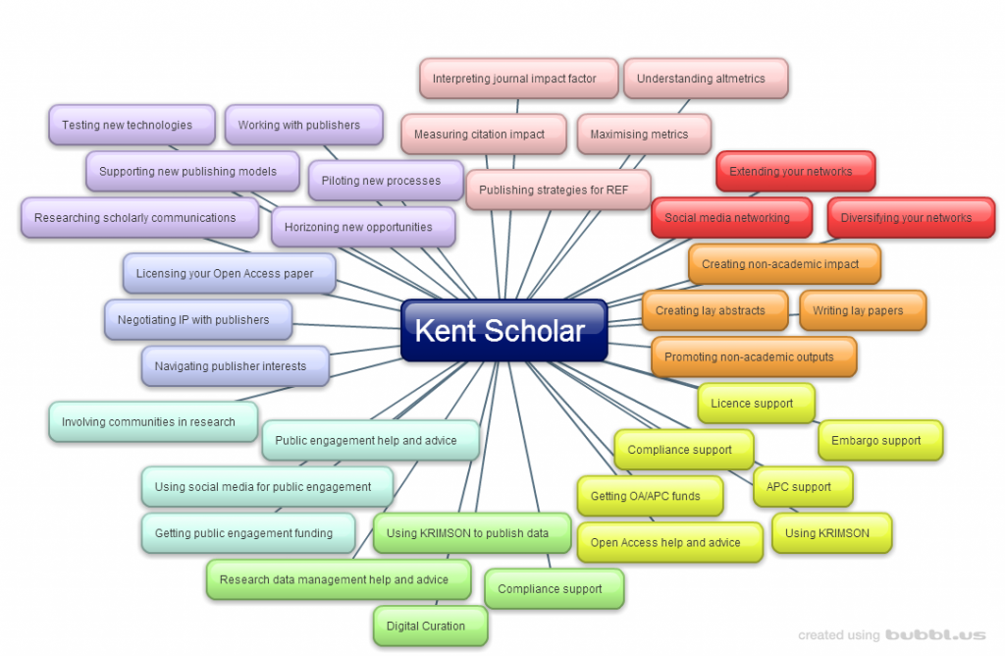
What does this actually mean?

Slide 6
How does the OSC work?
Collaborative, building on existing expertise within Kent
Seamless, providing an efficient, tailored service for individual researchers
Enabling, supporting and fostering collaboration, within Kent, nationally and internationally
Inspiring innovation, leading scholarly communication in a fast changing research environment

Slide 7
Some key things we’re looking at
Technical Plans
Directors of Research - Role
Research facilities at Kent
Tools & Systems
Supporting specialist outputs
Fostering collaboration

Slide 8
Notes:
This

