Slide 1
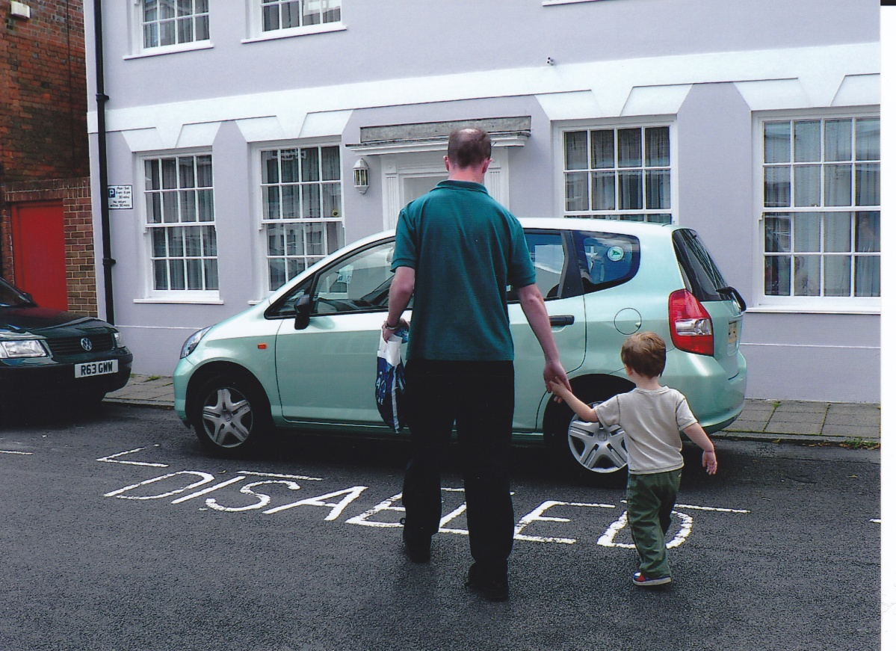
Autistic Identity: a personal (and political) reflection
Dr. Damian E M Milton

Slide 2
Introduction
This presentation gives a personal perspective on the formation of autistic identity.
Reflects on methods used in projects exploring self-identity.
And some of the issues/politics involved more broadly when discussing identity in relation to autistic people.

Slide 3
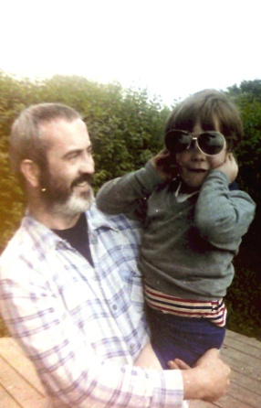
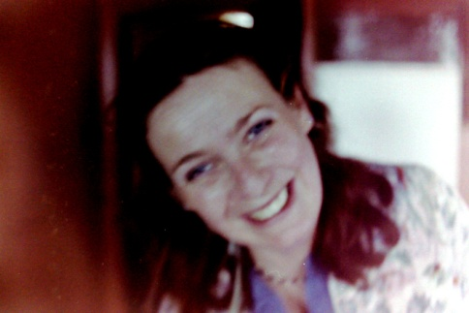
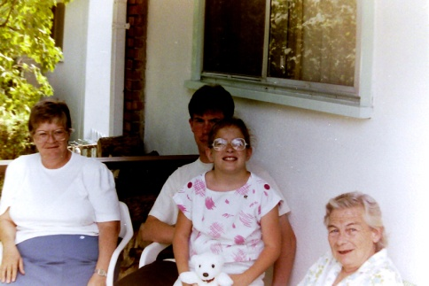
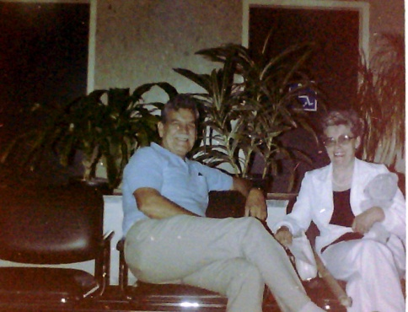
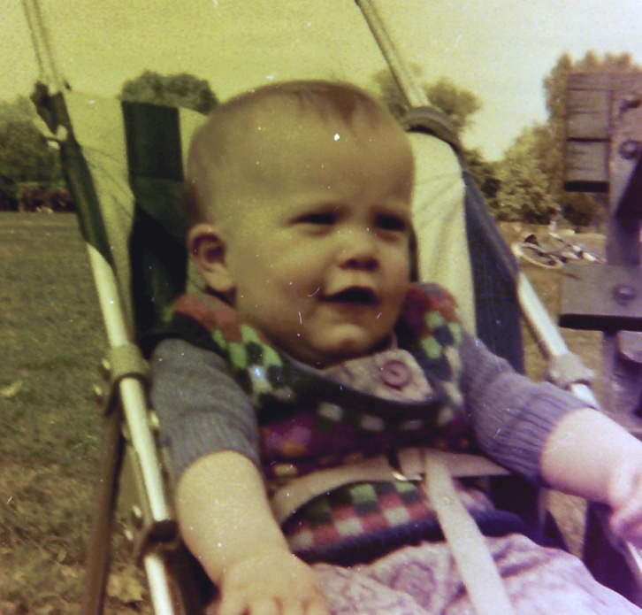
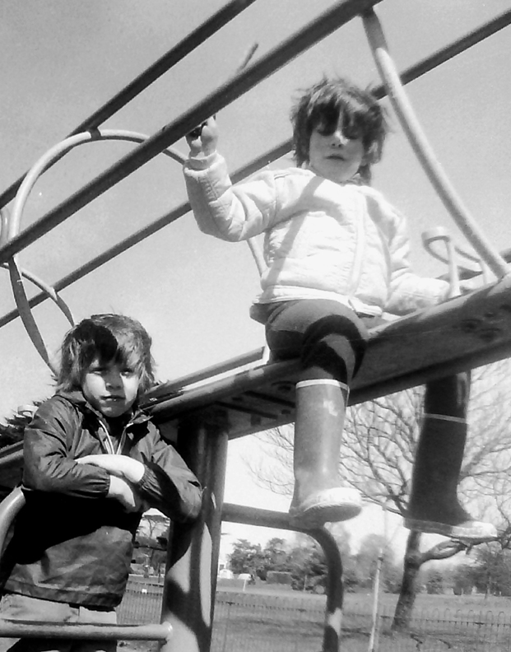
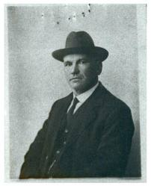
Born into an unusual family, Summer 1973

Slide 4
Early days
“[My father]...came to see the boys yesterday...[my brother]...seemed pleased to see him and after an hour of watching [them both] together, Damian finally decided to say hello. I’m convinced Damian just didn’t remember...[my father]...and refused to be friendly all afternoon.” (My mother, 27/08/75).
“Must admit to feeling rather miserable – reasons why: just over a week ago Damian got ill and finally I called the doctor...and evidently it was an attack of asthma. He’s much better now, but it was so frustrating sitting up all night with him with one hand being clutched, totally unable to do anything positive to ease his breathing for him.” (My mother, 11/07/77).

Slide 5
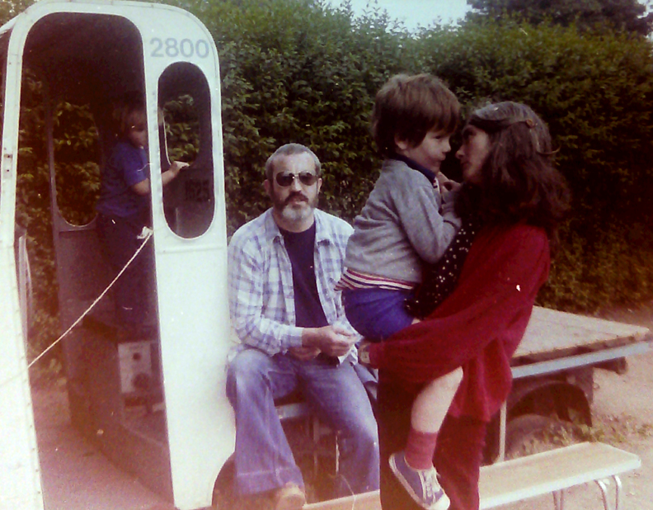
My first school sports day, July 1978

Slide 6
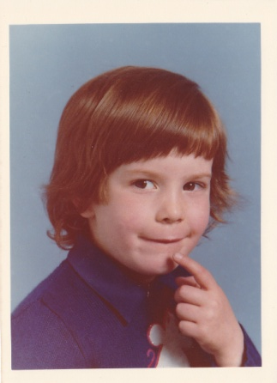
An unusual boy
What was up with him though? He seemed sensitive, silly, yet serious and bright.
The ‘silent volcano’.
Avoidance of ‘everyday demands’.
Neologisms and list making.
Fact and science fiction.
Obsessive interests.
Memory ‘tricks’.
“He finds little difficulty tackling new mechanical arithmetical processes, or indeed with new mathematical concepts. Mental Arithmetic: A.” (Maths teacher, 22/07/82).

Slide 7
‘A bump to the head’
Concussion and bruising to the brain – motor difficulties and concentration affected.
“Damian’s effort is hard to define as his enthusiasm and concentration vary so much from day to day. He is very capable and I am certain that he is not reaching his full potential...especially when requested to work on his own initiative...there has been very little progress in spelling and punctuation. Examination grade: B., Effort Grade: B.” (English teacher 22/07/83).
“Works always with ease – not always with speed. Mathematics: A.”

Slide 8
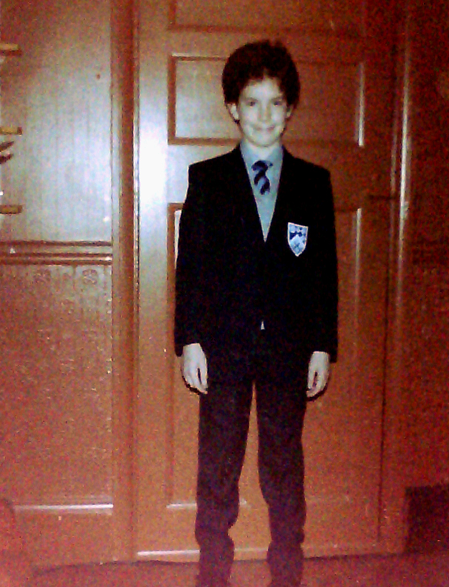
Secondary school
“Thank you for your offer of a place for my son Damian. Naturally I would be delighted to accept, save that my Grant entitlement of some £3,000 per annum cannot cover the costs. I am a single parent and have no other financial resources.” (My Mother 05/03/84).
First term went okay, mostly B and C grades, enjoyed History, and got an A in Art, but a D in Chemistry: “He needs to concentrate much harder.” Only a C in Maths though:
“Surely he can do better than this with more concentration.” (Maths teacher, Autumn term, 1984).

Slide 9
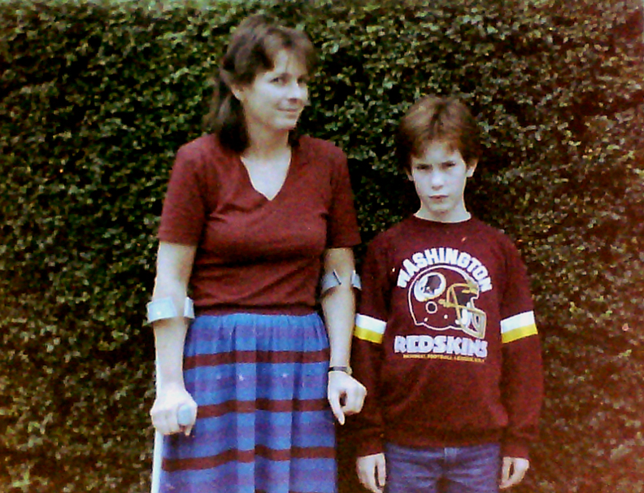
The accident and the aftermath
Road traffic accident in December 1984.
“He has become very lethargic this term. His presentation is dreadful. He really must try harder. The work is getting on top of him again.” (French teacher, Spring term, 1985).
“Rather struggling at times.” (Biology teacher, Spring term, 1985).
Being accused of cheating.

Slide 10
The blame game
By Autumn term 1985 things had gotten much worse and I had D’s and E’s across the board...
“Dear Mrs. Milton, I intend to put your son on report because of – English, History, Geography, Latin, French, Physics, Chemistry, Biology and Music. This means that he will have to carry a card and present it in class for signing by his subject masters.” (Form teacher, 25/10/85).
I was on report for the next four years until I left the school in July 1989.

Slide 11
“Damian is content to let the lessons go on around him without really getting involved.” (R.E. teacher, Autumn term, 1985).
“He seems completely lost and there seem no signs ever of any degree of interest.” (Classics teacher, Autumn term, 1985).
“Unfortunately he seems to have neither any aptitude for the subject nor any desire to improve.” (Physics teacher, Autumn term, 1985).
“Despite encouragement, cajoling, threats and eventual punishment, nothing seems to get through to him. He seems to lack drive or any will to improve.” (Form teacher, 1985).

Slide 12
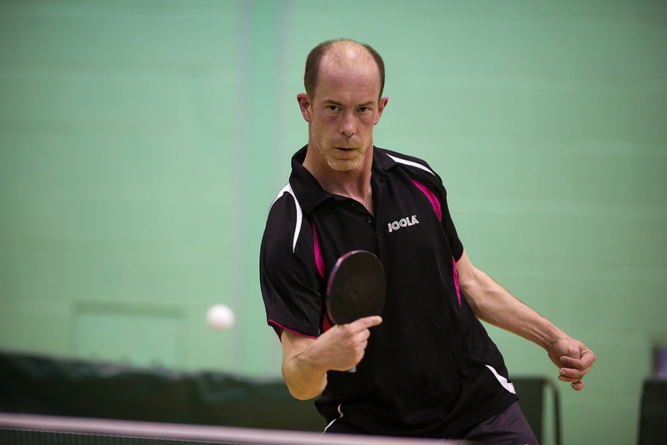
What did they know?
“Appalling, I fear I am at a loss to know where to begin and what to try next. Fortunately, he enjoys his table-tennis.” (French teacher, Autumn term, 1985).
The Geek gang.

Slide 13
My fate was sealed?
Psychiatric encounters and the ongoing court case.
The tutelage of Mrs. Socrates: “Damian always produces good work when present.” (Mrs. Socrates, Spring term, 1987).
And yet, by now my identity had been sealed:
“He seems to have little energy, enthusiasm or ambition. Instructions are ignored, work is never handed in on time, if at all, and he seems to have no explanation for any of this.” (Head of Middle School, 20/11/87).
“It does not appear that Damian is very bright and therefore lack of effort only compounds the problem.” (Form teacher, Autumn term, 1987).
But to quote my friend and colleague Dr. Dinah Murray: “Perseverance furthers’.

Slide 14
A growing political consciousness
“My major worries about the future are foreign affairs and the environment. These are issues that endanger the Human Race. The world has many groups in conflict, like the Labour party vs. the Conservative party. This kind of competition I feel is not beneficial to any of us. If we all worked together to create a better life and tried to understand one another’s beliefs and ideas, things would become much easier.” (Letter to Sir George Young MP, 1990)

Slide 15
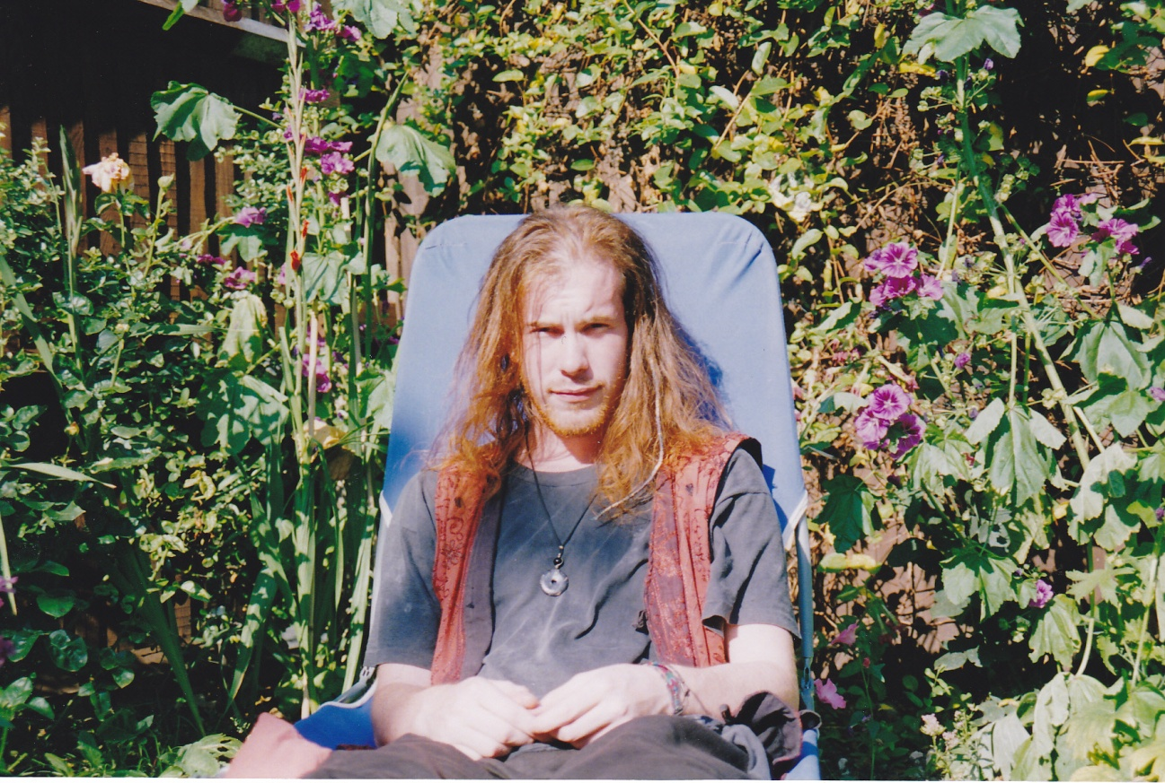
First attempt at studying a degree
“I have become increasingly concerned over your absence from lectures and failure to submit valuable coursework. With examinations starting on 1st June and the threat of failing the Degree Course, I am keen to speak with you urgently about your future...” (Course tutor, 01/05/92).
Dropping out.

Slide 16
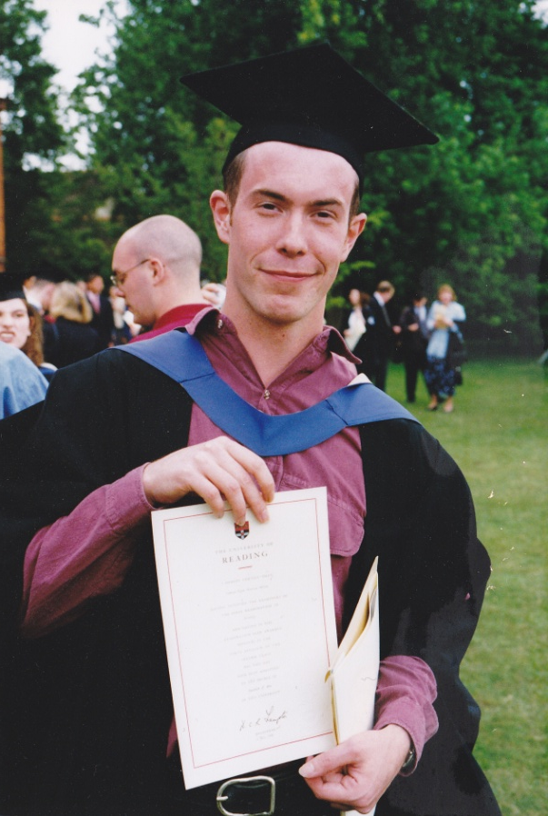
Studying Sociology
“The box most applicable to my perceptions of selfhood in Kramer's (1994) analysis, is that of the 'socially isolative schizoid', which to me underlies a belittling of 'abnormal' dispositions.”(Milton, 1999).
“Extremes of any combination come to be seen as 'psychiatric deviance'. In the argument presented here, where disorder begins is entirely down to social convention, and where one decides to draw the line across the spectrum.” (Milton, 1999 - spectrum referring to the 'human spectrum of dispositional diversity').

Slide 17
Dropping out again...and retracing myself
“One of the shocks is that the voice of the ‘other’ is being heard, rather than the voice of unity and harmony usually alluded to in the ‘perfect norm’ family narrative – papering over the cracks of the past.” (Milton, D., cited in Milton, C., 2002).
“Expressions of discontinuity are more likely found in individual artistic expressions or from the socially marginalised or from the eccentric dynamic character.” (Milton, D., cited in Milton, C., 2002).

Slide 18
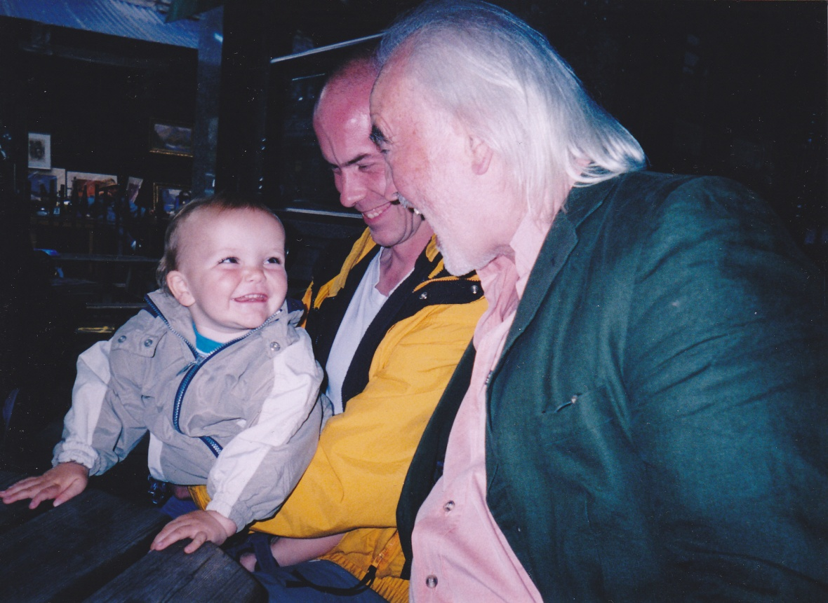
Becoming a dad
Initial worries over ‘ventricular enlargement in the brain’.
Born with an abnormally large head circumference.
Finding work as an FE lecturer.
Gift for numbers and puzzles.
Another ‘proud dad’.
The day nursery encounter.
‘Regression’.

Slide 19
Self-identification
Textbook and autobiographical accounts.
Self-identification, Autumn 2004.
Initial service provision.
Statements and forms – disabled by bureaucracy.
Being made redundant, Summer 2008.

Slide 20
Diagnosis day, Autumn 2009
“Appearance and behaviour: Mr. Milton was tall and thin with a long face. He was wearing an anorak, tracksuit bottoms and trainers. He had very little eye contact, a markedly reduced range of facial expressions and made little use of gesture.”
“Speech: Mr Milton’s speech was low and flat with little modulation...”
“Physical examination:...fell over during tandem walk.”
No mention of Dyspraxia of possible need for assessment though.
On the ADI-R I scored well above the cut-off on all areas.
“Unequivocal on all counts.”

Slide 21
The report
“According to his description, his social anxiety was much more severe in the past, and previously caused him significant social impairment. Whilst Mr. Milton has ongoing social anxiety symptoms causing him a degree of distress. In our opinion he does not meet the full criteria for a diagnosis of social phobia.”
“Mr. Milton does not appear to be currently depressed. His previous episodes may have constituted adjustment disorders or depressive episodes.”
Social services assessment recommended – happened but decided I did not need any (although I was minimising needs as single father at time).

Slide 22
Other recommendations
CBT and social skills groups. May wish to consider a course of SSRI’s. OT and a social worker.
“Mr. Milton and his family may benefit from contacting the National Autistic Society...local support groups and support networks.” (Only they do not have these resources in my area and I don’t drive). Also suggested was the NAS PROPSPECTS employment service (which is now no longer running).

Slide 23
Cognitive tests
Perfect EF score on a non-verbal task, well above average on the block design test and completed the digit span test backwards to the point they ran out of numbers to test me on.
“While he was able to interpret such utterances in terms of emotional / mental factors, he made an incorrect justification as to why the characters were using such language...[yet] when understanding other’s mental states and taking another’s perspective (Theory of Mind), Mr. Milton shows little difficulty.”
I did test as somewhat of a ‘poster boy’ in regards to the theory of weak central coherence (and likely would have done for monotropism or other theories had they applied them).

Slide 24
Recommendations
“Mr. Milton may benefit from being given additional time in conversation and people should be made aware of this.”
“The results should therefore be taken as case specific and those around Mr. Milton should be aware of how his diagnosis of Asperger’s syndrome may affect his abilities to act appropriately in social situations.”

Slide 25
Back to the ‘drawing board’
Finding out about the self-advocacy and neurodiversity movements (Sinclair, 1993; Sainsbury, 2000; Murray et al. 2005, Arnold, 2010).
Finding practitioners and academics in the field who seemed to be ‘on the right path’.
Further study and starting a PhD...again (Autumn 2009).

Slide 26
“I know that I exist, the question is: what is this ‘I’ that I know?” (Descartes, 1641).
Retracing myself again...some examples of identity research from my past:
Jo Spence (1986) – highlighted issue: feelings of powerlessness and being infantilised by medical practice.
Alexa Wright (1999) – exhibition called ‘I’ – examined social expectations of beauty – placing the disabled body in a context where it is not usually seen.
Barthes (1977) – ‘Studium’ (obvious symbolic meaning) and the ‘Punctum’ (personal to the individual – that ‘pierces the viewer’).

Slide 27
Kelly (1955) – personal construct theory – ordering experiences – discovering, and when needed re-evaluating constructs.
Garfinkel (1967) – breaching of the natural attitude – the re-construction of constructs.
Derrida (1988) – deconstruction and discontinuity.

Slide 28
Subverting the ‘functional’ family album
Single photographs – accompanied by narratives written in hindsight by both myself and my mother.
Focusing on the traumatising effects of the road-traffic accident.
Charting the history of the effects and continuation of the process (rather than resolution).
Trauma as a breach which does not ‘heal’ (Garfinkel, 1967). Trauma as permanent discontinuity with previous sense of self.

Slide 29
‘Views’ (Blay, 2004)
Severe head injury in 1985 – leading to both working and long-term memory difficulties.
Dissertation project ‘Views’ – perceptions of ‘being and spirituality’.
Black and white portrait photograph – followed by a translucent sheet with personal narratives written in own handwriting, and then a photograph depicting how that person wanted to be seen.

Slide 30
Alternative means of communication / research
The ‘Photo Book’.
Photo taking and reporting.
Photo sorting.
Photo-montage and collage.
Linear narrative and deconstruction: the ‘aut-ethnography’.
Tangible alternatives – ‘objects of reference’.

Slide 31
Subverting the narrative
“Due to the logic of power structures – the most powerful individuals with ‘control’ of social processes will usually have a vested interest in the norms of society and giving the impression of unity and common purpose...There is an obvious need for both unity and discontinuity – for resolution and non-resolution – in the course of human history. What is fascinating socially speaking is where these needs are expressed.” (Milton, D., cited in Milton, C., 2002).

Slide 32
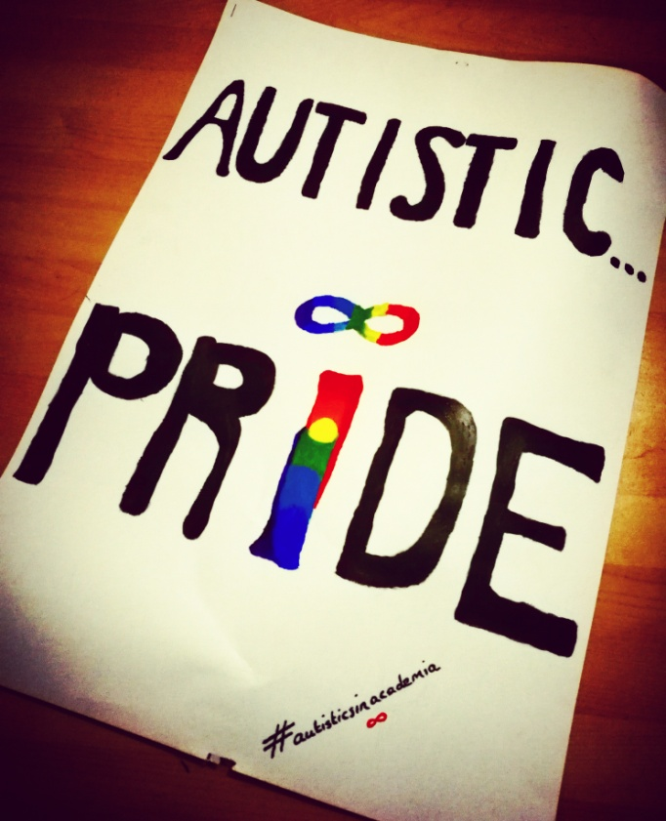
Identity and the social model of disability
“Because most of us are not ill at all, but have injuries or genetic conditions of a permanent nature, the goal of ‘getting better’ is impossible to achieve, but changing the way we are treated as disabled people is possible. Therefore the social model is full of hope for us.” (Mason, 2000: 57).

Slide 33
Wider themes and ‘social issues’
How much has changed for autistic people within mainstream education?
How much use is a pathologising deficit model diagnosis?
How much use is a cultural identity and sense of belonging? Clue: the answer should be obvious.
How are such personal stories usually framed? Subverting the ‘self-narrating zoo exhibit’.
The psycho-emotional disablement of autistic identity.
Autism itself is not a ‘problem’ that can be remedied, the problem is how to build understanding and communication in both directions (limiting the effects of the ‘double empathy problem’ – Milton, 2012).

Slide 34

Where next for me? What next for the autistic community?
To mix two old sayings together:
Watch this space...because you ain’t seen nothing yet...

Slide 35
References
Arnold, L. (2010) The Medium is the Message, accessed from: www.ucl.ac.uk/cpjh/Arnold, on 16/02/12.
Barthes, R. (1977) Camera Lucida: Reflections on Photography. New York: Hill and Wang.
Blay, A. (2004) Views [BA dissertation project – unpublished]. University of Portsmouth
Derrida, J. (1988) Limited Inc. Evanston: Northwestern University Press.
Descartes, R. (1641/1985) The Philosophical Writings of Rene Descartes. Cambridge: Cambridge University Press.
Garfinkel, H. (1967) Studies in Ethnomethodology. Englewood Cliffs: Prentice-Hall.
Kelly, G. (1955/1991) The Psychology of Personal Constructs, volumes 1 and 2. London: Routledge.
Milton, C. (2002) Beyond the Frame [MA project – unpublished]. University of Portsmouth.
Mason, M. (2000) Incurably Human. Nottingham: Inclusive Solutions.
Milton, C. (2002) Beyond the Frame [MA project – unpublished]. University of Portsmouth.
Milton, D. (1999) The Rise of Psychopharmacology [Masters Essay – unpublished]. University of London.
Milton, D. (2012) On the ontological status of autism: the double empathy problem. Disability and Society. Vol. 27(6): 883-887.
Spence, J. (1986) Putting myself in the picture: a Political, Personal and Photographic Autobiography. London: Camden Press.
Wright, A. (1999) I. Accessed at: http://www.medphys.ucl.ac.uk/mgi/alexa/ipg.html, on 21/02/12.

