Slide 1
Participatory autism research: from ideological tensions to practical opportunities.
Dr. Damian E M Milton

Slide 2
Introduction
This presentation reflects upon the involvement of autistic people in research and what autistic people have to say when able to raise their voices in regard to autism research, theory and practice.
I will also reflect upon the various barriers and difficulties involved in participatory research.
In the field of autism studies, a mass of competing and contradictory accounts can be found.
By reflecting on a number of studies, this presentation will seek to address the ideological tensions that have formed within and between various ‘stakeholder’ groups and delve into some of the deeper reasons as to why such tensions exist.

Slide 3
A note on participation
“Some of us aren’t meant to belong. Some of us have to turn the world upside down and shake the hell out of it until we make our own place in it.” (Lowell, 1999).

Slide 4
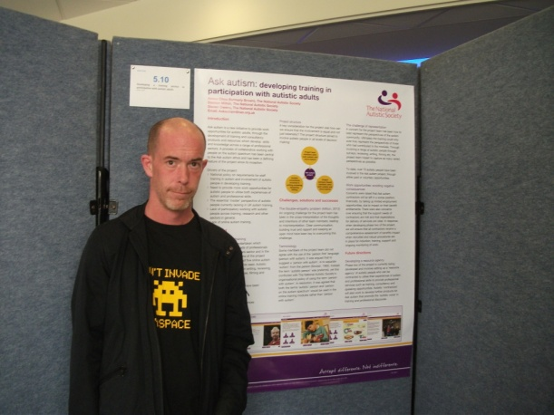
A growing understanding
Obtaining the views of disabled people – requirement of policy / legislation both nationally and internationally (UN, 2006).
Lack of involvement and representation in organisations ‘for’ autistic people.
Conflict between growing autistic voice and the discourse of dysfunction, deficiency, and dependency.
A Future Shaped Together (Pellicano et al. 2013).
The Shaping Autism Research UK project.

Slide 5
Nothing about us, without us
Having an autonomous voice – an essential requirement for individual well-being.
For people on the autism spectrum however, there can be a number of barriers to participation in wider social life.
People on the autism spectrum have often been excluded from contributing towards the decisions that directly affect their own lives.
This has led many autistic-led advocacy groups to rally behind the slogan: ‘Nothing about us, without us’.

Slide 6
Aspects of social participation
Acceptance and understanding – a sense of belonging.
Engagement in public and political life – being able to express oneself and affect change.
Individual and collective concerns.
Present lived realities – a more collaborative future?

Slide 7
Arnstein (1969)
Degrees of citizen power | Citizen control
 | Delegated power
 | Partnership
Degrees of tokenism | Placation
 | Consultation
 | Informing
No power / non-participation | Therapy
 | Manipulation

Slide 8
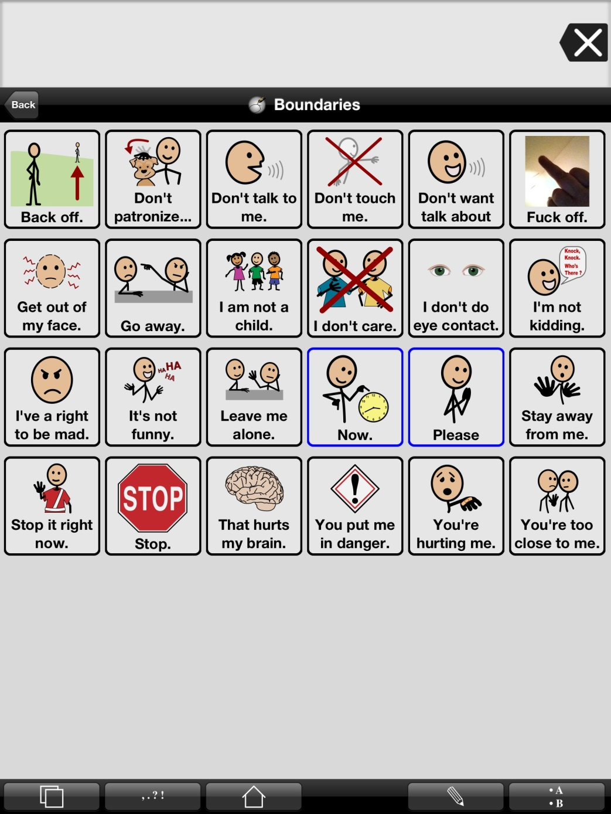
Aims and objectives – controversies in the field
Normativity or the acceptance/celebration of diversity?
Baggs (2012) - communication page.
Scientific trials and/or building collaborative communities of practice (Wenger, 1998).

Slide 10
The concept of neurodiversity
Variations in neurological development as part of natural diversity, rather than something to be pathologised.
This is not to say that those who identify as autistic people or other forms of neuro-identity do not find life challenging. Autistic people are significantly disadvantaged in many aspects of life.

Slide 11
AET consultation data

Slide 12
Mutual incomprehension
“95% of people don’t understand me”.
“Friends are overwhelming”.
“Adults never leave me alone”.
“Adults don’t stop bullying me”.
Quotes taken from Jones et al. (2012).

Slide 13
The ‘double empathy problem’
The different perceptual worlds of people with differing dispositions and effect on interactions (Milton, 2012, 2014, Chown, 2014).
Empathy problems as a ‘two-way street’ (Sinclair, 1992).
In this theory, it is not only the autistic person who struggles to read the intentions and motivations of non-autistic people, but the same can also be said in reverse.
Theory of autistic mind can often leave a great deal to be desired.
‘Fork ‘andles’!

Slide 14
Stakeholder perceptions
Findings from PhD research.
Significant tensions over a number of issues:
Celebrating the diversity of learners and not trying to ‘normalise’ them.
Radical change in society.
Pupil-led vs. teacher-led activities.
Social skills training and the appropriateness of behaviour.
The ‘three-way dispositional problem’!

Slide 15
Spectrum of educational views

Slide 16
Common ground?
Not a great deal!
Against extreme normalisation?
Enabling environments?
Building relationships, communication and mutual understanding.

Slide 17
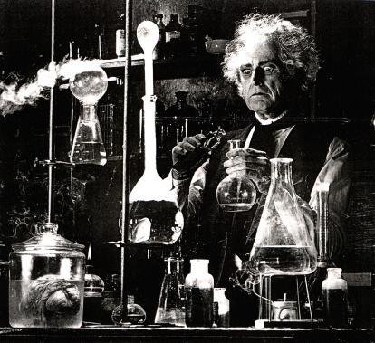
The autistic voice and the production of knowledge
People on the autism spectrum rarely in the role of researcher, traditionally seen as passive subjects.
The ‘glass sub-heading’ (Milton and Bracher, 2013).

Slide 18
Co-production
“Co-production means delivering public services in an equal and reciprocal relationship between professionals, people using services, their families and their neighbours" (New Economics Foundation).
To what extent is this currently possible?
To what extent is this ideal taken seriously in service provision or research?

Slide 19
Participatory research
A range of theoretical and methodological approaches.
Yet with the main objective of handing power from the researcher to research participants, who are often community members or community-based organisations.
In participatory research, participants have control over the research agenda, the process and actions taken.
Most importantly, people themselves are the ones who analyse and reflect on the information generated, in order to obtain the findings and conclusions of the research process.

Slide 20
Emancipatory research
“By definition emancipatory disability research should be judged mainly by its ability to empower disabled people through the research process, but whether this is achievable is a highly contentious issue.” (Barnes, 2001)

Slide 21
Difficulties in the involvement of autistic people in research
Sampling and representativeness – diverse breadth of experiences of those on the autistic spectrum.
Cognitive and linguistic demands may impair full involvement for those with learning disabilities, yet hearing views is important for participation/contribution (Lewis and Porter, 2004).
Representativeness of peers and familiar adults as proxy informants (Lewis and Porter, 2004).
Pictures and schedules – not always sure that views reported were the children’s own (Preece and Jordan, 2009).

Slide 22
Episodic memory and ‘recency’ effect (Jordan and Powell, 1995).
Questions regarding wishes and aspirations may be meaningless or even threatening (Beresford et al., 2004, cited in Preece and Jordan, 2009).
Trouble understanding use of language (literal, echolalia, idiosyncratic).
Preece and Jordan (2009) found that participants were best at identifying preferences regarding concrete objects (something tangible and not vague). Emotions and reasons for liking and disliking others more difficult for participants to answer.

Slide 23
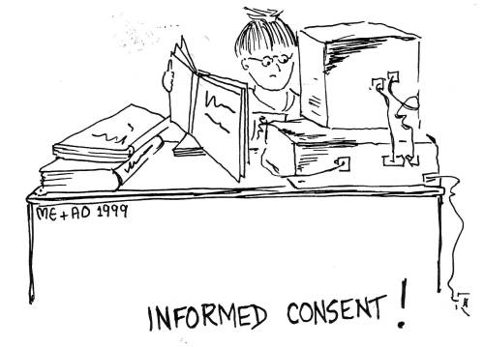
Consent
Individualised letter explaining the research and an introductory meeting (Preece and Jordan, 2009).
Ongoing process rather than one-off agreement (Lewis and Porter 2004; Preece and Jordan, 2009).

Slide 24
Recommendations for involving autistic people in research
Lewis and Porter (2004) suggest the very minimum should be establishing the value of research for those with learning disabilities – how is it useful? Avoiding harm.
Participants should be able to provide responses to initial analysis and receive feedback from the outcomes of a study (and in an accessible format).
Observational research where a child had little or no speech (Preece and Jordan, 2009).

Slide 25
Accessible outlines of interview questions given in advance. Or time to give a considered response / use of the Internet (Lewis and Porter, 2004).
Opportunity for use of other mediums – drawing, photography, film – useful ‘aide-memoires’ (Powell and Jordan, 1992, cited in Preece and Jordan, 2009).
Concrete manipulation – piles of like and dislike. Photographic narratives / scrapbooks (Preece and Jordan, 2009).

Slide 26
Practicalities
How can controversies be handled ethically?
Not everyone wishes to be a researcher (although some will), but do want their views heard, understood and utilised to help others.
Variety of consultation and participatory methods can be used – yet may need to start with small steps.

Slide 27
Are the assumptions made by researchers justified?
Repetitive behaviour and obsessions or monotropism, interests and flow states? (Murray et al. 2005, Lawson, 2010, Milton, 2012a, McDonnell and Milton, 2014)?
Theory of mind deficit or the double empathy problem (Milton, 2012b)?
The capacity of less verbal autistic people to participate.

Slide 28
Collaboration
Setting the research agenda.
Design and development of strategies and methodologies.
Avoiding tokenism...

Slide 29
Participatory methods in practice
The Autism Education Trust (AET) and the Transform Autism Education (TAE) project.
The Ask autism project.
The Theorising Autism Project.
The Autonomy journal.
The Cygnet mentoring project and the use of Personal construct theory (PCT).
The Participatory Autism Research Centre (PARC) at London South Bank University.
The National Autism Project (NAP) and Westminster Commission.

Slide 30
The Participatory Autism Research Collective (PARC)
Network initially based at LSBU promoting participatory research in the field of autism studies.
Involving autistic adults and researchers, guest researchers and students.
Held meetings, presentations and book launches.
Led to publications and stream at Learning Disability Today conference.
Shortlisted for ‘most creative community project’ at National Autistic Society annual awards 2017.
Leading a stream at the next CeDR disability studies conference in September 2018.

Slide 31
The Research Autism Cygnet Mentoring Project
A two year pilot project designed by people on the autism spectrum to evaluate a mentoring intervention.
After mentor training, selection, matching and completion of the Melbourne Personal Wellbeing Index (PWI), 12 pairs met for one hour per week over 6 months. Supervision was built in throughout.
3 Goals were set initially and reviewed throughout project.
Meeting record sheets jointly completed and a reflective journal were individually completed after each session.
After the final mentoring session, research assistants completed another evaluation and PWI with participants.
Data has been collected and analysed by the research team with input from The Advisory Group.

Slide 32
Personal wellbeing index results
PWI | All – pre-intervention | Pre (who finished) | Post | Difference
Thinking about your own life and personal circumstances, how satisfied are you with your life as a whole? | 5.08 | 6 | 7.8 | 1.8
How satisfied are you with what you are achieving in life? | 5.08 | 5.4 | 7 | 1.6
How satisfied are you with how safe you feel? | 6.42 | 7.4 | 8.8 | 1.4

Slide 33
Average progress toward goals
All – pre-intervention | Pre (who finished) | Post | Difference
3.75 | 4 | 8 | 4

Slide 34
“…this helped me dig my way out of a life threatening hole that I could not see any way out of. It reminded me to make progress towards goals. [The mentor] Listened when I needed it, was a regular weekly marker in my chaotic life, provided an opportunity to reflect and plan and self manage. I wouldn't have done this otherwise.”

Slide 35
Conclusion
“Traditional methods of consulting and working in partnership may not always be effective, and new avenues for connection may need to be sought, however when collaborative ventures are pursued, and when people on the autism spectrum feel included and empowered, the ability to live as one chooses greatly increases.” (Milton, 2014b).

Slide 36
References
Barnes, C. (2001), accessed at: http://disability-studies.leeds.ac.uk/files/library/Barnes-glasgow-lecture.pdf
Jordan, R. and Powell, S. (1995) Understanding and Teaching Children with Autism. Chichester: Wiley.
Lewis, A. and Porter, J. (2004) ‘Interviewing children and young people with learning disabilities: guidelines for researchers and multi-professional practice.’ British Journal of Learning Disabilities. Vol. 32: 191-197.
Lawson, W. (2010) The Passionate Mind: how people with autism learn. London: Jessica Kingsley.
Lowell, E. (1999) Remember Summer. London: Avon.
Milton, D. (2012a) So what exactly is autism? London: Autism Education Trust.
Milton, D. (2012b) On the Ontological Status of Autism: the ‘Double Empathy Problem’. Disability and Society. Vol. 27(6): 883-887.
Milton, D. (2014a) Autistic expertise: a critical reflection on the production of knowledge in autism studies. Autism: The International Journal of Research and Practice (special edition ‘Autism and Society’), Onlinefirst, 17/03/14.
Milton, D. (2014b) What is meant by participation and inclusion, and why it can be difficult to achieve. NAS Ask autism conference: Participation and inclusion from the inside-out: autism from an autistic perspective, London Jan 2014.

Slide 37
Milton, D. and Bracher, M. (2013) Autistics speak but are they heard? Medical Sociology Online. Vol. 7(2): 61-69.
Milton, D. and Moon, L. (2012) The normalisation agenda and the psycho-emotional disablement of autistic people, Autonomy Vol. 1(1).
Milton, D. and Bracher, M. (2013) Autistics speak but are they heard? Medical Sociology Online. Vol. 7(2): 61-69.
Murray, D., Lesser, M. and Lawson, W. (2005) ‘Attention, monotropism and the diagnostic criteria for autism.’ Autism. Vol. 9(2), pp. 136-156.
Ne’eman, A. (2011) Question and Answer interview, accessed at http://www.talkaboutautism.org.uk/community/live-qa-events/010611-ari-neeman
Pellicano, L., Dinsmore, A. and Charman, T. (2013) A Future Shaped Together: Shaping Autism Research in the UK. London: Institute of Education.
Preece, D. and Jordan, R. (2009) ‘Obtaining the views of children and young people with autism spectrum disorders about their experience of daily life and social care support.’ British Journal of Learning Disabilities. Vol. 38, pp. 10-20.
Sinclair, J. (1993) Don’t Mourn For Us [online] http://www.autreat.com/dont_mourn.html
United Nations (2006) Convention on the Rights of Persons with Disabilities. New York: United Nations.
Wenger, E. (1998) Communities of Practice: Learning, Meaning and Identity. Cambridge: Cambridge University Press.
Williams, D. (1996) Autism: An Inside-Out Approach. London: Jessica Kingsley.

