Slide 1





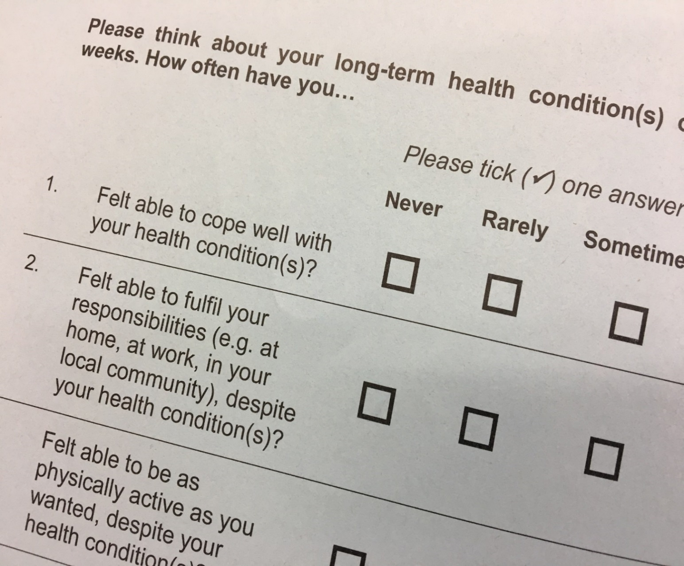
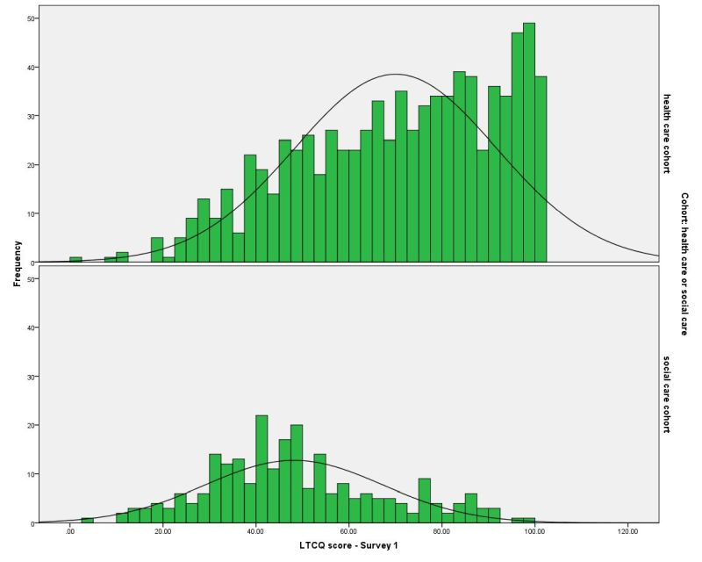
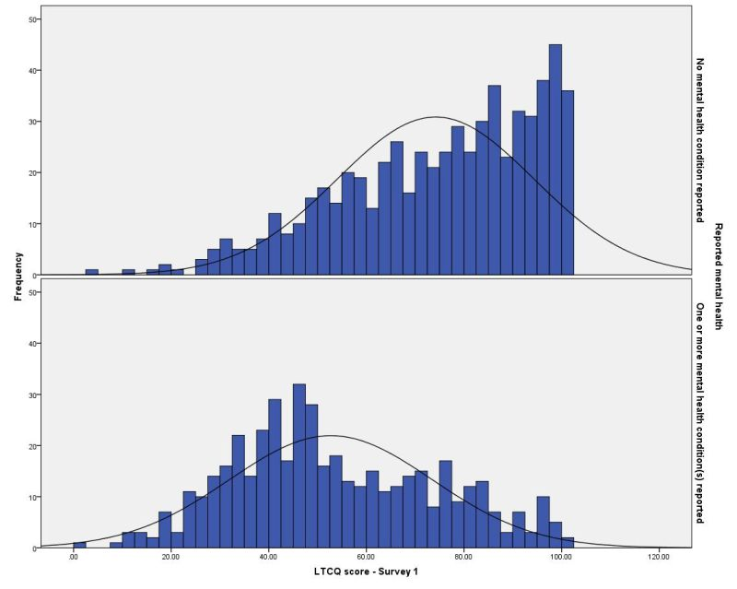
Known-groups validity of the Long-Term Conditions Questionnaire (LTCQ): a measure for potential use in integrated care Caroline Potter,^{1,5} Laurie Batchelder,^{2,4} Louise Geneen,^{1,4} Diane Fox,^{2,4} Laura Kelly,^{1,5} Elizabeth Gibbons,^{1,5} Crispin Jenkinson,^{1,4} Karen Jones,^{2,4} Julien Forder,^{2,3,4} Ray Fitzpatrick,^{1,4,5} Michele Peters^{1,4} 1. Health Services Research Unit, University of Oxford 2. Personal Social Services Research Unit, University of Kent 3. The London School of Economics and Political Science 4. QORU: Quality and Outcomes of Person-Centred Care Policy Research Unit 5. Collaboration for Leadership in Applied Health Research and Care (CLAHRC) Oxford
Context
Rising burden and costs of long-term conditions (LTCs), especially multi-morbidity
Drive for integrated health and social care services
Importance of person-centred outcomes
Long-Term Conditions Questionnaire
Developed to capture the overall impact of living with LTCs, for:
Single and multiple LTCs
Physical and/or mental health conditions
Health care and social care settings
Participants and Methods
Health care participants (N=917) were recruited through 15 primary care practices, and social care recipients (N=294) were recruited through four Local Authorities. All participants had at least one LTC.
Data were collected via postal surveys from February 2016 to January 2017. Participants’ LTCs were reported via a multi-morbidity scale.
For participants who completed all 20 LTCQ items, LTCQ scores were calculated on a scale ranging from 0 to 100, with higher scores indicating ‘living well with LTCs’.
Analysis of variance (ANOVA) and non-parametric tests for comparing sample means were used to explore differences between groups.
Results
Statistically significant differences in LTCQ scores between health care cohort (N=838, mean LTCQ score 70) and social care cohort (N=244, mean LTCQ score 48): Mann-Whitney U=46596, p<0.001
Statistically significant differences in LTCQ scores between those reporting only physical health conditions (N=624, mean LTCQ score 74) and those reporting at least one mental health condition (N=458, mean LTCQ score 53): Mann-Whitney U=65482, p<0.001
Known social care users and those reporting at least one mental health condition were disproportionately represented in the lowest two quintiles of the sample (LTCQ score < 60): 75% of social care users and 64% of those reporting at least one mental health condition
LTCQ scores: comparison among known groups |  | Mean | SD | SE | 95% CI | α | ANOVA
 | Total sample (N=1082) | 65.1 | 23.0 | 0.70 | 63.7 - 66.5 | 0.95
cohort | Health care sample (N=838) | 70.0 | 21.7 | 0.75 | 68.6 - 71.5 | 0.95 | F (1, 1080) = 201.8, p < 0.001
 | Social care sample (N=244) | 48.2 | 19.1 | 1.22 | 45.8 - 50.8 | 0.92
mental health | no mental LTC(s) reported (N=624) | 74.2 | 20.2 | 0.81 | 72.6 - 75.8 | 0.94 | F (1, 1080) = 291.2, p < 0.001
 | mental LTC(s) reported (N=458) | 52.7 | 20.8 | 0.97 | 50.8 - 54.6 | 0.94
Distribution within LTCQ quintiles | LTCQ score range | Mean EQ-5D-5L value (SD) | Mean EQ-VAS score (SD) | Social Care recipients (N=244) | No social care use reported (N=838) | Mental LTC(s) reported (N=458) | No mental LTC(s) reported (N=624)
1 | 1-43 | 0.24 (0.27) | 38 (20) | 44% | 14% | 37% | 9%
2 | 44-59 | 0.47 (0.25) | 49 (17) | 31% | 18% | 27% | 16%
3 | 60-75 | 0.70 (0.19) | 66 (17) | 14% | 22% | 19% | 21%
4 | 76-89 | 0.83 (0.15) | 79 (13) | 9% | 22% | 11% | 25%
5 | 90-100 | 0.93 (0.10) | 88 (8.7) | 2% | 24% | 6% | 29%
Mean = mean LTCQ score for sub-sample SD = standard deviation SE = standard error of the mean 95% CI = 95% confidence interval α = Cronbach’s alpha (internal consistency) for 20 LTCQ items ANOVA = one-way between-groups analysis of variance of LTCQ scores
Conclusions
LTCQ scores clearly distinguished social care recipients and those reporting mental health condition(s) from their counterparts within this diverse health and social care sample.
Taken together with the acceptability, content validity, internal consistency, test-retest reliability, and convergent construct validity previously reported for the LTCQ (Peters et al. 2016., Kelly et al. 2016, Potter et al. 2017), this evidence of known-groups validity further supports the LTCQ as a useful measure in the context of integrated care.
Figure: LTCQ score distributions compared for health versus social care cohorts (green) and the absence or presence of mental health conditions (blue)
Acknowledgements: We would like to thank the participants with long-term conditions for taking part in this study. This research was funded by the Policy Research Programme (PRP) in the Department of Health England, which supports the Quality and Outcomes of Person-centred Care Policy Research Unit (QORU), and by the National Institute for Health Research (NIHR) Collaboration for Leadership in Applied Health Research and Care (CLAHRC) Oxford at Oxford Health NHS Foundation Trust. The views expressed are those of the author(s) and not necessarily those of the NHS, the NIHR or the Department of Health.
References: Peters M, Potter CM, Kelly L, et al. (2016) The Long-Term Conditions Questionnaire: conceptual framework and item development. Patient Related Outcome Measures 7:109-125.
Kelly L, Potter CM, Hunter C, et al. (2016) Refinement of the Long-Term Conditions Questionnaire (LTCQ): patient and expert stakeholder opinion. Patient Related Outcome Measures 7: 183–193.
Potter CM, Batchelder L, A’Court C, et al. (2017) The Long-Term Conditions Questionnaire (LTCQ): initial validation survey among primary care patients and social care recipients in England. BMJ Open, in press.

