Slide 1
Judicial bias¹ in the Court of Appeal?
A statistical analysis of recent personal injury decisions
Per Laleng
Obs discussion Group/Staff seminar
19 November 2014
1. And whilst we’re at it: are there any other biases at work?

Slide 2
Frequency & Relative frequency of types of claim initiated by Claimants
Source: Compensation Recovery Unit

Slide 4
Breakdown of type of non-intentional personal injury case decided by the Court of Appeal 2003 - 2013 by frequency and relative frequency. Mean annual figures included in total column.

Slide 5
The difference between claims initiated and the work of the Court of Appeal
(on average)

Slide 6
The types of legal issue dealt with by the Court of Appeal

Slide 7
Standard Tort textbook coverage of legal issues

Slide 8
Winners and losers in the Court of Appeal:
“Prospects of Success” for litigation funding

Slide 9
An emerging trend?

Slide 10
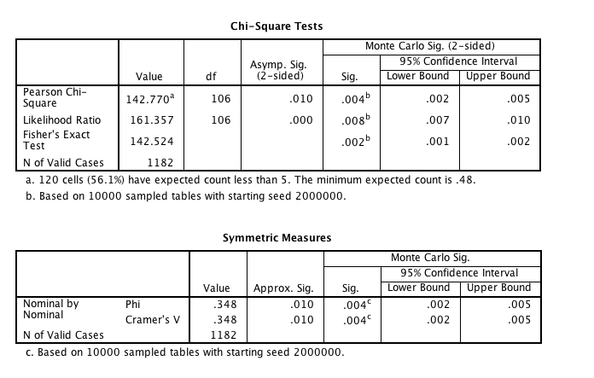
Is there evidence of systematic bias in the Court of Appeal?

Slide 11
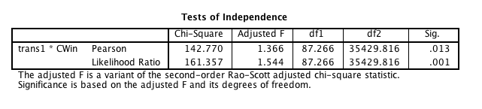
Removing those with less than 10 cases against their name (which caters for the assumption under chi-square test of need for 5+ “expected values”).

Slide 12
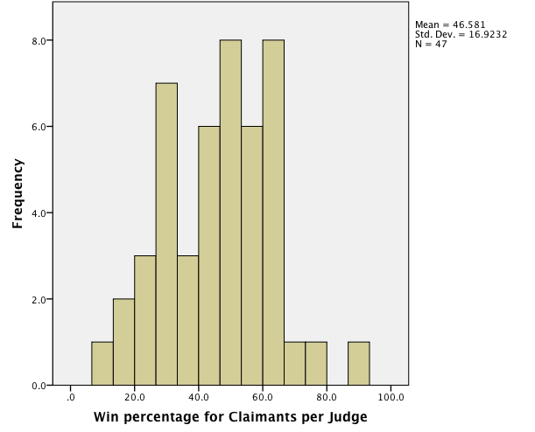
Where judges have sat on panel >10 times

Slide 13
