Slide 1

THE OFFICE FOR SCHOLARLY COMMUNICATION/ Responsible Metrics at Kent

Slide 2
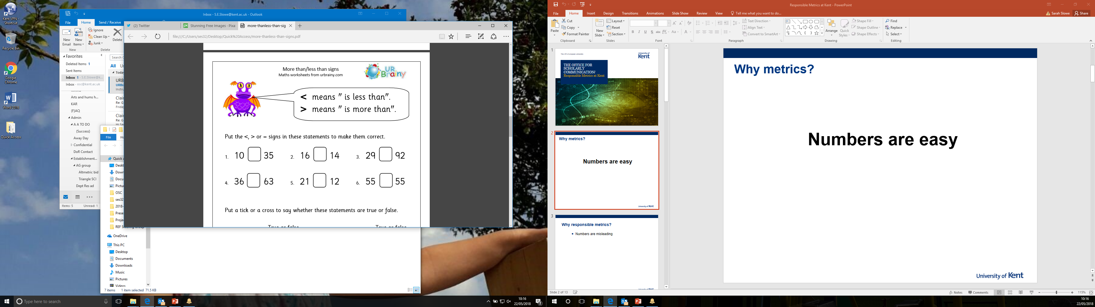
Why metrics?
Numbers are easy...

Slide 3
Why responsible metrics?
Numbers can be unhelpful
  “Mine’s a 3!”
    This 3?
    0, 0, 0, 0, 0.1, 0.2, 0.7, 0.8, 0.83, 3
    Or this 3?
    3, 5, 12, 24, 67, 89, 93, 105, 213, 1980

Slide 4
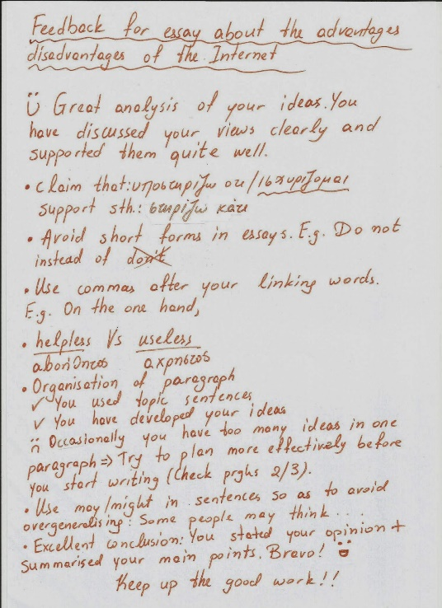
Why responsible metrics?
Numbers don’t tell the whole story, but they can help

Slide 5


Why responsible metrics?
Bigger isn’t always better...
  What is most appropriate?
    Attention?
    Citation?

Slide 6


Metrics v Effort

Slide 7
San Francisco Declaration on Research Assessment
General Recommendation
  Do not use journal-based metrics, such as Journal Impact Factors, as a surrogate measure of the quality of individual research articles, to assess an individual scientist’s contributions, or in hiring, promotion, or funding decisions.
For institutions
  Be explicit about the criteria used to reach hiring, tenure, and promotion decisions, clearly highlighting, especially for early-stage investigators, that the scientific content of a paper is much more important than publication metrics or the identity of the journal in which it was published.
  For the purposes of research assessment, consider the value and impact of all
  research outputs (including datasets and software) in addition to research publications, and consider a broad range of impact measures including qualitative indicators of research impact, such as influence on policy and practice.

Slide 8
The Leiden Manifesto
The Leiden Manifesto brings together accepted but disparate principles of good practice in research evaluation. The manifesto represents the “distillation of best practice in metrics-based research assessment so that researchers can hold evaluators to account and evaluators can hold their indicators to account”
The ten principles are:
Quantitative evaluation should support qualitative, expert assessment.
Measure performance against the research missions of the institution, group or researcher.
Protect excellence in locally relevant research.
Keep data collection and analytical processes open, transparent and simple.
Allow those evaluated to verify data and analysis.
Account for variation by field in publication and citation practices.
Base assessment of individual researchers on a qualitative judgement of their portfolio.
Avoid misplaced concreteness and false precision.
Recognize the systemic effects of assessment and indicators.
Scrutinize indicators regularly and update them.

Slide 9
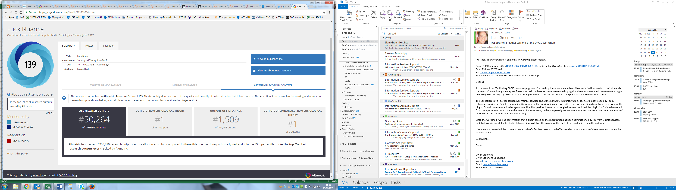
What was it designed to measure?
Journals: e.g. JIF, SNIP, SJR
  Measures - From Clarivate Analytics: “The JIF is defined as citations to the journal in the JCR year to items published in the previous two years, divided by the total number of scholarly items, also known as citable items [articles and reviews], published in the journal in the previous two years.”
Researchers: e.g. H-index
Article Attention: e.g. Altmetrics
Specific interaction
  Downloads, mentions etc. etc.

Slide 10

Appropriate use

Slide 11
Avoiding over precision
1.73205081
2
Square root of 3? Minutes to lunch?

Slide 12
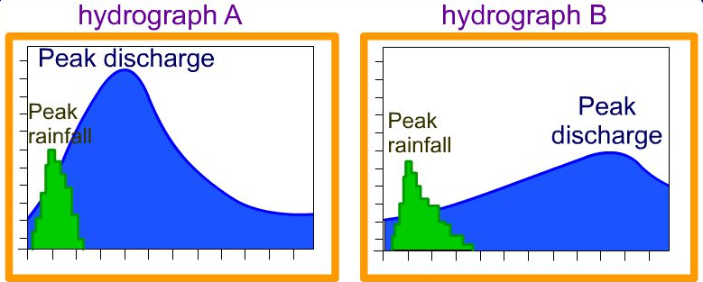
The time factor

Slide 13
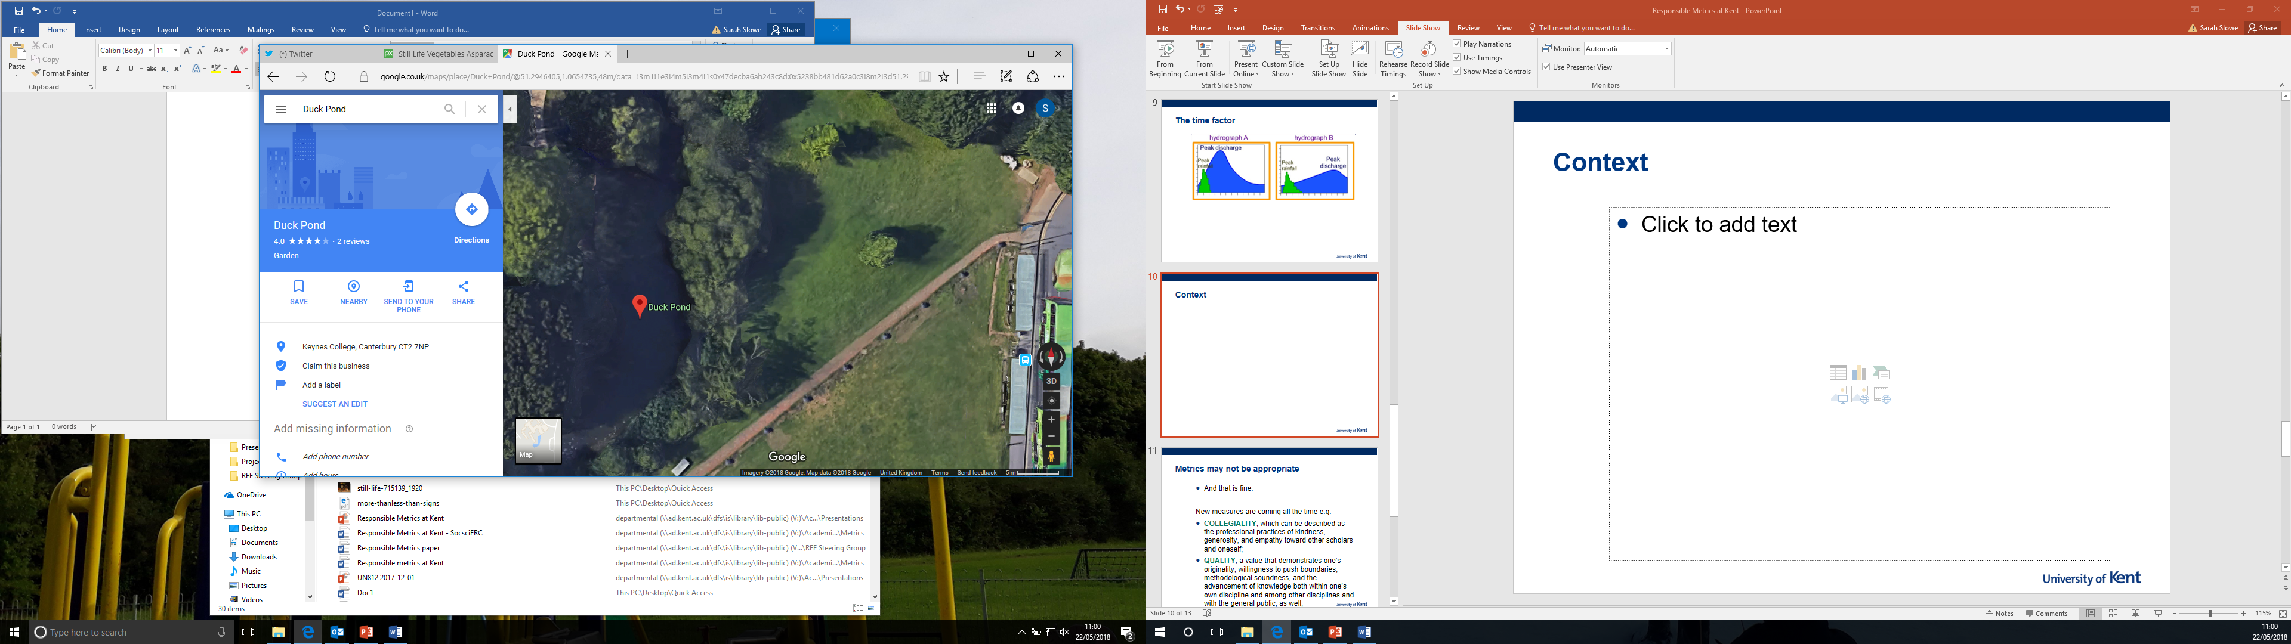


Context is vital
Largest bodies of water....

Slide 14
Metrics may not be appropriate
And that is fine.
New measures are coming all the time e.g. Humane Metrics Initative
COLLEGIALITY, which can be described as the professional practices of kindness, generosity, and empathy toward other scholars and oneself;
QUALITY, a value that demonstrates one’s originality, willingness to push boundaries, methodological soundness, and the advancement of knowledge both within one’s own discipline and among other disciplines and with the general public, as well;
EQUITY, or the willingness to undertake study with social justice, equitable access to research, and the public good in mind;
OPENNESS, which includes a researcher’s transparency, candor, and accountability, in addition to the practice of making one’s research OPEN ACCESS at all stages; and
COMMUNITY, the value of being engaged in one’s community of practice and with the public at large and also in practicing principled leadership.

Slide 15
For REF 2021
Outputs should be selected for inclusion based on qualitative, expert assessment with support from quantitative indicators where appropriate.
Metrics used in relation to a research output should relate directly to that output, not the researcher or the publication it is part of.
Metrics regarding an output should be considered in relation to the context of the article, taking into consideration factors such as career stage, gender, language of publication and date of publication, even within a UOA context.
Ensure Metrics reflect the reach of the work
  Check KAR to ensure all research works are recorded there correctly.
  Maximise metrics, by maximising visibility of research
    Make Open Access (pre-print, green, gold, …) as soon as possible
    Open Data reporting/references in the article
    Contact osc@kent.ac.uk for specific advice or queries
  Encourage researchers to register for and use an ORCID iD to ensure consistent, reliable attribution of work
  Work with the Research Excellence Team to ensure details in Scopus are accurate – this is particularly the case if researchers have recently changed name or institution.

Slide 16
Notes:
This

