Slide 1
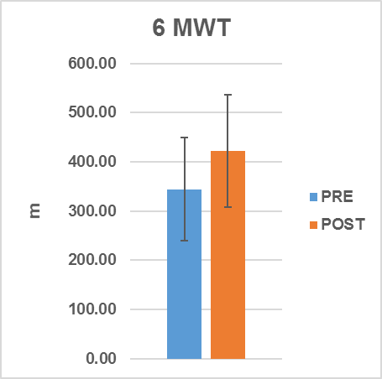
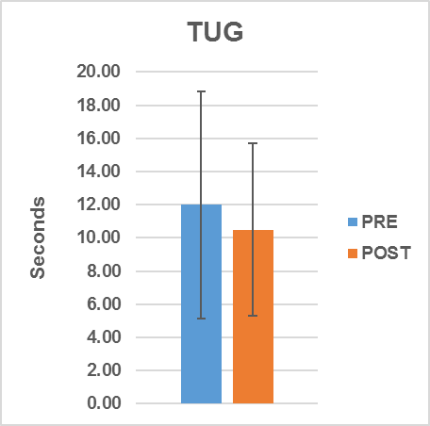
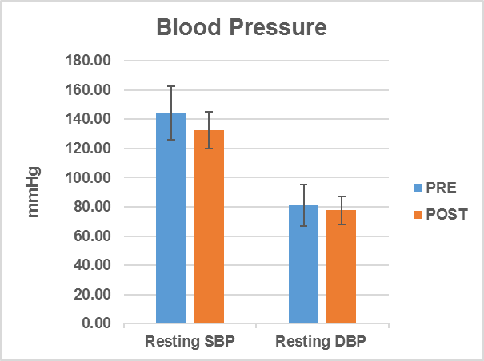
Should Exercise Be Used As Medicine in Stroke Rehabilitation? School of Sport and Exercise Sciences, University of Kent, The Medway Building, Chatham Maritime, Kent. ME4 4AG
R.C. Cox, S.N. Meadows & A. Ferrusola-Pastrana
rs494@kentforlife.net
Introduction
More people are surviving a stroke than ever before, however almost 67% leave hospital with a disability (Stroke Association, 2017). A large population of stroke survivors live with the after effects of a stroke; such as a reduction in activities of daily living, loss of independence & fatigue. Physical activity helps to reduce this impact. There is also overwhelming evidence of the benefits exercise provides towards modifiable risk factors such as physical inactivity, high blood pressure & obesity, all of which increase the risk of having a stroke (O’Donnell, et al., 2016). Strength & fitness training were included in the NICE (2013) pathway for stroke & should follow physiotherapy. However, the opportunities to exercise in a specialist class environment are limited, as are referral rates to these stroke rehabilitation services.
Table 1. Results of health & functional assessments (mean ± SD) at baseline & post-12 week exercise programme. Resting SBP, 6MWD (m), TUG mean (s), mean GS left & GS right (kg) showed significant improvements. Mean age of participants = 61.67 (±11.57) years.
Assessment | Pre (n=21) (mean ±SD) | Post (n=21) (mean ±SD) | Difference | P value
Weight (kg) | 79.88 (±14.58) | 80.54 (±15.12) | 0.66 | 0.24
BMI (kg.m²) | 28.58 (±4.89) | 28.94 (±5.37) | 0.36 | 0.14
Waist Circumference (cm) | 94.00 (±12.43) | 94.07 (±12.31) | 0.07 | 0.82
Resting SBP (mmHg) | 144.24 (±18.18) | 132.38 (±14.11) | -11.86 | 0.001
Resting DBP (mmHg) | 81.24 (±12.61) | 77.57 (±9.55) | -3.67 | 0.06
6MWD (m) | 344.43 (±104.71) | 422.29 (±113.97) | 77.86 | 0.0001
TUG mean (s) | 11.99 (±6.84) | 10.50 (±5.21) | -1.49 | 0.02
GS Left (kg) | 24.11 (±14.06) | 26.68 (±13.55) | 2.57 | 0.04
GS Right (kg) | 24.33 (±11.34) | 26.83 (±8.87) | 2.50 | 0.04
Study Aims and Hypothesis
Aims: To provide a weekly group exercise session for stroke survivors in a local community setting using multi-modal exercises (cardiovascular, strength, co-ordination, etc.).
Hypothesis: Following a 12 week exercise period functional ability & health status will improve, along with reduction in key stroke risk factors (e.g. BP).
Methods
Recruitment
Individuals were either referred by the local stroke services, or their GP. Promotion at stroke support groups also had a positive impact on attendance. Universal referral criteria does not exist, so a referral form was designed to facilitate patient screening & risk stratification.
Assessments
Health & functional assessments were completed before exercise attendance & repeated following 12 weeks of exercise sessions.
Health assessments: Resting heart rate (RHR) & blood pressure (BP), height, weight, BMI, waist circumference.
Functional Assessments: Six-minute walk distance (6MWD), timed up & go (TUG) & bilateral grip strength (GS).
Multi-modal Exercise Intervention
Warm Up
Graded 15 minute cardiovascular warm-up, consisting of various multi-directional mobility movements, co-ordination & stretching exercises.
Cardiovascular (CV) Conditioning Component
Circuit format of functional skill related exercises e.g. shuttle walking, sit to stand & step-ups. The circuit lasted for a continuous 30 minute period consisting of 1 minute on each station & 30 seconds active transition.
CV Cool Down
Graduated 10 minute cool down using walking or gentle stationary movements for those less mobile. Stretching also included.
Strength Conditioning Component
A combination of 3 – 4 strength exercises to promote upper limb mobility. 8 – 10 reps, focused on quality of movement, posture & symmetry (10 minutes).
Upper & lower limb stretches concluded the session. Stretches held for 10-30 seconds to promote muscle lengthening & avoid adaptive shortening, especially around the shoulders (5 minutes).
Figure 2. Mean ±SD change in 6MWD between baseline 344.43 (±104.71) m & post-intervention 422.29 (±113.97) m assessments. Mean improvement of 77.86 m, or 22.6% (p<0.0001).
Figure 3. Mean ±SD change between baseline 11.99 (±6.84) s & post-intervention assessments of 10.50 (±5.21) s for TUG mean (s). Mean improvement of -1.49 (s), or 12.40% (p<0.02).
Conclusion
Once weekly exercise incorporated into stroke rehabilitation can reduce SBP into a normotensive range, despite no alterations in resting HR or medication changes. Functional capacity improved as indicated by an increase in 6MWD (22.6%). Interestingly, peak RPE remained consistent despite increases in peak HR, suggesting an improvement in fitness & functional ability. TUG also improved (12%) suggesting greater strength, speed & balance, despite no extra effort required, as RPE remained the same. GS improved, with the greatest change on their effected side. Results indicate a general improvement in health & functional parameters, suggesting exercise is an effective intervention in long term stroke rehabilitation.
Limitations
Recent reports have identified a lack of long-term rehabilitation, despite it being an absolute necessity for stroke survivors. Stroke disability impacts on independence, quality of life & creates an increased burden on the healthcare system & carers. As regular support is not easily accessible, this jeopardises patient’s recovery. Exercise after stroke does not have a nationally recognised pathway, unlike other clinical populations e.g. cardiac & pulmonary rehabilitation. This presents a barrier to promotion, referral rates & attendance. Supervised exercise rehabilitation can help stroke survivors regain & sustain their independence. It also provides an effective secondary prevention strategy, helping to reduce future costs & burden to the healthcare system.
Further Research Recommendations
Stroke is a recovering condition, unlike other neurodegenerative conditions. This study continues to provide a compelling case for supportive therapies, with promising results following just 12 weeks of exercise (1 x week). Larger longitudinal studies with control groups are needed to quantify dose-response benefits of exercise to support the routine use in post-stroke recovery, secondary prevention & reduced co-morbidities.
Results
References
National Institute for Health and Care Excellence (2013). Stroke Rehabilitation in Adults. Available: https://www.nice.org.uk/guidance/cg162. Last accessed 14th May 2018.
O’Donnell, M.J., et al (2016). Global and regional effects of potentially modifiable risk factors associated with acute stroke in 32 countries (INTERSTROKE): a case-control study. Lancet 388, 761-775.
Stroke Association (2017). State of the Nation. Stroke Statistics – January 2017. Available: https://www.stroke.org.uk/sites/default/files/state_of_the_nation_2017_final_1.pdf. Last accessed 14th May 2018.
Figure 1. Mean (±SD) SBP (mmHg) reduced from baseline of 144.24 (±18.18) mmHg & 12 weeks post-intervention of 132.38 (±14.11) mmHg. Mean reduction of -11.86 mmHg or -8.22% (p<0.001). Slight reduction in DBP (trend), but not statistically significant (p<0.06).

