Slide 1

THE OFFICE FOR SCHOLARLY COMMUNICATION/ Launch Event

Slide 2
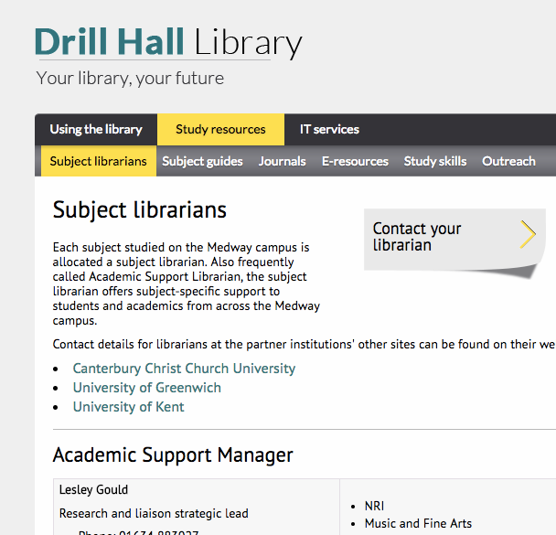
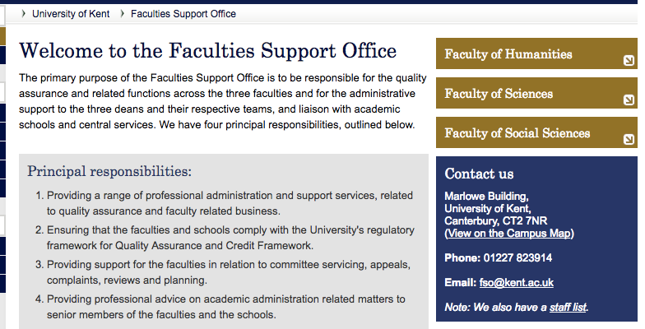
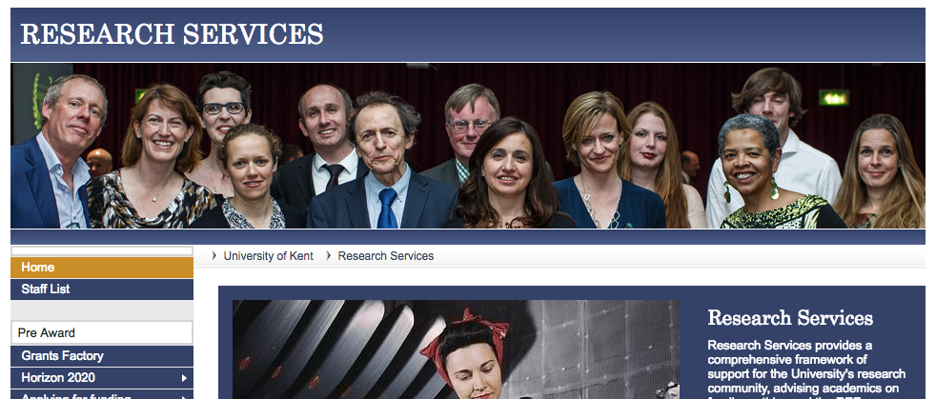


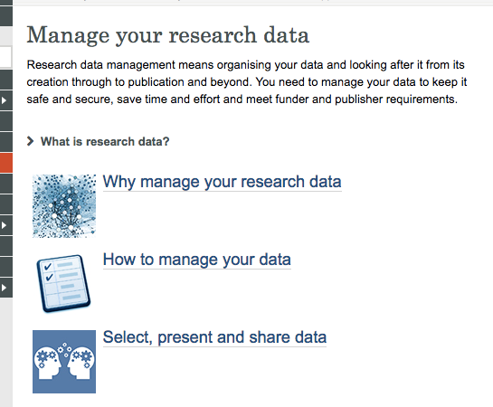
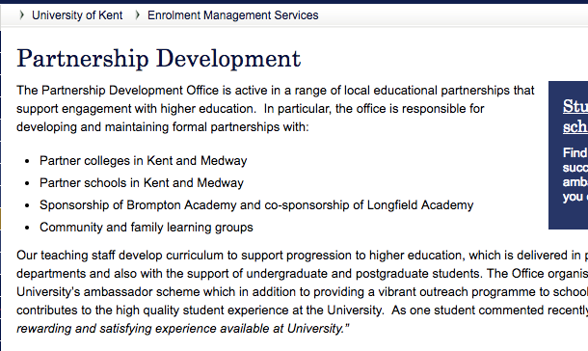
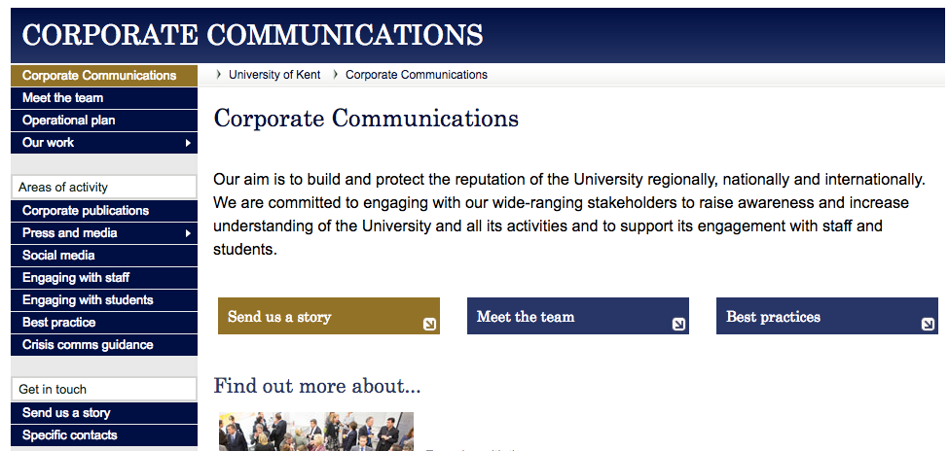





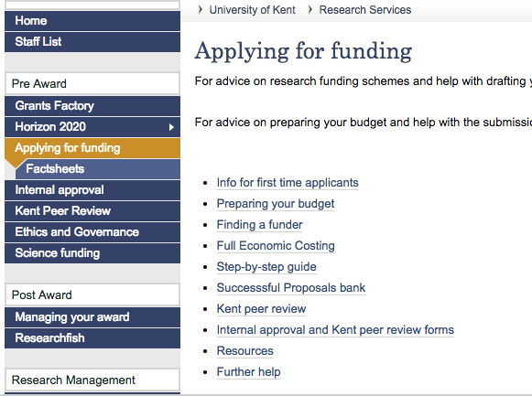


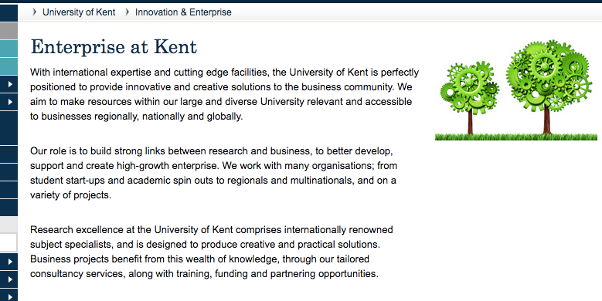
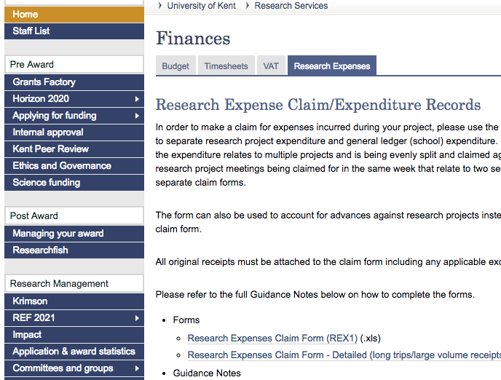
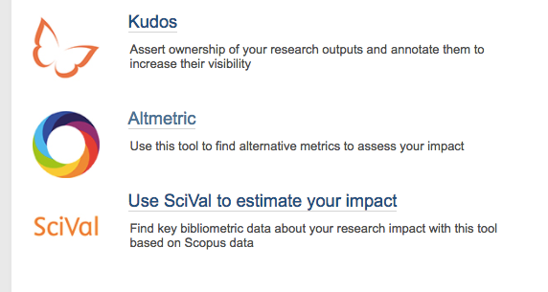
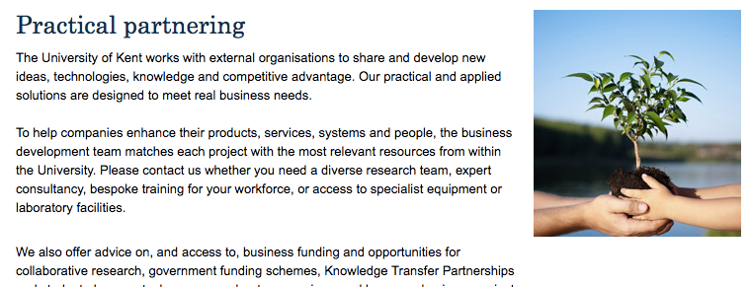
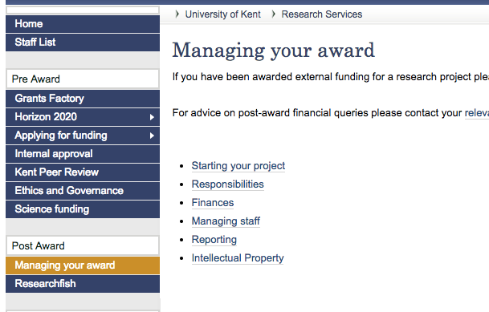

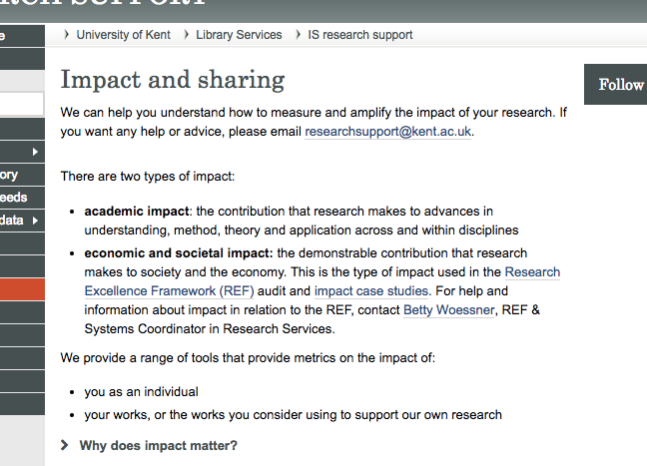
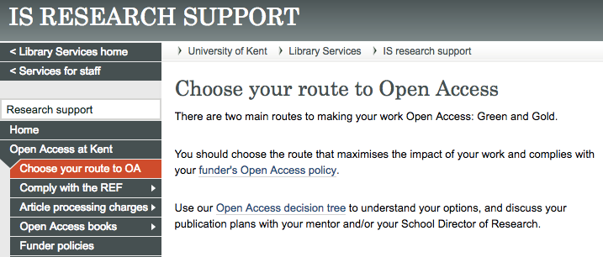




The history – Why do we need an OSC?

Slide 3
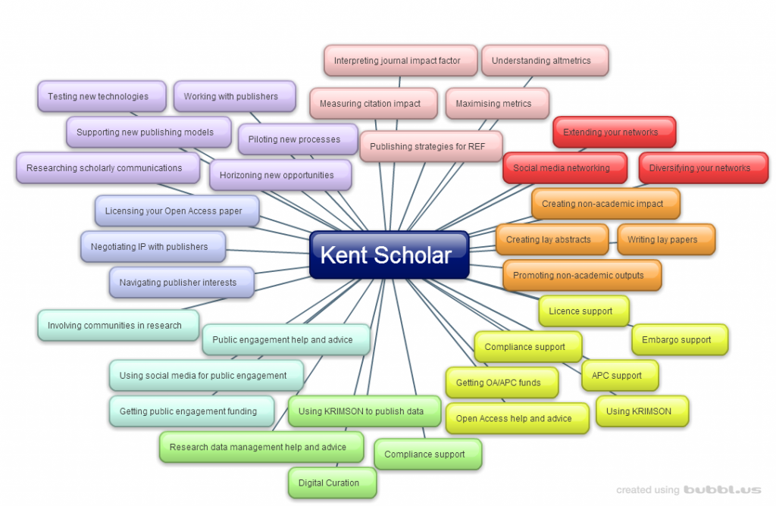
What does this actually mean?

Slide 4
The future – Why do we need an OSC?
New tools, new challenges
UKSCL, DORA, Leiden Manifesto
BASE, Open knowledge maps, Google scholar
Kudos, Altmetric
Looking at how, with the rise in openly accessible, non peer reviewed outputs, we ensure visibility of outputs from Kent, continuity of availability and discoverability...

Slide 5
So… what is the OSC?
“A centre for excellence in scholarly communications that is highly visible, highly accessible and understanding of the needs and concerns of the academic community across all faculties – a building block for Kent’s inclusive, supportive and disruptive research environment. The Office for Scholarly Communication will actively align support from Research Services, Information Services and other pockets of excellence to create a single point-of-need service creating added value in and from scholarly communications activity.”
IS SMT January 2016 – Office for Scholarly Communication proposal - Model

Slide 6
OSC to do list.... (the short version...)
The Office for Scholarly Communication is a one-stop-shop that will support academics to routinely extend profile and impact from their research through expert advice and service provision in the areas of:
Advice on journal (and other outlets) esteem and metrics,
Metrics, altmetrics and maximising academic impact
Developing academic and non-academic networks through evidence based information
Promoting and achieving non-academic impact from publication
Supporting best practice in open access
Supporting best practice in research data management
Supporting best practice in public engagement with research
Supporting best practice in social media to promote research and research outputs
Enabling publication strategies and workflows that meet all funder requirements
Enabling researchers to make informed decisions about intellectual property and publication
Inspiring and initiating disruptive innovation in scholarly communication
Leading and promoting new activities such as a Kent University Press

Slide 7
But... what will the OSC do for me: as an individual researcher?
Provide an efficient, tailored service for individual researchers
Signpost to all the specialist expertise research support at Kent
Create a bank of expert knowledge

Slide 8
But... what will the OSC do for me: working with collaborators?
Enable, support and foster collaboration, within Kent, nationally and internationally
Work with researchers to overcome challenges and barriers to increased collaboration.

Slide 9
But... what will the OSC do for me? looking ahead.
Inspire innovation, leading scholarly communication in a fast changing research environment.
Provide a guide through the new tools and opportunities that the new scholarly communication environment brings.

Slide 10
Next steps?
Establish a starting point
Set priorities
Posters
Get in touch!
S.E.Slowe@kent.ac.uk or osc@kent.ac.uk
Kent.ac.uk/osc
16645
@headunikentosc
Somewhere in the Library...!

Slide 11
Notes:
This

