Slide 1
Embedding communication in my work
HELEN CARR KLS

Slide 2
MY WORK
HOUSING AND HOMELESSNESS
Successful impact case study for REF
Law Commission work pre working at Kent, then taken up by Welsh assembly with proposals affecting half a million people

Slide 3
Ref case study
Building on prior work for the Law Commission, Helen Carr’s research provided the inspiration for major reforms in Welsh housing tenure. Working in collaboration with Professor Dave Cowan (University of Bristol) and Professor Caroline Hunter (University of York), the research provided evidence, inspiration and a legal framework for the new Housing Bill now in place.
Proposals included simplification, uniformity across tenures, and avoiding the diverse layers of housing tenure. It is thought the legislation could affect the lives of approximately half a million tenants and landlords.

Slide 4
Current work
  Homeless veterans and statutory duties
  Report for Shelter on inadequacies in housing law revealed by Grenfell
  Problems with leasehold tenure
  More generally work on housing affordability and housing conditions in London and the South East
  Continued implementation of Welsh legislation

Slide 5
Thinking strategically about impact
Contacts
Context
Collaborate
Communication

Slide 6
Contacts
Maintain or create links outside of academia
  Part time judicial role
  Write occasional practitioner pieces
  Write statutory commentary
Offer to do stuff for people
  Chair professional conferences
  The tower blocks network

Slide 7
Context
Think hard about what it is about your work that might be of interest outside of academia
Also think hard about what it is that makes your work unique
Location, location, location
  Canterbury is in the south east of England and in the shadow of London with its extrordinary housing crisis

Slide 8
collaboration
With other academics
  Does not affect impact
  Easier to get stuff done
With professionals
  They have networks and understand priorities
Remember often the non-academic world wants something quick and dirty
People are always happy to say thank you in writing if that helps you

Slide 9
Communication
How can you talk about your work in a way which engages a lay audience?
Practice
Via the media
Learn political tricks
Doesn’t mean you have to give up on what interests you, you just need to make it relevant

Slide 10

THE OFFICE FOR SCHOLARLY COMMUNICATION/ Research Impact Conference

Slide 11
The problem of communication & impact
“The single biggest problem in communication is the illusion that it has taken place”
George Bernard Shaw

Slide 12
Planning effective communication
At the start of the project
  Who is interested?
  Why?
  What do they want to know
How will you tell them effectively?
  Giving them a stake in the topic
  What are their key requirements?
  What are your key messages?
  How will they find it? Can they access it?

Slide 13
Dissemination plans
Publications and workshops
Building time for dissemination into the project
Re-purposing content – article extract as blog post? Blog post as a media story?
Archiving – Lab books? Data? Website?

Slide 14
Tracking Dissemination
Ask for feedback
Article/output level metrics
Kudos

Slide 15
Tools
Kudos: https://growkudos.com/
Metrics Toolkit: Helping you use metrics responsibly http://www.metrics-toolkit.org/
Jobs.ac.uk: Research Publications Planner http://www.jobs.ac.uk/media/pdf/careers/resources/research-publications-planner.pdf
Digital Curation Centre: How to Develop a Data Management and Sharing Plan http://www.dcc.ac.uk/resources/how-guides/develop-data-plan

Slide 16
Contact
Blogs.kent.ac.uk/osc
@headunikentosc
osc@kent.ac.uk
S.E.Slowe@kent.ac.uk

Slide 17
Notes:
This

Slide 18
Collaborating with industry (the outside):
Academic/TT view !
Maximising Your Research Impact, 14th May,2018
Dr Gary Robinson
Senior Lecturer Microbial Technology & Senior Commercialisation Manager
University of Kent gkr@kent.ac.uk (01227) 823530

Slide 19
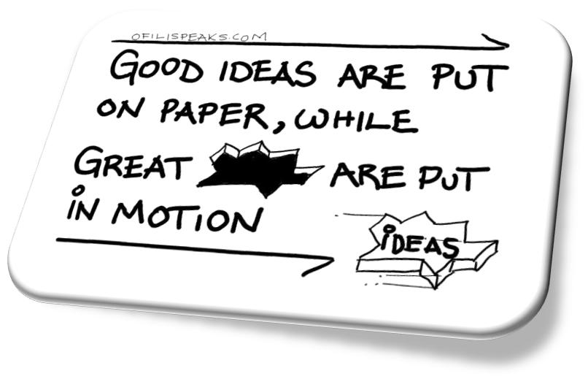
Overview
Context
Why work with industry?
Expectations
Thoughts – how can we improve?

Slide 20
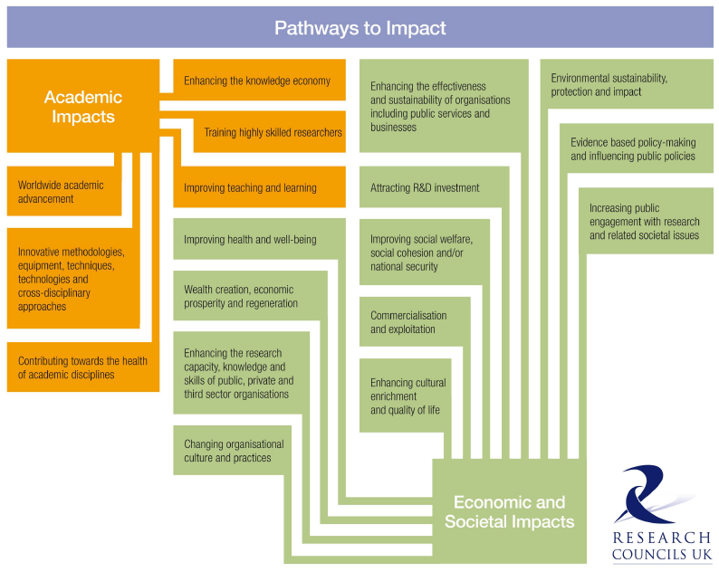

Slide 21
What does Stern report say:
Recommendation 5: Institutions should be given more flexibility to showcase their interdisciplinary and collaborative impacts by submitting ‘institutional’ level impact case studies, part of a new institutional level assessment.
Recommendation 6: Impact should be based on research of demonstrable quality. However, case studies could be linked to a research activity and a body of work as well as to a broad range of research outputs.
Recommendation 7:Guidance on the REF should make it clear that impact case studies should not be narrowly interpreted, need not solely focus on socio-economic impacts but should also include impact on government policy, on public engagement and understanding, on cultural life, on academic impacts outside the field, and impacts on teaching
Wider IMPACT interpretation?
Wider interdisciplinarty?

Slide 22
Why work with industry?
Funding opportunities – from iCASE to InnovateUK opportunities – obligate industry requirement.
Expertise & Infrastructure – opportunities that can’t be found in HEI
Impact – end-user engagement and uptake often good for Impact
Fun – asking real questions that are important to address.
Opportunity – collaboration, placement, secondment and revenue may arise.

Slide 23


Slide 24


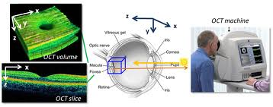



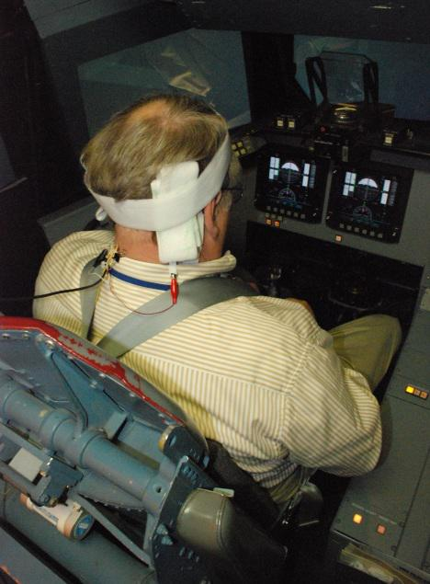


Wider university context?

Slide 25
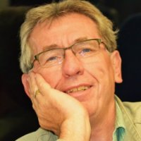




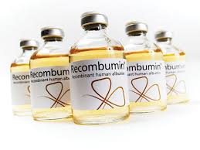


Impact and collaboration (1992-2014)

Slide 26
Business Interactions.
Many mechanisms for interaction:
Consultancy- university v non-university
(Co)-funded research (eg InnovateUK, Research Councils) – some require and or led by industry
Research Contracts (Short and Long Term)
Student Placements (Undergraduate and postgraduate)
In-house employee registration
Any combination of the above.

Slide 27
Resources that you should draw on in industrial ‘collaborations’.
Agreements – Non-Disclosure Agreements (NDA), Material Transfer Agreements (MTA), Collaboration agreements – have copies of all but often collaborators / externals will want them to use theirs.
Invention Disclosures – internal to enable evaluation (and ownership!) of any invention
Support letters and inputs (visits and meetings if required)
Budgets – e.g. for IP protection (often patents). Will always work with other institutions.
Exploitation agreements – licensing and spin-out

Slide 28
Lessons learnt on IMPACT (questions remaining)?
Earlier the publication the earlier the impact can be built
Impact is very variable – e.g. subject lags differ between a drug, a diagnostic and a protocol.
Still not sure which is best – bottom line revenue or social benefit (not mutually exclusive)
Impact doesn’t just happen – it needs managing and resourcing.
Evidence acquisition key.
Paper and patent(s) are NOT sufficient
Don’t presume people will tell you what you want to know when, and in a form, that you want it.
Decide ahead of time – not now but have to have firm ideas for 2017 for 2021.

Slide 29
Thoughts on (company) collaboration
Good collaborations based on good relationships at all levels but principally on personal level.
Have clear expectations and appreciate theirs
What company wants is not (always/ever) the same as what university wants
Timelines matter and generating goodwill can be very time consuming.
Ownership of IP may be VERY important (to them primarily)
Flexibility on costing but will not undersell.
Collaboration built on clarity and compromise

Slide 30
Our usual view of ownership (to prevent pipelining with public monies).
A
B
C
D
If company wishes to go from A to D and knows the steps/methodology for
B & C then they may rightfully claim all as Background IP.
If company wishes to go from A to D but does not know steps B & C then this
will be Foreground IP and we would make claim to (part) ownership.

Slide 31

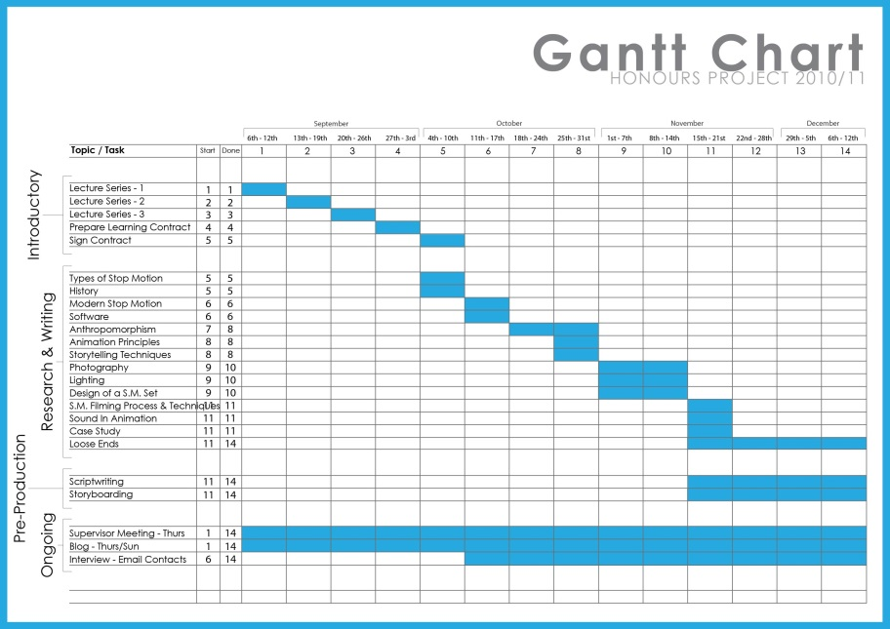
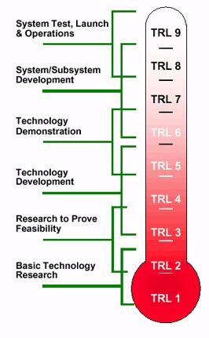



Comments

Slide 32
Questions?
Is industrial collaboration important to you?
Why / what do you want from it?
How might we (i.e. the institution) improve your opportunities to collaborate with external companies?
Has anything stopped you engaging with external companies?
How are you planning to improve impact?

Slide 33
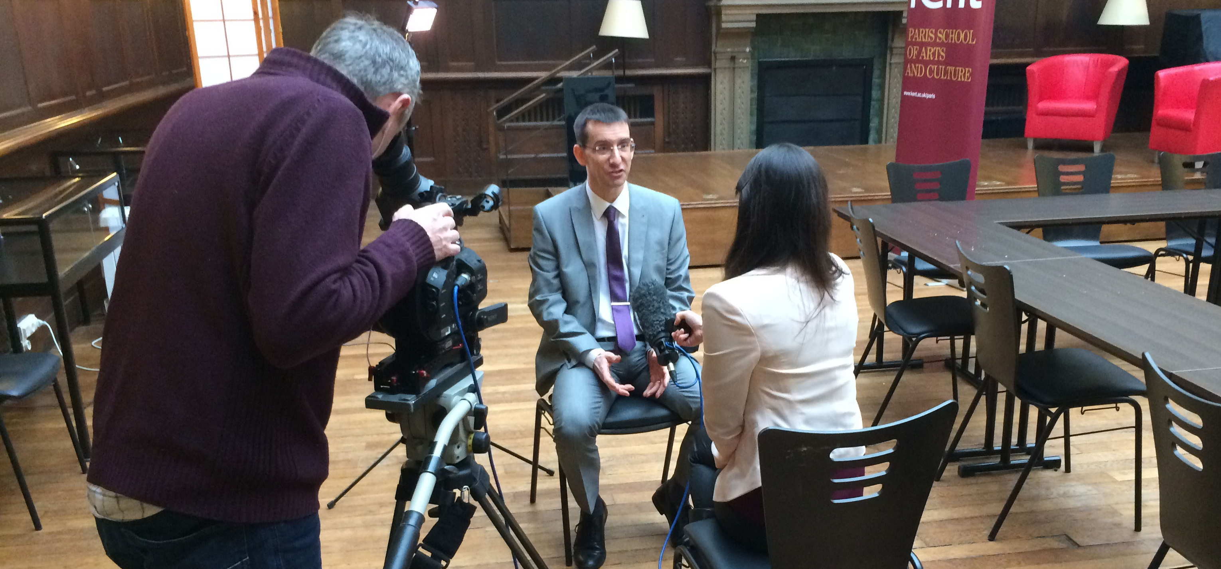
Working with the Media
Gary Hughes
Press Office, Corporate Communications
Notes:
V1.0
To change the footer on every slide:
1. On the menu go to Insert > Header and Footer…
2. Select the Footer checkbox and enter the footer text in the accompanying text box
3. Click “Apply to All”

Slide 34
What is media today?
news print/online & broadcasting
consumer
trade/specialist
local/regional
national
international

Slide 35
Why work with the news media?
best way to communicate with the public
communicating research to potential users
wider public debate
gain public support
be an expert
profile raising
potential funders or partners

Slide 36
Media Impact Survey
coverage would be part of REF submission – 59%
the impact of media work on ability to secure funding – 59%
changed approach to research – 25%
received invitations to speak/present – 51%
experienced increase in media requests – 59%
new requests for research collaboration – 51%
political impacts – 14%

Slide 37
What makes a good news story
timing
significance
superlatives
relevance
human interest
understanding

Slide 38
What a journalist (usually) wants to know
what
why
where
when
who
how much/many

Slide 39
Press Office contacts
Gary Hughes, Head of Press Relations
Sandy Fleming – Sports Science, SMAS, POLIR, SAC, Journalism, KSA, SECL
Martin Herrema – Pharmacy, Biosciences, SPS, Psychology, KLS, History, Arts & SMFA
Dan Worth – EDA, Computing, Medical School, SSPSSR, KBS, Economics, English
Karen Baxter – media monitoring, reports

Slide 40
Working together
media strategies
news angles & key messages
appropriate targets
appropriate medium
arrange interviews
advice
media training
reports

Slide 41
Do
get in touch
provide lay copy for complex research
state interview/media preferences
role in research
availability
contact details
partners/collaborators/publishers etc

Slide 42
Kent coverage 2017
almost 400 news releases or expert comments
almost 13,000 pieces of print and broadcast coverage
39 authors/58 articles in The Conversation
(to date 135 authors/315 articles)
print - 346 academic experts/PhDs from UK & BSIS
182 academic experts/PhDs interviewed by more than 204 unique radio/TV progammes

Slide 43
Feedback from researchers
‘Timeliness and professional approach to the press release.’
‘Very friendly. Very helpful. Very quick in contact. Very insightful. Very good summary of my work.’
‘Received strong coverage; gave the authors time to comment on and edit the press release.’
‘Very quick response time in terms of media coverage - was picked up immediately by multiple news channels.’

Slide 44
Notes:
This

