Slide 1
How does morality influence drug policy? Analysing drug policy constellations in the UK
Alex Stevens
Professor in Criminal Justice
University of Kent

Slide 2
This presentation
Research questions:
What moral commitments underly the policy positions that actors in UK drug policy debates support?
How do these ethico-political bases of drug policy shape the policy positions of policy actors?
Theory
The Police Constellations Approach
Methods
Critical realist discourse analysis
Two-mode social network analysis
Findings
The five ethico-political bases of UK drug policy
Mapping UK drug policy constellations and their ethico-political bases

Slide 3
Conclusion: morality in UK drug policy
UK drug policy constellations share the ethico-political base of compassion
They cluster around four other ethico-political bases
Traditionalism
Paternalism
Progressive social justice
Liberty
The most powerful constellations favour traditionalism (social control) and paternalism (public health).
They come together in the hyprid, medico-penal constellation.
This explains
The ongoing balance between paternalism and social control in UK drug policy
The usual exclusion of policy positions based on progressive social justice, or liberty, from UK drug policy decisions.

Slide 4
The Policy Constellations Approach
Policy constellations
set of social actors (individuals and organisations) who come together in deploying various forms of socially structured power to pursue the institutionalisation in policy of shared moral preferences and material interests. Constellations are not stable groups with fixed rules or memberships. They are fluid sets of actors who gravitate towards each other on the basis of shared preferences and norms.
Implications
Policy actors will tend to cluster together around shared policy preferences
These constellations will overlap when their normative preferences are compatible.
They will not collaborate with policy constellations with whom their normative preferences clash
The most successful positions in policy debates will be those that suit the normative commitments of the most structurally powerful constellations

Slide 5
Methods for studying policy constellations
Critical realist discourse analysis.
Analysis of texts and images to identify recurring narrative, tropes, factoids and policy positions
Assumes these discursive elements relate to an external world that has some reality outside discourse.
Assumes there are underlying generative mechanisms that produce this reality and discourse.
Two-mode social network analysis (SNA)
Mapping the connections between:
Policy actors (mode 1)
Policy positions (mode 2)
If theory correct, then it will be possible to identify constellations that cluster around shared normative bases.
Data
149 policy documents (2015-2021)
Interviews with 21 policy actors
Auto-ethnography of >10 years of my work in UK drug policy making

Slide 6
Five ethico-political bases of UK drug policy positions
Compassion
Traditionalism
Liberty
Paternalism
Progressive social justice

Slide 7
Five ethico-political bases of UK drug policy positions
Progressive social justice
Paternalism
Compassion
Liberty
Traditionalism

Slide 8
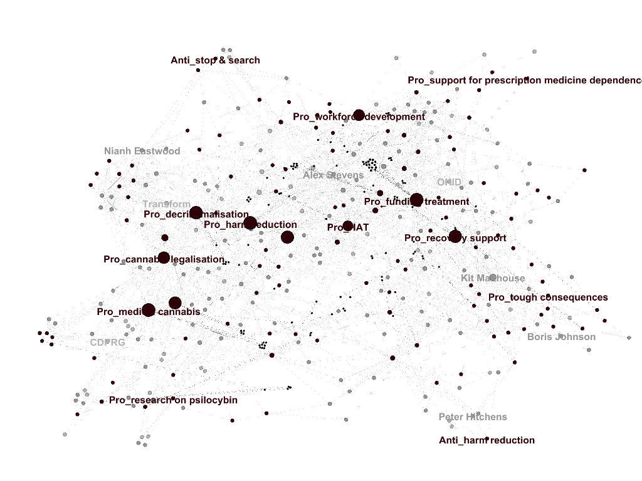
UK policy constellations: actors and positions

Slide 9
UK policy constellations: actors and positions

Slide 10
UK policy constellations: actors and positions

Slide 11
UK policy constellations: actors and positions

Slide 12
UK policy constellations: actors and positions

Slide 13
Progressive social
justice
Paternalism
Liberty
Traditionalism

Slide 14
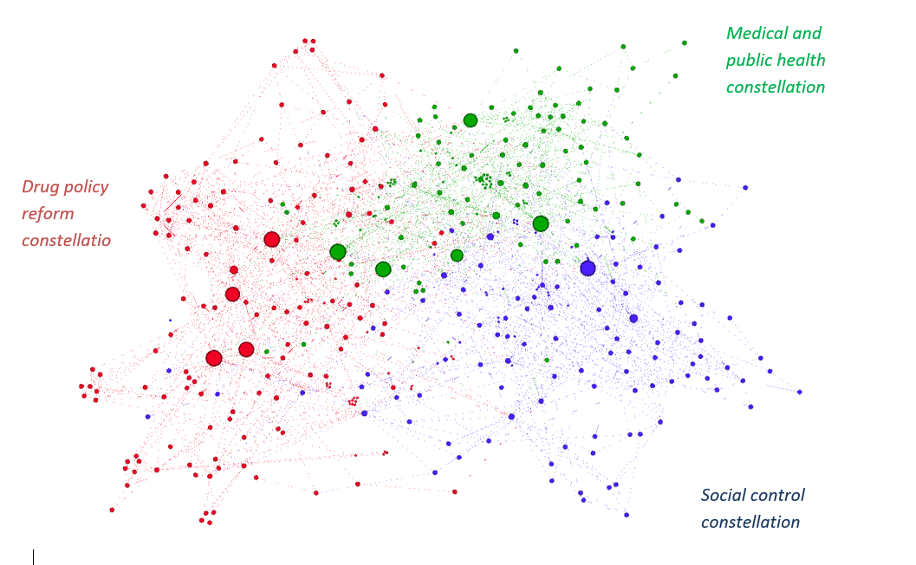
UK policy constellations: 3 macro constellations

Slide 15
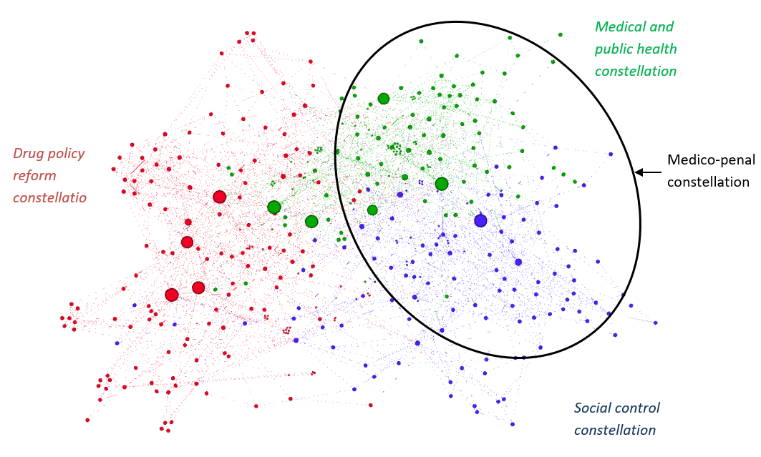
UK policy constellations: 3 macro constellations

Slide 16
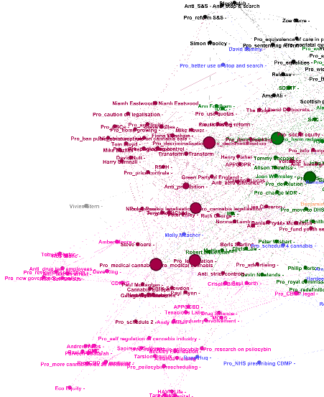
3 micro drug policy reform constellations

Slide 18
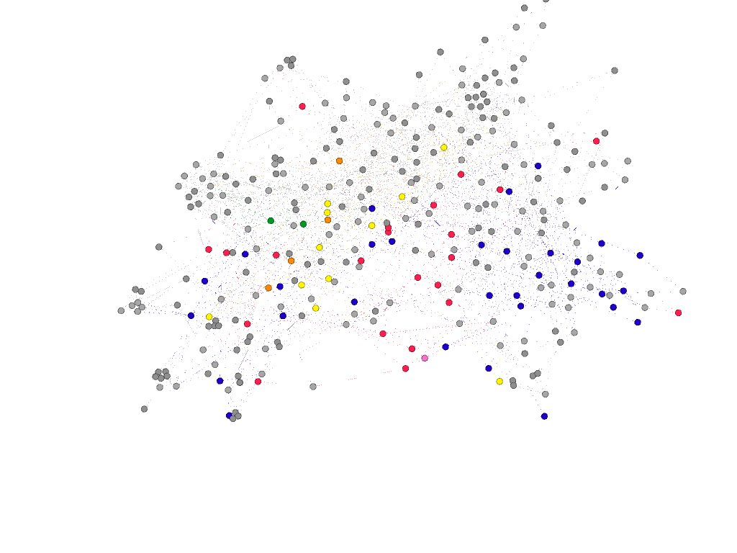
Policy positions by political party

Slide 19
Conclusion: morality in UK drug policy
UK drug policy constellations share the ethico-political base of compassion
They cluster around four other ethico-political bases
Traditionalism
Paternalism
Progressive social justice
Liberty
The most powerful constellations favour traditionalism (social control) and paternalism (public health).
They come together in the hyprid, medico-penal constellation.
This explains
The ongoing balance between paternalism and social control in UK drug policy
The usual exclusion of policy positions based on progressive social justice, or liberty, from UK drug policy decisions.

