Slide 1



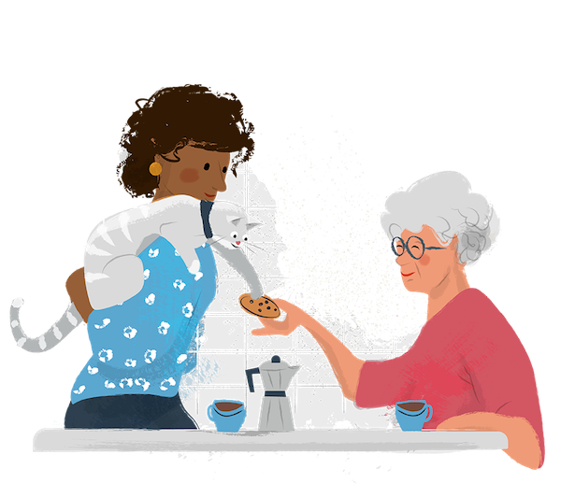
The role of adult social care services in individual and dyadic quality of life: perspectives from older carers and individuals they support
Dr Barbora Šilarová (she/her)
Grace Collins MSc¹, Dr Stacey Rand¹, Dr Wenjing Zhang² & Professor Alisoun Milne³
¹Personal Social Services Research Unit
²Centre For Health Services Studies
³School of Social Policy, Sociology and Social Research
University of Kent

Slide 2
Our Team
Grace Collins
Alisoun Milne
Stacey Rand
Barbora Silarova
Wenjing Zhang
Research Advisors: Christina Reading, Helen Ramsbottom & Della Ogunleye
Notes:
Our team includes seven members. And you met today Grace, Helen (Christina). The team is lead by Dr Stacey Rand. Other members include Professor Alisoun Milne and Dr Wenjing Zhang. As you heard from Christina we have also two research advisors X who is here today and Y who will join the meeting tomorrow.

Slide 3

Disclaimer
  This presentation reports independent research funded by the National Institute for Health and Care Research School for Social Care Research (NIHR SSCR).
  The views expressed in this presentation are those of the authors and not necessarily those of the National Institute for Health and Care Research or the Department of Health and Social Care.
  Images used from: free library showing ‘positive and realistic’ images of older people in a bid to challenge negative and stereotypical views of later life.

Slide 4
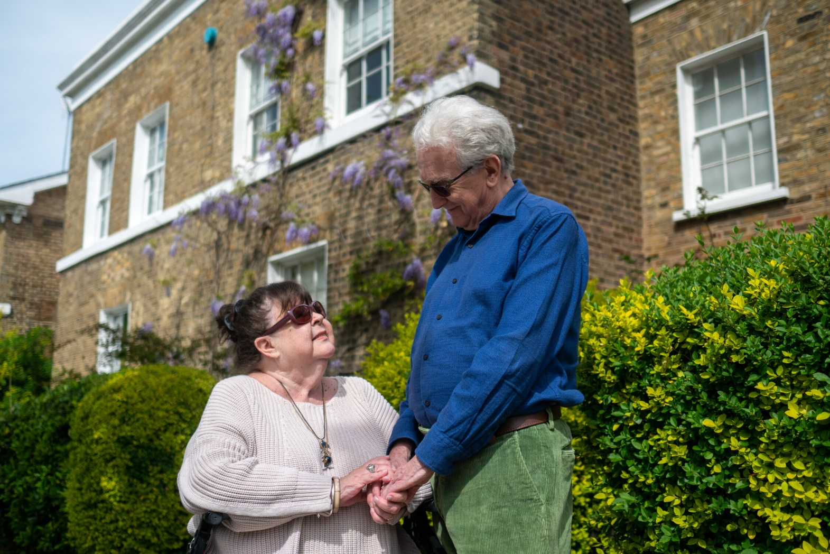
Background
Seven million of family members/friends in the UK supports someone with their day-to-day activities.
At least 20% of the seven million unpaid carers are aged over 65 years.
Older unpaid carers have their own specific needs.
Notes:
Support provided by family/friend carers is a vital part of care for people with dependency needs. Most carers are of
working age, however, carers aged 65 years and older are the fastest growing group. These older carers make up at
least 20% of the seven million carers in the UK.

Slide 5

Community based social care and support
Aims to support a person to stay at home and maintain their independence, links with local community, and wellbeing.
Paid for by people who need services and their families and/or by the local council's social services department.
Examples: help at home from a paid carer; meals on wheels; having home adaptations; day centre; lunch clubs; carers’ groups etc.
Notes:
But often understood as the impact on the person with support needs, not the carer or ’dyad’ (carer and the person they support together)

Slide 6
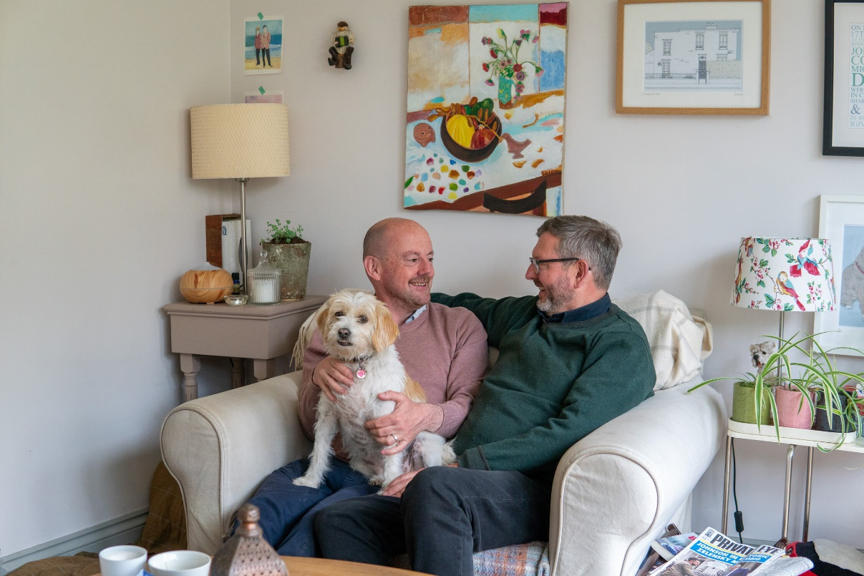
Aims
to understand the quality of life of older carers and the people they support – on an individual and dyadic level;
to understand the role of services in quality of life of older carers and the people they support – on an individual and dyadic level.

Slide 7




Methods – Semi-structured interviews
In the interview, we asked the carer and the person they supported about their everyday experiences.
For each of these, we also talked about whether and how community-based support made a difference in their lives.
Safety
Occupation
Social participation
and involvement
Control over daily living

Slide 8
Inclusion criteria:
Carers and the person they supported (pair)* could take part if they lived together and the carer was aged 65 years or over
Used at least one type of social care community based service
Able to consent and able to engage in interviews in English
Have to live in England
*Carers could take part on their own
Recruitment period:
19th April until 31st December 2021

Slide 9

Preliminary Results

Slide 10
Participants
Carers (n=27): 75.1 years (SD:6.8; 67-95); 48% (n=13) females; 88.9% (n=24) White/White British; 88.9% (n=24) cared for their spouse/partner; 66.7% (n=18) provided 50+hours per week of care; 22% (n=6) provided care 24/7; 29.6% (n=8) provided ≥ 10 years of care
Service users (n=27): 75.2 years (SD: 12.8; 29-99 years old); 52% (n=14) females, 92.6% living with dementia
Care services: 70.4% (n=19) of participants paid for the social care services either in full or a contribution

Slide 11
Community based social care and support
Figure 2. ASCOT for Carers
Table 1. The use of adult social care services
Variable | N (percentage)
Support or services used over the last 12 months
Information and advice | 19 (70.37%)
Support or services allowing a break from caring | 17 (62.96%)
Home care/home help | 14 (51.85%)
Day centre/day activities | 7 (25.93%)
Lunch club | 2 (7.41%)
Meals services | 0 (0%)
Equipment or adaptation to the home | 16 (59.2%)
Lifeline alarm | 4 (14.81%)
Support from a carers organisation | 19 (70.37%)

Slide 12
Framework analysis
Experience of health care and adult social care services
Help from family, friends etc.
Routine
Relationship
Dilemmas related to receiving social care services
Impact of COVID

Slide 13
Experience of health care and adult social care services
 | Recommendation
Unpaid carers | Power of attorney Memory books Emergency arrangements Sharing the routine with e.g. respite care staff
Family, friends, neighbours | Initiate social activities
Local authority (social services department) | Clear information regarding attendance allowance, a council tax reduction etc. List of available services/help to navigate the adult social care services
Community based adult social care services | Provision of the activities on the same day/time Provision of same paid carers
Assessment of needs | Provision of assessment to unpaid carers
Health care services | Awareness of dementia
Government | Adequate funding

Slide 14
Routine
‘Yeah, how do I explain it? I mean, again, everything has been so incremental. What I’m doing now is my new norm, so...
….No, it’s – I try to work it round so that – I mean once he’s finished his phone calls he’ll go and have a lie down. While he’s lying down, and resting, recovering from that, I won’t do anything that makes a noise.’
ID:008_c, carer, female, cares for husband
‘I have my routines and I follow my routines. Every Wednesday I go for a walk with the ramblers, and I do other things as well. There’s a routine and, yeah, I’m not being told to do anything or forced – well, she’ll ask me to do some things but, yeah.’
ID:008_cr, male, supported by wife

Slide 15
Relationship
‘I would say my time, yes. And the reason why I say that is because he gets a bit clingy. If I’m in the kitchen, sometimes I’ll have to come in the spare room to kind of separate myself that I can think.’
ID:015_c, carer, female, cares for husband
‘…..if it is your wife or your partner that is the carer, you have to realise that they see things differently. So that’s there, and I think the longer it will go on, I think the gap between myself and my wife in relation to that will close because I’ll be more dependent on her.’
ID:015_cr, male, supported by wife

Slide 16
Dilemmas related to receiving social care services
‘He's not very keen on the day centre, because they're old and they don't – you don't have as much banter. And there's not as much interaction and everything. But the Tuesdays and the Wednesdays have this – they call it something else now. They've got little groups now and he's used to the groups.’
ID:019_c, carer, female, cares for husband
‘I mean I – I went to visit some Alzheimer’s groups but most of them were very old people and they weren’t the young ones. And so, you know, it was no use to me at all.’
ID:008_cr, male, supported by wife

Slide 17
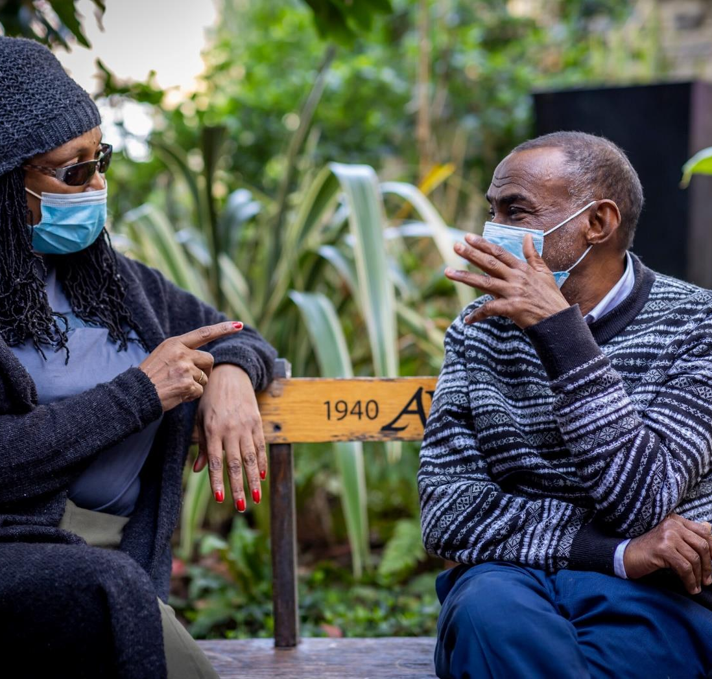
Impact of COVID
Social contact with family and friends
Feeling safe
Death of a family member, friend
Occupation (including voluntary work and hobbies)
Levelling up the field
Getting COVID
Routine
Assessment
Change in delivery of services provision

Slide 18
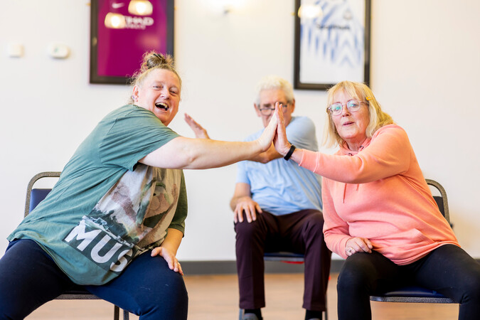
Next steps
Finalising the results in summer 2022
DYADS project online event: 19th September 2022, 1.30 to 3pm
the DYADS study

Slide 19


Thanks for your attention!
Contact: b.silarova@kent.ac.uk
@BarboraSilarova

