Slide 1
Measuring the social care outcomes of people with dementia and carers
Dr Stacey Rand¹, Dr Barbora Silarova¹, Ann-Marie Towers² &
Professor Karen Jones¹
¹ Personal Social Services Research Unit (PSSRU), University of Kent
² Centre for Health Services Research (CHSS), University of Kent

Slide 2


Disclaimer
  This presentation presents independent research funded by the NIHR under its Research for Patient Benefit (RfPB) Programme (Grant Reference Number: NIHR200058).
  The views expressed are those of the author(s) and not necessarily those of the NIHR or the Department of Health and Social Care.

Slide 3
Background
Over 767,000 people living with dementia in England and Wales
  The majority (approx. 2/3rds) live in own home
    Maintain independence, community connections & familiar environment
    Role of community-based care in supporting people with dementia and their carers
They are at risk of exclusion from social care data collections used to inform policy and decision-making
  Adult Social Care Survey (ASCS)
    Annual self-completion postal survey of social care service users
    Used to generate indicators in the Adult Social Care Outcomes Framework (ASCOF)
    Guidance to exclude people who lack capacity, but…
      Approx. 10% response ‘by proxy’, on behalf of the person without their consultation

Slide 4
Background
Adult Social Care Outcomes Toolkit (ASCOT)
  A measure of social care-related quality of life
  ASCOT is collected in the Adult Social Care Survey (ASCS) in England
  Reported as ASCOF 1A
Adult Social Care Outcomes Toolkit for Carers (ASCOT-Carer)
  An expanded version of the Carer SCRQoL, which is collected in the Survey of Adult Carers in England (SACE)
  Reported as ASCOF 1D
Improving inclusion and representativeness of national surveys (and social care research) is a priority.

Slide 5
Development of the ASCOT-Proxy
  What are the key issues related to proxy-report?
    Focus groups and interviews with potential proxy respondents (Caiels et al, 2019)
      Carers (n=8, semi-structured interviews)
      Care workers (n=35, in 8 focus groups)
    Literature review (Caiels and Rand, 2015)
  Adapting the ASCOT to a proxy-report version
    Semi-structured interviews based on the draft questionnaire (Rand et al, 2018)
      Three iterative rounds of interviews with paid care workers and carers (n=25)
      Cognitive interview method (‘think aloud’ with probes)

Slide 7
Development of the ASCOT-Carer
  Semi-structured interviews with carers (n=31) (Rand et al, 2012)
  Interview survey of carers (n=387) (Rand et al, 2015)
    But only a small subsample of carers of people with dementia (n=61)

Slide 8
Aims and objectives
To evaluate psychometric properties of ASCOT-Proxy* & ASCOT-Carer
  Feasibility
  Construct validity
  Structural characteristics
  Test-retest reliability. This aspect of the study was dropped due to the pandemic.
    * For both proxy perspectives (proxy-proxy, proxy-patient)
Notes:
Proxy perspectives (The instrument uses two different perspectives for rating – proxy-proxy or proxy-patient. Which should be used/reported?
Feasibility (Is it acceptable/feasible to complete? Use missing data as an indicator.)
Construct validity (i.e. do the instruments measure what we expect them to?)
Structural validity (i.e. do the individual questions/items form a single scale? Are there subscales?)
Note: These are interim findings so will focus on proxy perspectives, feasibility and construct validity.

Slide 9
Methods
A survey of carers of people with dementia in England (n=313)
  Survey conducted from January 2020 to April 2021
    Inclusion criteria
      Unpaid carer of a person living with dementia…
      who uses social care services (e.g. home care, day activities)…
      and lives at home
    Recruited via Join Dementia Research (JDR), local carers organisations, NHS sites
  Questionnaire by postal survey or online (Qualtrics)
    Individual characteristics for the carer (self-report) & person with dementia (proxy-report)
      e.g. age, ethnicity, social care service use, self-rated health, I/ADLs
    ASCOT-Proxy, ASCOT-Carer and other measures
      e.g. EQ-5D, DEMQOL-Proxy, C-DEMQOL

Slide 10
 | N (%)
Male | 76 (24.3%)
Age ≥65 years | 137 (43.8%)
Ethnicity: White British | 296 (94.6%)
MDS-CPS: severe or very severe | 185 (59.1%)
Care recipient ADLs with difficulty
1-4 ADLs | 123 (39.3%)
5-7 ADLs | 86 (27.5%)
All 8 ADLs | 101 (32.2%)
missing data | 3 (1.0%)
Co-resident with care-recipient | 181 (57.8%)
Hours of informal care / week:
0-19 hours | 95 (30.4%)
20-50 hours | 68 (21.6%)
≥50 hours | 147 (47.0%)
missing data | 3 (1.0%)
Completed survey online | 250 (79.9%)
The majority cared for parent (48.9%) or spouse/partner (41.5%).
Home care was most commonly-used service (67.7%). Other types of support: equipment or adaptations (55.8%), day activities (31.1%), short-breaks e.g. sitting service (24.4%).

Slide 13
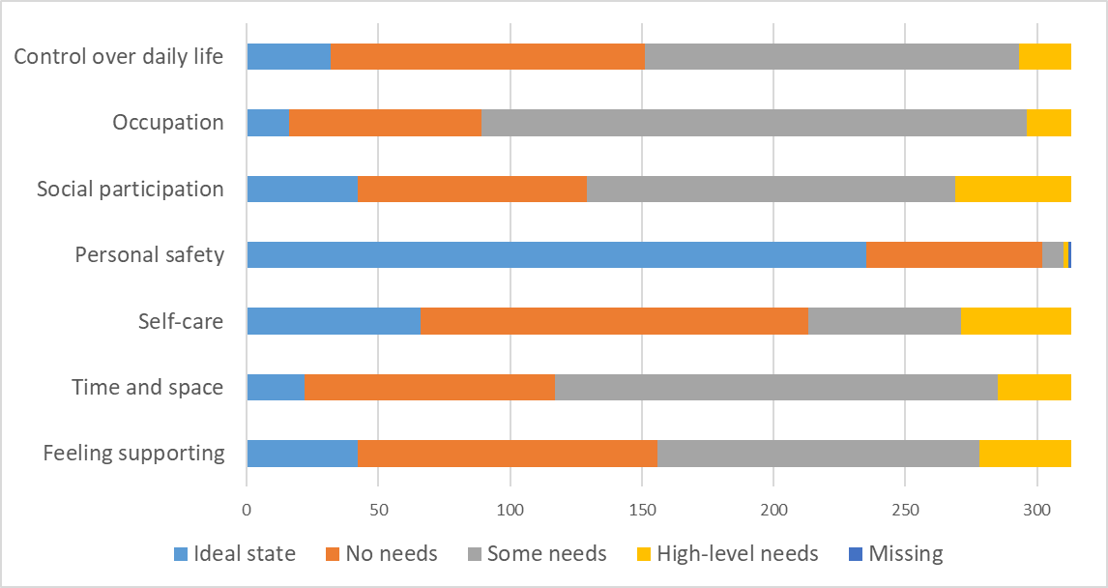

Slide 14
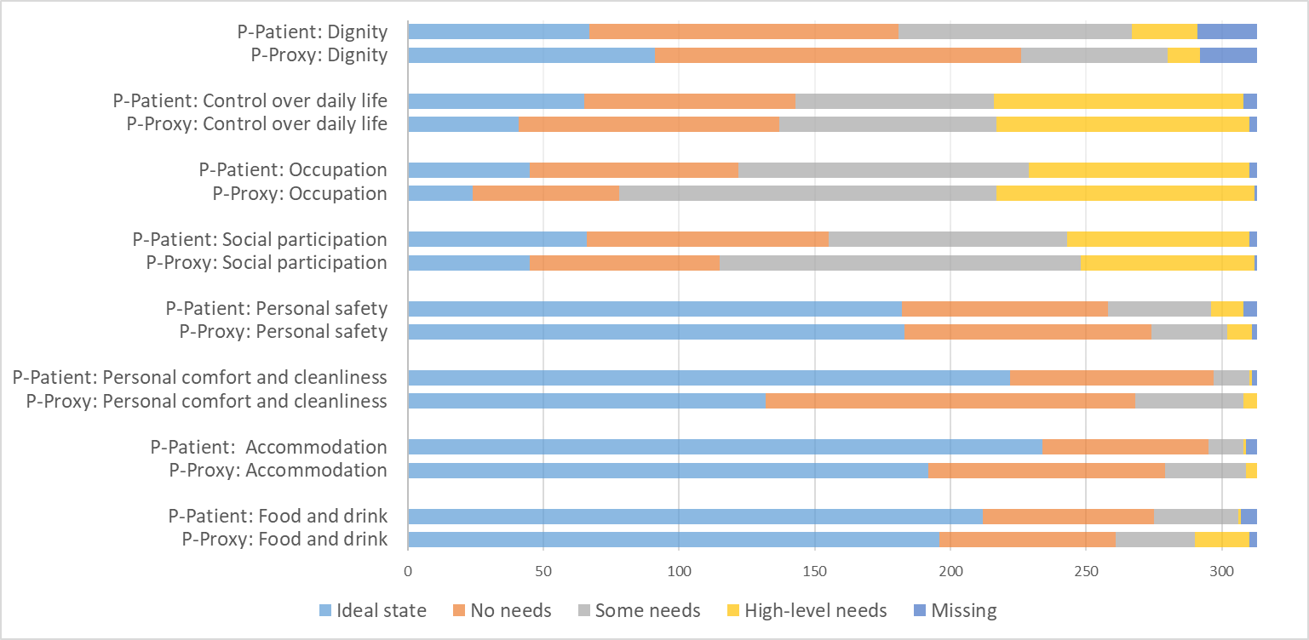

Slide 15
Preliminary findings for ASCOT-Carer
Evidence of good internal reliability (Cronbach’s α = .82)
Construct validity
  Strong to moderate positive correlation with measures of related constructs
    Dementia carer-related QoL (C-DEMQOL) (+ve, strong)
    Overall QoL (+ve, strong)
    Health-related QoL (EQ-5D-3L) (+ve, moderate)
  Correlations with factors hypothesized to be related to social care-related QoL
    Satisfaction with services (+ve, moderate)
    Intensity of service use (home care hrs, per week) (+ve, weak)
    Number of informal care hours per week (-ve)
Structural characteristics
    Confirmatory factor analysis (CFA) based on Rand et al, 2015
      Good fit statistics (i.e. TLI/CFI > .95, SRMR < .08, RMSEA < .06)
Notes:
Rand et al, 2015 = Seven items onto single factor (SCRQoL) with covariance of errors for safety & self-care
Standardized Root Mean Square Residual (SRMR)
Tucker-Lewis Index (TLI)
Comparative Fit Index (CFI)
Root Mean Square Error of Approximation … Hu and Bentler (1999): RMSEA < 0.06

Slide 16
Next steps
Further analysis of ASCOT-Proxy:
  Internal reliability
  Construct validity
  Structural characteristics
  Difference between proxy perspectives
  Effect of mode of administration (online vs postal)
Discussion with Social Services User Survey Group to inform whether and how to adopt ASCOT-Proxy into the ASCS
Integration of ASCOT-Proxy into ASCOT online resources: www.pssru.ac.uk/asocot.

Slide 17
Email: s.e.rand@kent.ac.uk www.pssru.ac.uk
Any questions?

