Slide 1
Copyright Literacy in the UK: Results from a survey of library and information professionals
https://ukcopyrightliteracy.wordpress.com @UKCopyrightLit
Jane Secker and Chris Morrison
LSE and University of Kent
European Conference on Information Literacy, Tallinn, Estonia 19-23 October 2015
Notes:
Very briefly – attended the session last year – ran the survey in December 2014 in the UK

Slide 2
Copyright
Notes:
Jane to provide a background to study (e.g. presentation at ECIL).
Explain why we should study this now (e.g. copyright reform and position of libraries).
Something about how even back in 1993 Follett Review of Libraries recognised the increasingly important role librarians would play in copyright issues – related to the electronic environment
Mention the previous study by Oppenheim

Slide 3
Copyright? ZZZZZZZZZZZZ
Notes:
Acceptance that quite a lot of discussion about copyright is dry and sends people to sleep. Sets us up for the Play your Cards Right section.

Slide 4
Play your cards right
Notes:
At this point we say – let’s liven things up and make a game out it
Jane to hand out cards

Slide 5
Play your cards right
Moderate to Extreme ©
Confidence UK
Moderate to Extreme ©
Confidence Europe*
% think ©
Policy Important UK
% who have ©
Policy
UK
% think ©
Policy Important Europe*
% who have ©
Policy
Europe*
*European countries surveyed: Bulgaria, Croatia, France, Turkey

Slide 6
Play your cards right
Moderate to Extreme ©
Confidence UK
Moderate to Extreme ©
Confidence Europe
% think ©
Policy Important UK
?
50%
% who have ©
Policy
UK
% think ©
Policy Important Europe
% who have ©
Policy
Europe

Slide 7
Play your cards right
Moderate to Extreme ©
Confidence Europe
% think ©
Policy Important UK
Moderate to Extreme ©
Confidence UK
57%
50%
% who have ©
Policy
UK
% think ©
Policy Important Europe
% who have ©
Policy
Europe

Slide 8
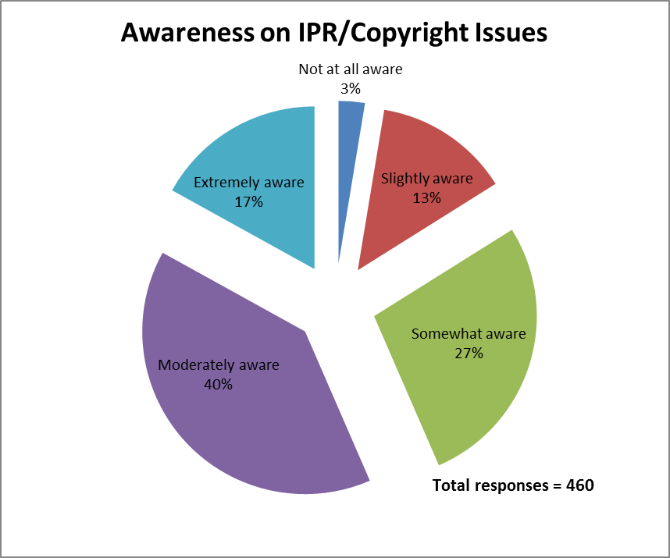

Slide 9
Play your cards right
Moderate to Extreme ©
Confidence Europe
% think ©
Policy Important UK
Moderate to Extreme ©
Confidence UK
57%
% who have ©
Policy
UK
% think ©
Policy Important Europe
% who have ©
Policy
Europe

Slide 10
Play your cards right
% think ©
Policy Important UK
Moderate to Extreme ©
Confidence UK
57%
Moderate to Extreme ©
Confidence Europe
33%
% who have ©
Policy
UK
% think ©
Policy Important Europe
% who have ©
Policy
Europe

Slide 11
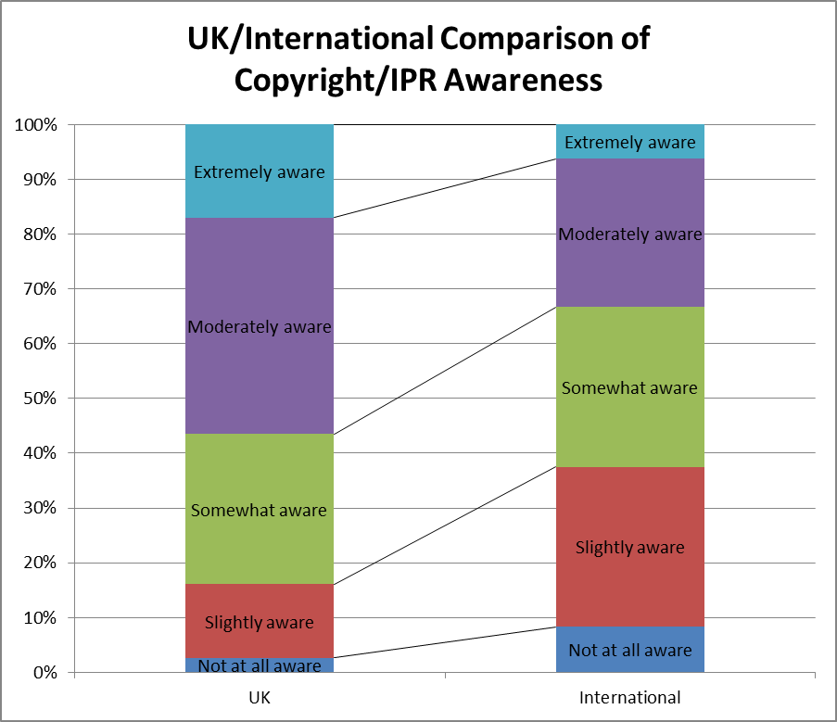
Notes:
Note – we don’t have access to the full data so this isn’t really that accurate a comparison – The Todorova statistics (p.143) only add up to 96% so I’m assuming that the other 4% didn’t answer. This is in contrast to our findings where 25% didn’t answer this question. However we had 460 responses.
Todorova does say that of the international responses the self-evaluated awareness level is lowest for Croatian and Bulgarian respondents and highest for the French. The Turkish respondents had moderate levels of awareness.

Slide 12
Play your cards right
% think ©
Policy Important UK
Moderate to Extreme ©
Confidence UK
57%
Moderate to Extreme ©
Confidence Europe
33%
% who have ©
Policy
UK
% think ©
Policy Important Europe
% who have ©
Policy
Europe

Slide 13
Play your cards right
Moderate to Extreme ©
Confidence UK
57%
Moderate to Extreme ©
Confidence Europe
33%
% think ©
Policy Important UK
76%
% who have ©
Policy
UK
% think ©
Policy Important Europe
% who have ©
Policy
Europe

Slide 14
Play your cards right
Moderate to Extreme ©
Confidence UK
57%
Moderate to Extreme ©
Confidence Europe
33%
% think ©
Policy Important UK
76%
% who have ©
Policy
UK
% think ©
Policy Important Europe
% who have ©
Policy
Europe

Slide 15
Play your cards right
Moderate to Extreme ©
Confidence UK
57%
Moderate to Extreme ©
Confidence Europe
33%
% think ©
Policy Important UK
76%
% think ©
Policy Important Europe
% who have ©
Policy
Europe
% who have ©
Policy
UK
63%

Slide 16
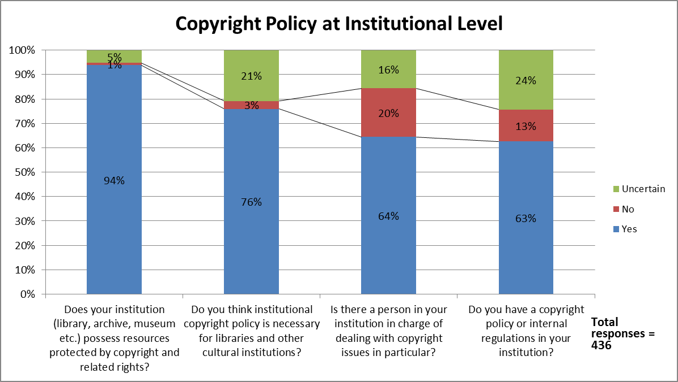
Notes:
Just mention the comparison with overseas institutions rather than show another slide. 71% in the Todorova report said they had no personnel specifically appointed to be in charge of copyright issues.

Slide 17
Play your cards right
Moderate to Extreme ©
Confidence UK
57%
Moderate to Extreme ©
Confidence Europe
33%
% think ©
Policy Important UK
76%
% think ©
Policy Important Europe
% who have ©
Policy
Europe
% who have ©
Policy
UK
63%

Slide 18
Play your cards right
Moderate to Extreme ©
Confidence UK
57%
Moderate to Extreme ©
Confidence Europe
33%
% think ©
Policy Important UK
76%
% who have ©
Policy
Europe
% who have ©
Policy
UK
63%
% think ©
Policy Important Europe
84%

Slide 19
Play your cards right
Moderate to Extreme ©
Confidence UK
57%
Moderate to Extreme ©
Confidence Europe
33%
% think ©
Policy Important UK
76%
% who have ©
Policy
Europe
% who have ©
Policy
UK
63%
% think ©
Policy Important Europe
84%

Slide 20
Play your cards right
Moderate to Extreme ©
Confidence UK
57%
Moderate to Extreme ©
Confidence Europe
33%
% think ©
Policy Important UK
76%
% who have ©
Policy
UK
63%
% think ©
Policy Important Europe
84%
% who have ©
Policy
Europe
29%

Slide 21
The united kingdom
Why the higher response rate in the UK (613 started, 417 complete responses)?
Why do LIS Professionals have higher confidence in the UK in terms of copyright literacy than elsewhere in Europe ?
UK institutions are more likely to have a dedicated Copyright Officer and an institutional policy. However this study doesn’t really examine what they do, whether makes a difference.
Why are UK institutions not aware of international jurisdictions or organisations (e.g. WIPO, EIFL) working in this area?
Notes:
We had a high response rate in the UK survey (600 + respondents)
LIS Professionals have higher confidence in the UK in terms of copyright literacy than elsewhere in Europe (to date). But why is this? Probably political, social and economic factors. Could be the CLA licence. Pick up on potential issues with parochialism.
UK institutions are more likely to have a dedicated Copyright Officer and an institutional policy. However this study doesn’t really examine whether this helps.
But UK institutions not aware of international jurisdictions or organisations working in this area.

Slide 22
LIS Education and CPD
Topic / Issue | LIS Education | LIS CPD
Overview of UK copyright legislation | 68 | 48
Recent updates to the law | 6 | 67
Copyright exceptions / relation to licences | 43 | 23
Practical application of copyright law | 34 | 30
Digital copyright / copyright and the internet | 33 | 20
Creative Commons / copyleft | 31 | 15
Fair dealing | 27 | 16
Specific Licensing schemes e.g. CLA, ERA | 27 | 15
As per previous answer | 0 | 41
Exceptions for libraries | 24 | 15
Open access and institutional repositories | 23 | 15
International copyright law | 20 | 14
Licensing of digital resources | 20 | 13
How to protect IP | 16 | 17

Slide 23
EDUCATION & CPD

Slide 24
Education & cpd: what should it cover?
General copyright awareness / copyright duration/ using images /fair dealing and quotation / digital content rights / creative commons / understanding terms & conditions & re-use licenses / implications of non-compliance (but in a good way using carrot not stick)…. Whatever it is it needs to be clear and as jargon free as possible to stop people glazing over.

Slide 25
Education & cdp: what should it cover?
General copyright awareness / copyright duration/ using images /fair dealing and quotation / digital content rights / creative commons / understanding terms & conditions & re-use licenses / implications of non-compliance (but in a good way using carrot not stick)…. Whatever it is it needs to be clear and as jargon free as possible to stop people glazing over.

Slide 26
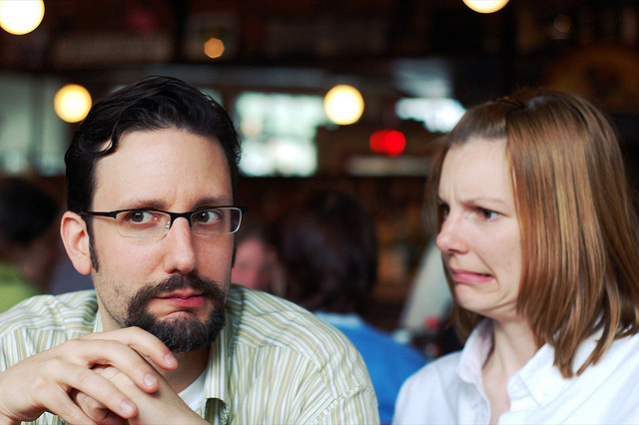
Feel the fear
I think copyright can seem daunting if you are not familiar with it, and by encouraging an awareness at an early stage, this would reduce any anxieties to follow.
I find that people are often scared of copyright…

Slide 27
Focus on positives
Copyright education should:
…reflect the fact that most LIS practitioners have significant exemptions and freedoms as regards copyright. Much existing copyright education is effectively written from a commercial rightsholder perspective and tends to be unduly dogmatic as a result.
Notes:
Exceptions

Slide 28
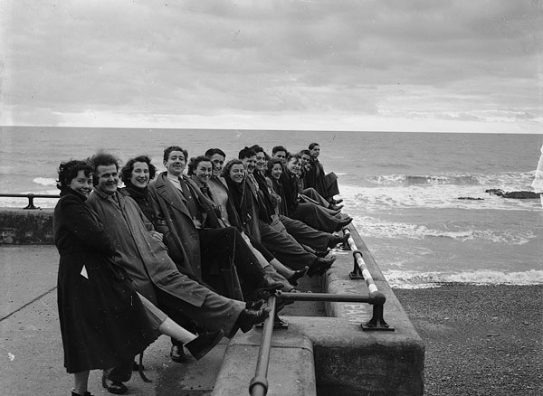
Embedding in LIS education
I have just finished my MSc and we had limited information on copyright law provided, the little I know I know because colleagues have shared it with me.
I don't remember copyright issues being addressed at all in my Postgraduate course and I think this was unfortunate.

Slide 29
Keeping up to date
…I still need to know what I am allowed to do and for whom, especially as digitisation has changed the field completely. We need updates on how legislation has changed and what a difference this makes to our work.

Slide 30
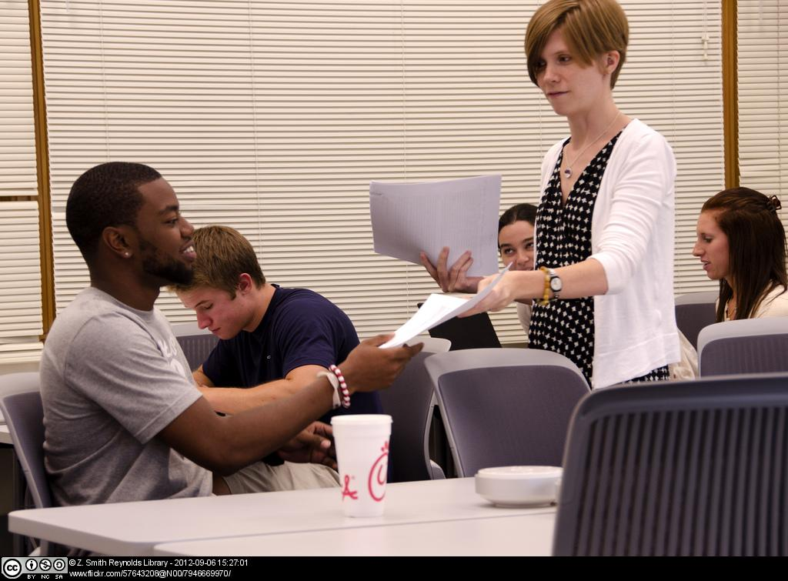
Train the trainers
Encouraging more general awareness of copyright issues so librarians/info specialists can educate academics about complying with copyright law. Also practical awareness for students’ creative work and using [copyright] material in their own work.

Slide 31
So what are we doing?
We’re on a mission to make copyright engaging, fun and empowering…
Notes:
Find new image to describe the engagement Jane and Chris are doing
OK we need a photo – I have a hat and shades, you need one too
Speaking to as many people as possible
- Lobbying CILIP

Slide 32
Engagement*
*No endorsement implied
Notes:
Talk about CILIP and LIS education initiatives
Looking to create an online course which integrates with other things
Talk about how we have also taken this to the rightsholder community – building trust and convincing publishers that librarians aren’t anarchists (well, not all of them)

Slide 33
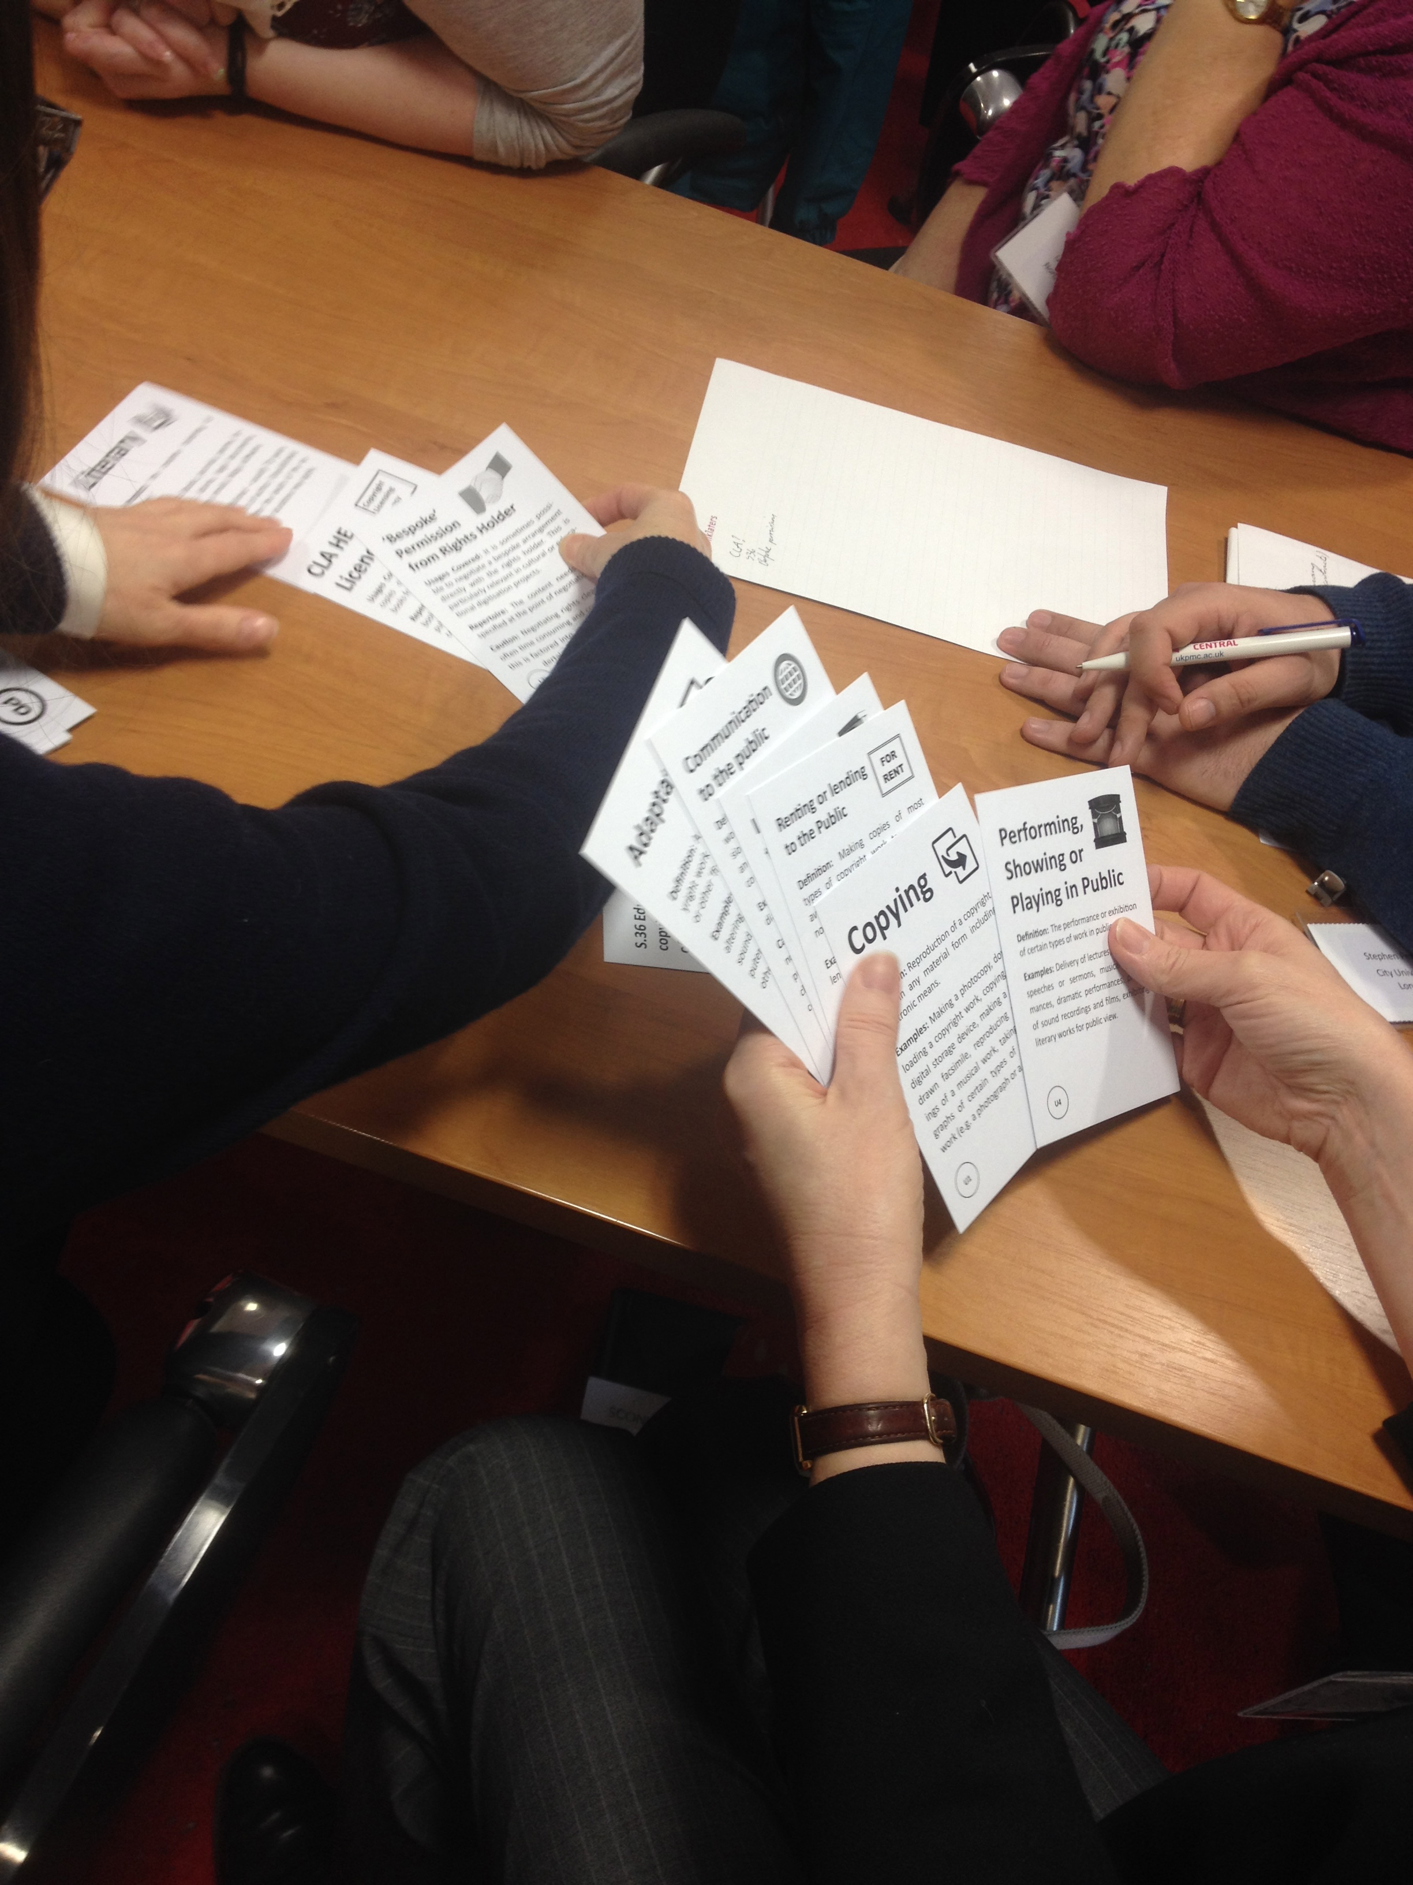
Copyright card game
Designed to teach librarians about copyright works, usages, licences and exceptions
Making copyright interactive and engaging
Downloaded over 1,800 times and consistently positive feedback
Creative Commons Licensed
Notes:
We are interested in talking to you if you would like to adapt it for another country and would be happy to have an all expenses paid trip to your country!

Slide 34
Conclusions and further research
Need for more cross-national analysis
Librarians likely to compare favourably to other professionals?
Need more qualitative data to investigate
How copyright literacy is effectively embedded in education
How to develop a effective approach to copyright literacy
Understand the role of the generalists vs dedicated copyright professional
More engaging training

Slide 35
Conclusions and further research
Need for more cross-national analysis
Librarians likely to compare favourably to other professionals?
Need more qualitative data to investigate
How copyright literacy is effectively embedded in education
How to develop a effective approach to copyright literacy
Understand the role of the generalists vs dedicated copyright professional
More engaging training

Slide 36
Conclusions and further research
Need for more cross-national analysis
Librarians likely to compare favourably to other professionals?
Need more qualitative data to investigate
How copyright literacy is effectively embedded in education
How to develop a effective approach to copyright literacy
Understand the role of the generalists vs dedicated copyright professional
More engaging training

Slide 37
Conclusions and further research
Need for more cross-national analysis
Librarians likely to compare favourably to other professionals?
Need more qualitative data to investigate
How copyright literacy is effectively embedded in education
How to develop a effective approach to copyright literacy
Understand the role of the generalists vs dedicated copyright professional
More engaging training

Slide 38
Conclusions and further research
Need for more cross-national analysis
Librarians likely to compare favourably to other professionals?
Need more qualitative data to investigate
How copyright literacy is effectively embedded in education
How to develop a effective approach to copyright literacy
Understand the role of the generalists vs dedicated copyright professional
More engaging training

Slide 39
Conclusions and further research
Need for more cross-national analysis
Librarians likely to compare favourably to other professionals?
Need more qualitative data to investigate
How copyright literacy is effectively embedded in education
How to develop a effective approach to copyright literacy
Understand the role of the generalists vs dedicated copyright professional
More engaging training

Slide 40
Conclusions and further research
Need for more cross-national analysis
Librarians likely to compare favourably to other professionals?
Need more qualitative data to investigate
How copyright literacy is effectively embedded in education
How to develop a effective approach to copyright literacy
Understand the role of the generalists vs dedicated copyright professional
More engaging training

Slide 41
Image Credits
Images from Flickr licensed under Creative Commons
Slide 24-25: Microsoft clip art
Slide 26: If you are not confused https://flic.kr/p/frJ48
Slide 27: Open: https://flic.kr/p/mzqM
Slide 29: Video tape archive storage https://flic.kr/p/aUgdnB
Slide 30: Z Smith Reynolds Library https://flic.kr/p/d7dL8d
Slide 31: Back to back https://flic.kr/p/8NCuPU
Others
Slide 28: Views of Aberystwyth from National Library of Wales (no known copyright)
Slide 32: Logos owned by respective organisations, no endorsement implied
Slide 33 by Jane Secker licensed under CC-BY-SA

Slide 42
References and futher reading
Morrison, C. (2015) Copyright the Card Game. Retrieved on July 20, 2015 from: http://find.jorum.ac.uk/resources/19369
Morrison, C and Secker, J (2015) Copyright Literacy in the UK: a survey of librarians and other cultural heritage sector professionals. Library and Information Research. (forthcoming)
Morrison, C. & Secker, J. (2015) Copyright Literacy Survey: high level summary. Available at: https://janesecker.files.wordpress.com/2015/06/copyright-literacy-uk-high-level-summary-report-morrison-secker-20151.pdf
Oppenheim, C. & Woodward, I. (2004). A survey of copyright advice and guidance in UK higher education libraries. Library and Information Research, 28, (89). Retrieved July 13, 2015 from http://www.lirgjournal.org.uk/lir/ojs/index.php/lir/article/view/167/214
Secker, J. (2010) Copyright and E-learning: a guide for practitioners. Facet Publishing: London (2nd edition with Chris Morrison coming in 2016)
Teaching in a Digital Age (2015). University of London International Programmes. Retrieved July 18, 2015 from: https://tda23things.wordpress.com/
Todorova, T., Trencheva, T., Kurbanoğlu, S., Dogan G., & Horvat, A. (2014) A Multinational Study on Copyright Literacy Competencies of LIS Professionals. Presentation given at 2nd European Conference on Information Literacy (ECIL) held in Dubrovnik. October 2014. Retrieved March 13, 2015 from http://ecil2014.ilconf.org/wp-content/uploads/2014/11/Todorova.pdf
https://ukcopyrightliteracy.wordpress.com
Notes:
Jane to add these from the ECIL paper

