Slide 1
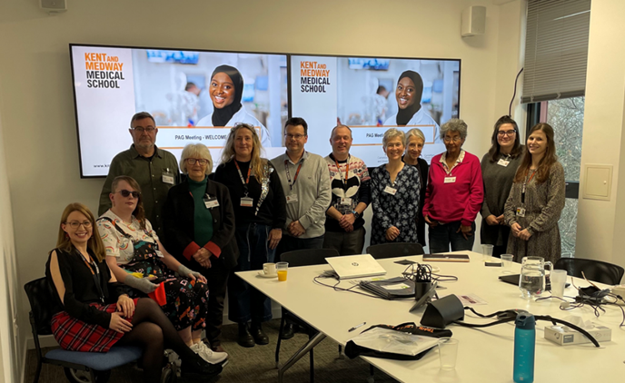
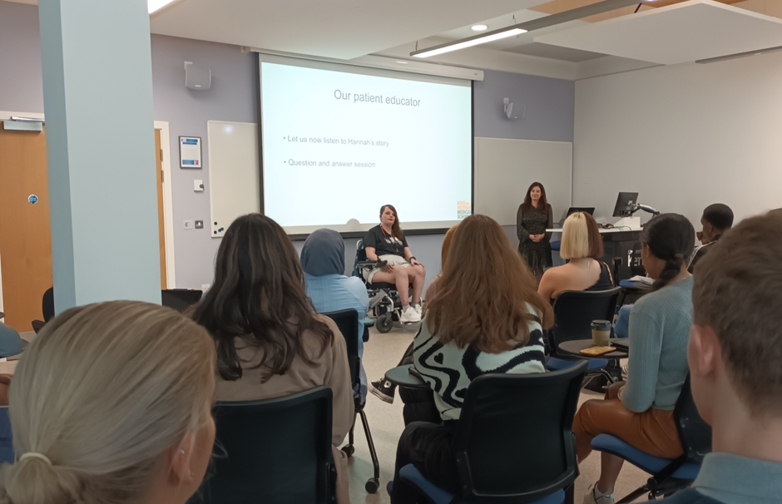
“The impact of Patient Educators on developing medical students’ consultation skills, empathy & attitudes” Dr Tim Collins & Ms Lizzie Holland
﻿

Slide 2
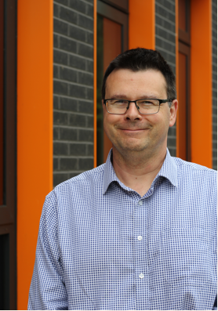
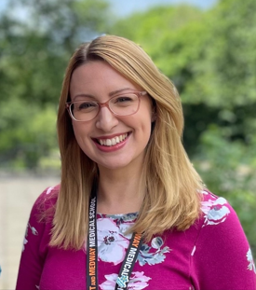
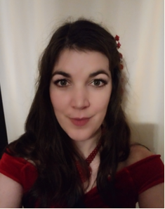
Patient Engagement Team
Dr Tim Collins, Academic Lead for Patient Engagement
Lizzie Holland, Patient Engagement Coordinator & Time for Dementia Administrator
Charlotte Russell, Course Assistant

Slide 3
Aims of Workshop:
To explore Patient Engagement activities at KMMS and how they impact student learning.
Reflect and discuss how hearing a patient narrative impacts on your understanding of patient experience.
Analyse how Patient Engagement activities enhance medical students’ teaching and learning of clinical and professional skills.
Notes:
“Learning outcomes should:
be written in the future tense
identify important learning requirements
be achievable and assessable
use clear language easily understandable to students” Taken from https://www.advance-he.ac.uk/knowledge-hub/writing-learning-outcomes
Learning outcomes with Blooms verb guide: https://www.liverpool.ac.uk/centre-for-innovation-in-education/resources/all-resources/learning-outcomes-blooms-verb-guide.html

Slide 4
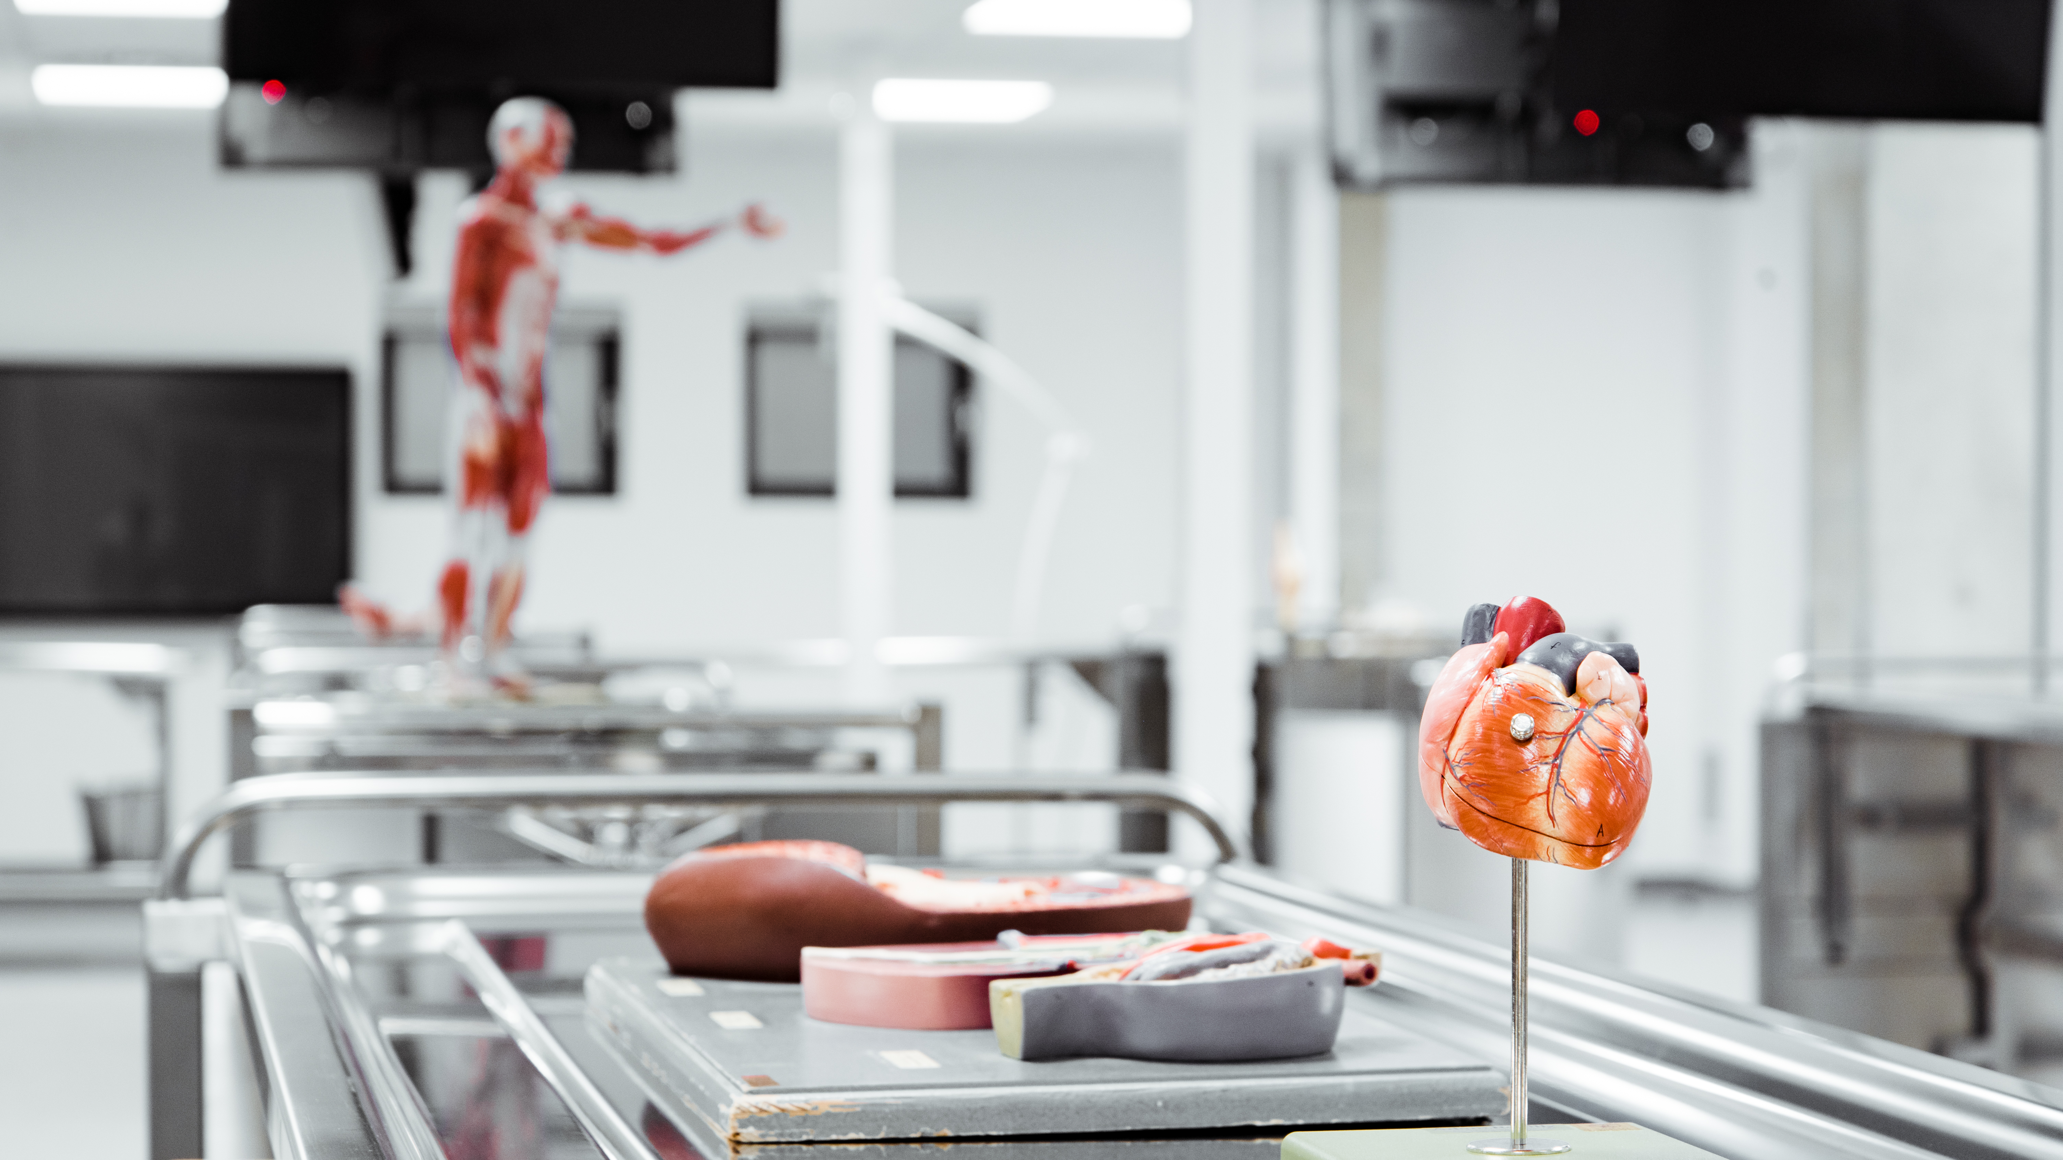
KMMS: Who Are We?
Opened in 2020 with 108 students/year Bachelor of Medicine, Bachelor of Surgery (BM BS), jointly awarded by the University of Kent and Canterbury Christ Church University.
5-year undergraduate programme.
KMMS is working in partnership with contingency school, Brighton and Sussex Medical School, for support and quality assurance purposes.
Following the General Medical Council’s (GMC) new medical school accreditation process for awarding primary medical qualification.
Inaugural students due to complete July 2025.
1 place to 18 applicants.
Increasing intake in line with NHS Workforce plan.
Placements across Primary Care Networks (PCNs) & NHS Trusts.
Notes:
Tim

Slide 5
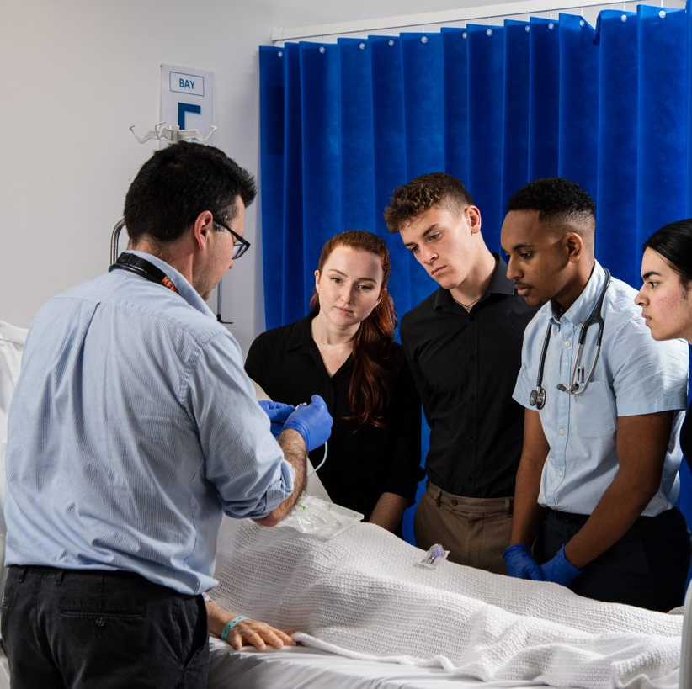

KMMS Vision
To be a beacon for first-class medical education and research, and the first choice for all those aspiring to achieve excellence in person-centred medical care in the UK.
One mechanism of achieving this is through our Patient Engagement programme and partnerships with charities and organisations.
Notes:
Tim

Slide 6
Voluntary Patient Engagement programme
Launched in January 2023.
Members of the public expressed interest via our webpage.
Patient Engagement Induction for all new Patient Educators (PEs).
Currently 46 volunteer Patients/Carers.
Conditions vary from diabetes, stroke, traumatic brain injury, alcoholism, psychological conditions, cancer, heart disease, arthritis, endometriosis, neurodiversity etc.
Age from 22 – to 80s.
Supported and coordinated across programme by Patient Engagement Coordinator and Assistant.

Slide 7
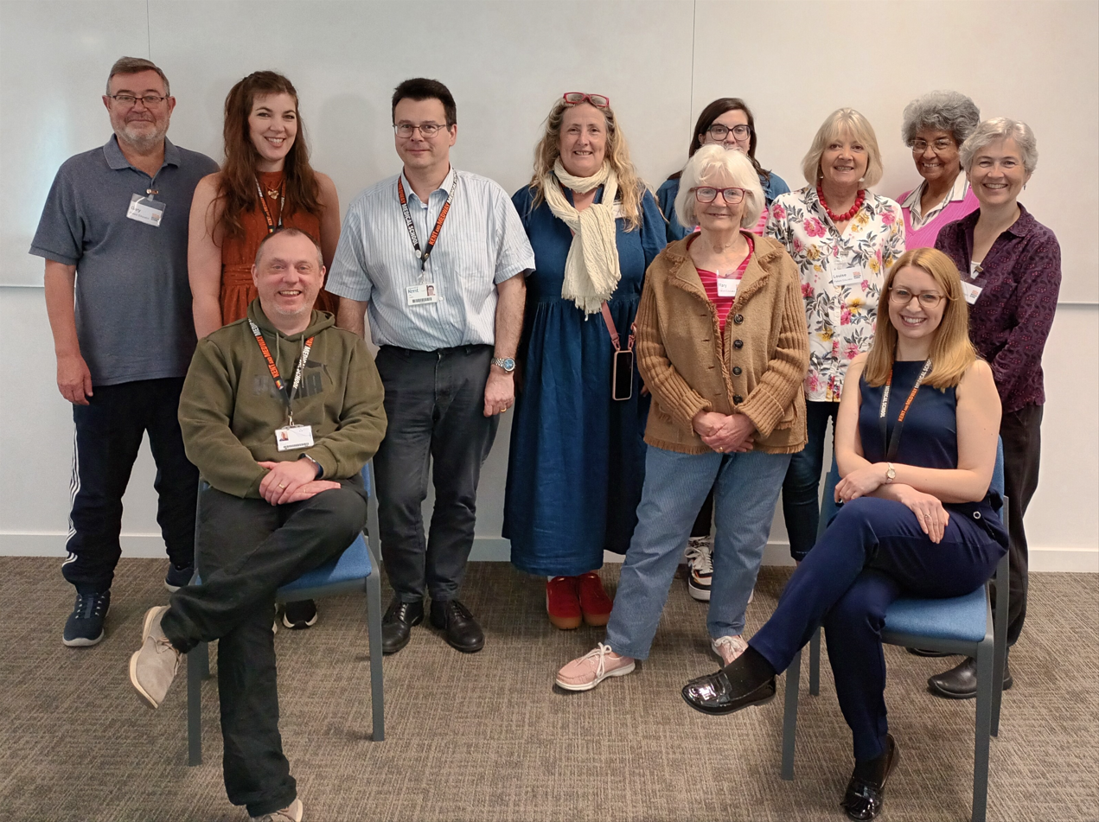
KMMS Patient Engagement Mission Statement
“We aim to develop future doctors who practice holistic health care and demonstrate person-centred values and behaviours, working in partnership with Patient Educators, charities, marginalised groups, and diverse communities.
We will embed a culture that enables the patient and carer’s voice to actively contribute to the governance, learning and assessment processes at KMMS.”

Slide 8
Teaching Activities
Patient/Carer Narrative
Patient Educator/Carer speaks about their lived experience often with a question-and-answer time, and/or group discussion.
May include journey of diagnosis, impact on their life and people close to them, and interventions which were helpful/not helpful from healthcare professionals.
Notes:
Tim

Slide 9
Teaching Activities
Physical Examination
Students have the opportunity to practice physical examination of a particular medical condition with real pathology.
Notes:
Tim

Slide 10
Teaching Activities
Medical History Taking
Students take holistic comprehensive medical history using a model of information gathering to practice their consultation skills.
This includes face to face or via virtual consultations.
Notes:
Tim

Slide 11
Assessment Activities
Clinical Examinations
Real patients with pathology take part in Objective Structure Clinical Examinations (OSCE) where students are assessed on physical examination, consultation and clinical reasoning diagnosis skills. This is high stakes assessment for progression.
Notes:
Tim

Slide 12
Patient Engagement involvement
Multi Mini Interviews for student admissions
Future Doctors Outreach Medical Society
Social Events
Curriculum planning & design
Patient Advisory Group (currently on hold)

Slide 13
Susan’s (Patient) Narrative
No photos, videos or audio recordings to be taken unless these are organised by the Patient Engagement Team, thank you.
We would like to invite Susan to share her narrative with you.
Susan will talk for up to 10 mins.
We will then use Mentimeter to reflect upon 3 questions following this to promote reflection & discussion
We aim to take questions at the end of the session.

Slide 14
Menti - Group Discussion
1. How did listening to Susan’s narrative make you feel?

Slide 15
Menti - Group Discussion
2. What do you think is the learning value of listening to patients and carers speaking about their experiences?

Slide 16
Feedback from Students after Patient Engagement Activities
“Hearing patients’ stories has a significant impact on our understanding and reminding us that we will be looking after people not patients.”
“It changed my beliefs about what an alcoholic can look like. I now have a deeper knowledge & understanding of how people may struggle with alcohol use.”
“Great learning opportunity that provided insight into the lives of people who are deaf, deafened or blind; and how we can help as future clinicians. Thank you so much for organising this!”

Slide 17
Menti - Group Discussion
3. How do you think future doctors/healthcare professionals can develop from having Patient Engagement activities included in their curriculum?

Slide 18
What the literatures states are the benefits of Patient Engagement in medical curriculum:
Develops communication skills (information giving/gathering)
Change in professional attitude & empathy skills
Increases student confidence
Clinical reasoning skills
Motivates students and improves their performance
Gain confidence with practising physical examination skills
Increases respect for patients and their individuality
Deepens students understanding of patients experience of living with a condition
Allows assessments on real pathology
Positive experiences for Patient Educators also

Slide 19
Application to Learning Theory
Pedagogy Andragogy Heutagogy
Teacher centred
Learner centred
Learner Led
Behaviourism theory:
“blank slate” with no recognition of prior learning.
GMC requirements
Initial tutor led teaching physical examination & history taking model
Clinical reasoning skills
Can scaffold learning to for patient engagement
Cognitivist theory:
“Integration of new information into existing knowledge”
Promotes reflection & behaviour change with empathy & patient experience.
Promotes problem solving with diagnosis/examination skills
Constructivism theory:
“constructs knowledge through experiencing phenomena & reflecting upon them”
Change behaviour from hearing PEs narrative & challenge prior experiences.
Experiential learning of skills.
Connectivism theory:
“Learning from multiple sources of information often digital resources”
Virtual online consultations.
Humanist theory:
“promotes person-centred well-being focusing self-esteem & confidence ”
Maslow's hierarchy of needs
Desire for learner to reach full potential for patient consultation skills.
Feeling of accomplishment “altruism”

Slide 20
Any Questions?

Slide 21
Summary
Patient Engagement in the curriculum provides opportunities for students to interact, physically examine and apply clinical reasoning skills.
Hearing patient narratives & experiences of living with medical conditions provides insights into how medical care can be tailored to support individualised patient care.

Slide 22
References and Resources
General Medical Council (2015). Promoting Excellence: Standards for Medical Education and Training. GMC.
Berlin, A. Seymour, C., Johnson, I. Cupit, S. (2011). Patient and Public Involvement in the Education of Tomorrow’s Doctors - “Today’s patients working with Tomorrow’s Doctors”. A UCL Public Engagement Beacon Innovation Seed Fund Project. October 2010- September 2011
Jha, V., Quinton, N., Bekker, H. & Roberts, T. (2009). What educators and students really think about using patients as teachers in medical education: a qualitative study. Medical Education, 43: 449–456.
Notes:
Use the KMMS referencing style – Harvard Cite-Them-Right 11th ed. KMMS referencing guide due, but in the meantime, more info. is available here: https://www-citethemrightonline-com.chain.kent.ac.uk/Basics/sample-text-and-reference-list-using-the-harvard-style?SearchResult=Action

