Slide 1

Using creative methods to understand the needs and priorities for Young Adult Carers
Dr Arti Makwana
University of Kent

Slide 2


Key contributors: Arti Makwana & Erica Ferris; Project Leads Hareni Niruban; Lived Experience Advisor Abby Giles & Maddison Keeble; Research Interns

Slide 3
Background
Young adult carers (YACs) are young people who provide unpaid care, usually to a parent, sibling, grandparent, partner, or other relative or friend.
About 9% of young adults provided care in the UK¹
They provide £3.5 billion of unpaid care per year²
However, being a YAC comes at a high personal cost²⁻⁵
Notes:
Young adult carers are young people aged 16-24 (sometimes up to the age of 29) who provide unpaid or informal care to someone, usually a member of their family, on a regular basis. The type of care offered can vary, including Practical tasks, such as cooking, housework and shopping. Emotional support, such as talking or listening to someone who is distressed. Personal care, such as helping someone dress or go to the toilet.²
YACs often provide a considerable amount of support; a 2023 survey by Carers Trust found that 51% of young (under 18) and young adult carers provide care for 20-49 hours each week, and furthermore 56% said that the time they spent caring had increased in the past year indicating that for some young people, it can be extremely demanding to balance school (and/or employment), spending time on social or leisure activities, and their caring responsibilities.
As such, it is not surprising that being a young adult carer can come at a high personal cost. For example, using longitudinal data, Brimblecombe and colleagues (2020)³ found that YACs had poorer mental and physical health, and worse employment outcomes compared to peers without caring responsibilities. Indeed, YACs are three times as likely to be NEET (not in education, employment or training) compared to other young people, they achieve fewer GSCSs compared to peers without caring responsibilities, and 45% of YACs report a mental health problem.

Slide 4
Why did we do this work?
YACs are underrepresented in carer research⁶⁻⁸
Unmet need and barriers for YACs to access support⁸
Better understanding = improved support for YACs^{9, 10}
Notes:
However, YACs are underrepresented in carer research^{4–6} as it is often difficult to identify who they are, and the extent of their caring responsibilities. As such, their unique experiences and challenges can be overlooked in carer research, leading to a lack of evidence-based targeted support services and policies.
There are a range of support services available, however little is known about how YACs access support, the quality of support available, and how culturally or personally relevant these services are. In order to access support, a young person must first identify that they are a carer, which is challenging as many YAC don’t consider themselves to be a carer until someone, most often a healthcare or social professional highlights this. Once they do identify as a carer, and are signposted to support services, not all YACs engage with these support services as they might be considered unhelpful, or not relevant to their specific needs or preferences. They can also experience a gap in provision as some youth services cease to offer support post-18 years of age, and adult services don’t really match YAC needs,
It is critical to understand what type of support young carers find useful (or not useful), in order to improve the uptake of YACs accessing appropriate support⁹ to help address inequalities in outcomes.¹⁰ And so the aim of our project was to understand YACs experiences of accessing support, what could be improved, and what researchers could do to further investigate these issues and implement interventions for change. The project is an ‘enhanced’ PPI activity in that we undertook this work to establish YACs priorities for future research, and to establish research questions for future research bids.

Slide 5

What support do YACs require, and how can future research address these support needs? Phase 1: Use photo elicitation to explore and identify YAC needs for support and priorities for future research (primary research) Phase 2: Co-produce a ranking of YAC priorities to guide future research. (consultation)
Notes:
We wanted this piece of work to be participant-led so that YACs could tell us about any experiences they consider to be relevant without being constrained by what we (as researchers) deemed relevant. As such, we opted to use a ‘creative’ methodology for a more autonomous person-centred approach to data collection that would empower participants by giving them agency in the research discussion, allowing them to express themselves in ways that might be difficult through traditional methods (e.g. surveys, interviews, focus groups) which tend to be largely researcher led. We also opted to have a mix of in-person and online activities to allow people with different preferences to engage in the project.
The first phase of our project collected research data using photo elicitation, which involves using photographs as a prompt for discussion. We opted for ‘participant generated photo elicitation’, which allows participants to capture and share photos which depict elements of their lives that might have gone unnoticed by traditional research methods. This methodology does not require the analysis of the photos (in comparison to other visual methodologies, e.g. photovoice) as the photographs are a means to elicit verbal responses. This method was facilitated in-person, supported by our research interns, and constitutes primary research as we were generating new knowledge of experiences in accessing support as a YAC.
The second phase was an online consultation with YACs to review the support needs and priorities we had established in the first phase, and to rank them in order of importance to establish a participant generated list of future research priorities. This was co-facilitated by our lived experience expert.
Both sessions were audio recorded and transcribed. Ethical approval was granted by the University of Kent, School of Social Policy, Sociology and Social research (now School of Social Sciences) – although phase 2 was not research, we still included it in the approval application for fullness of review.
We also consulted with 2 local YAC support services in the development of this project to ensure that the project was relevant, appropriate and accessible for YACs. Participants for both phases were identified by these 2 services; i.e. they were YACs who are already accessing support. We also advertised the project via the UoK’s student union and through other external channels.

Slide 6
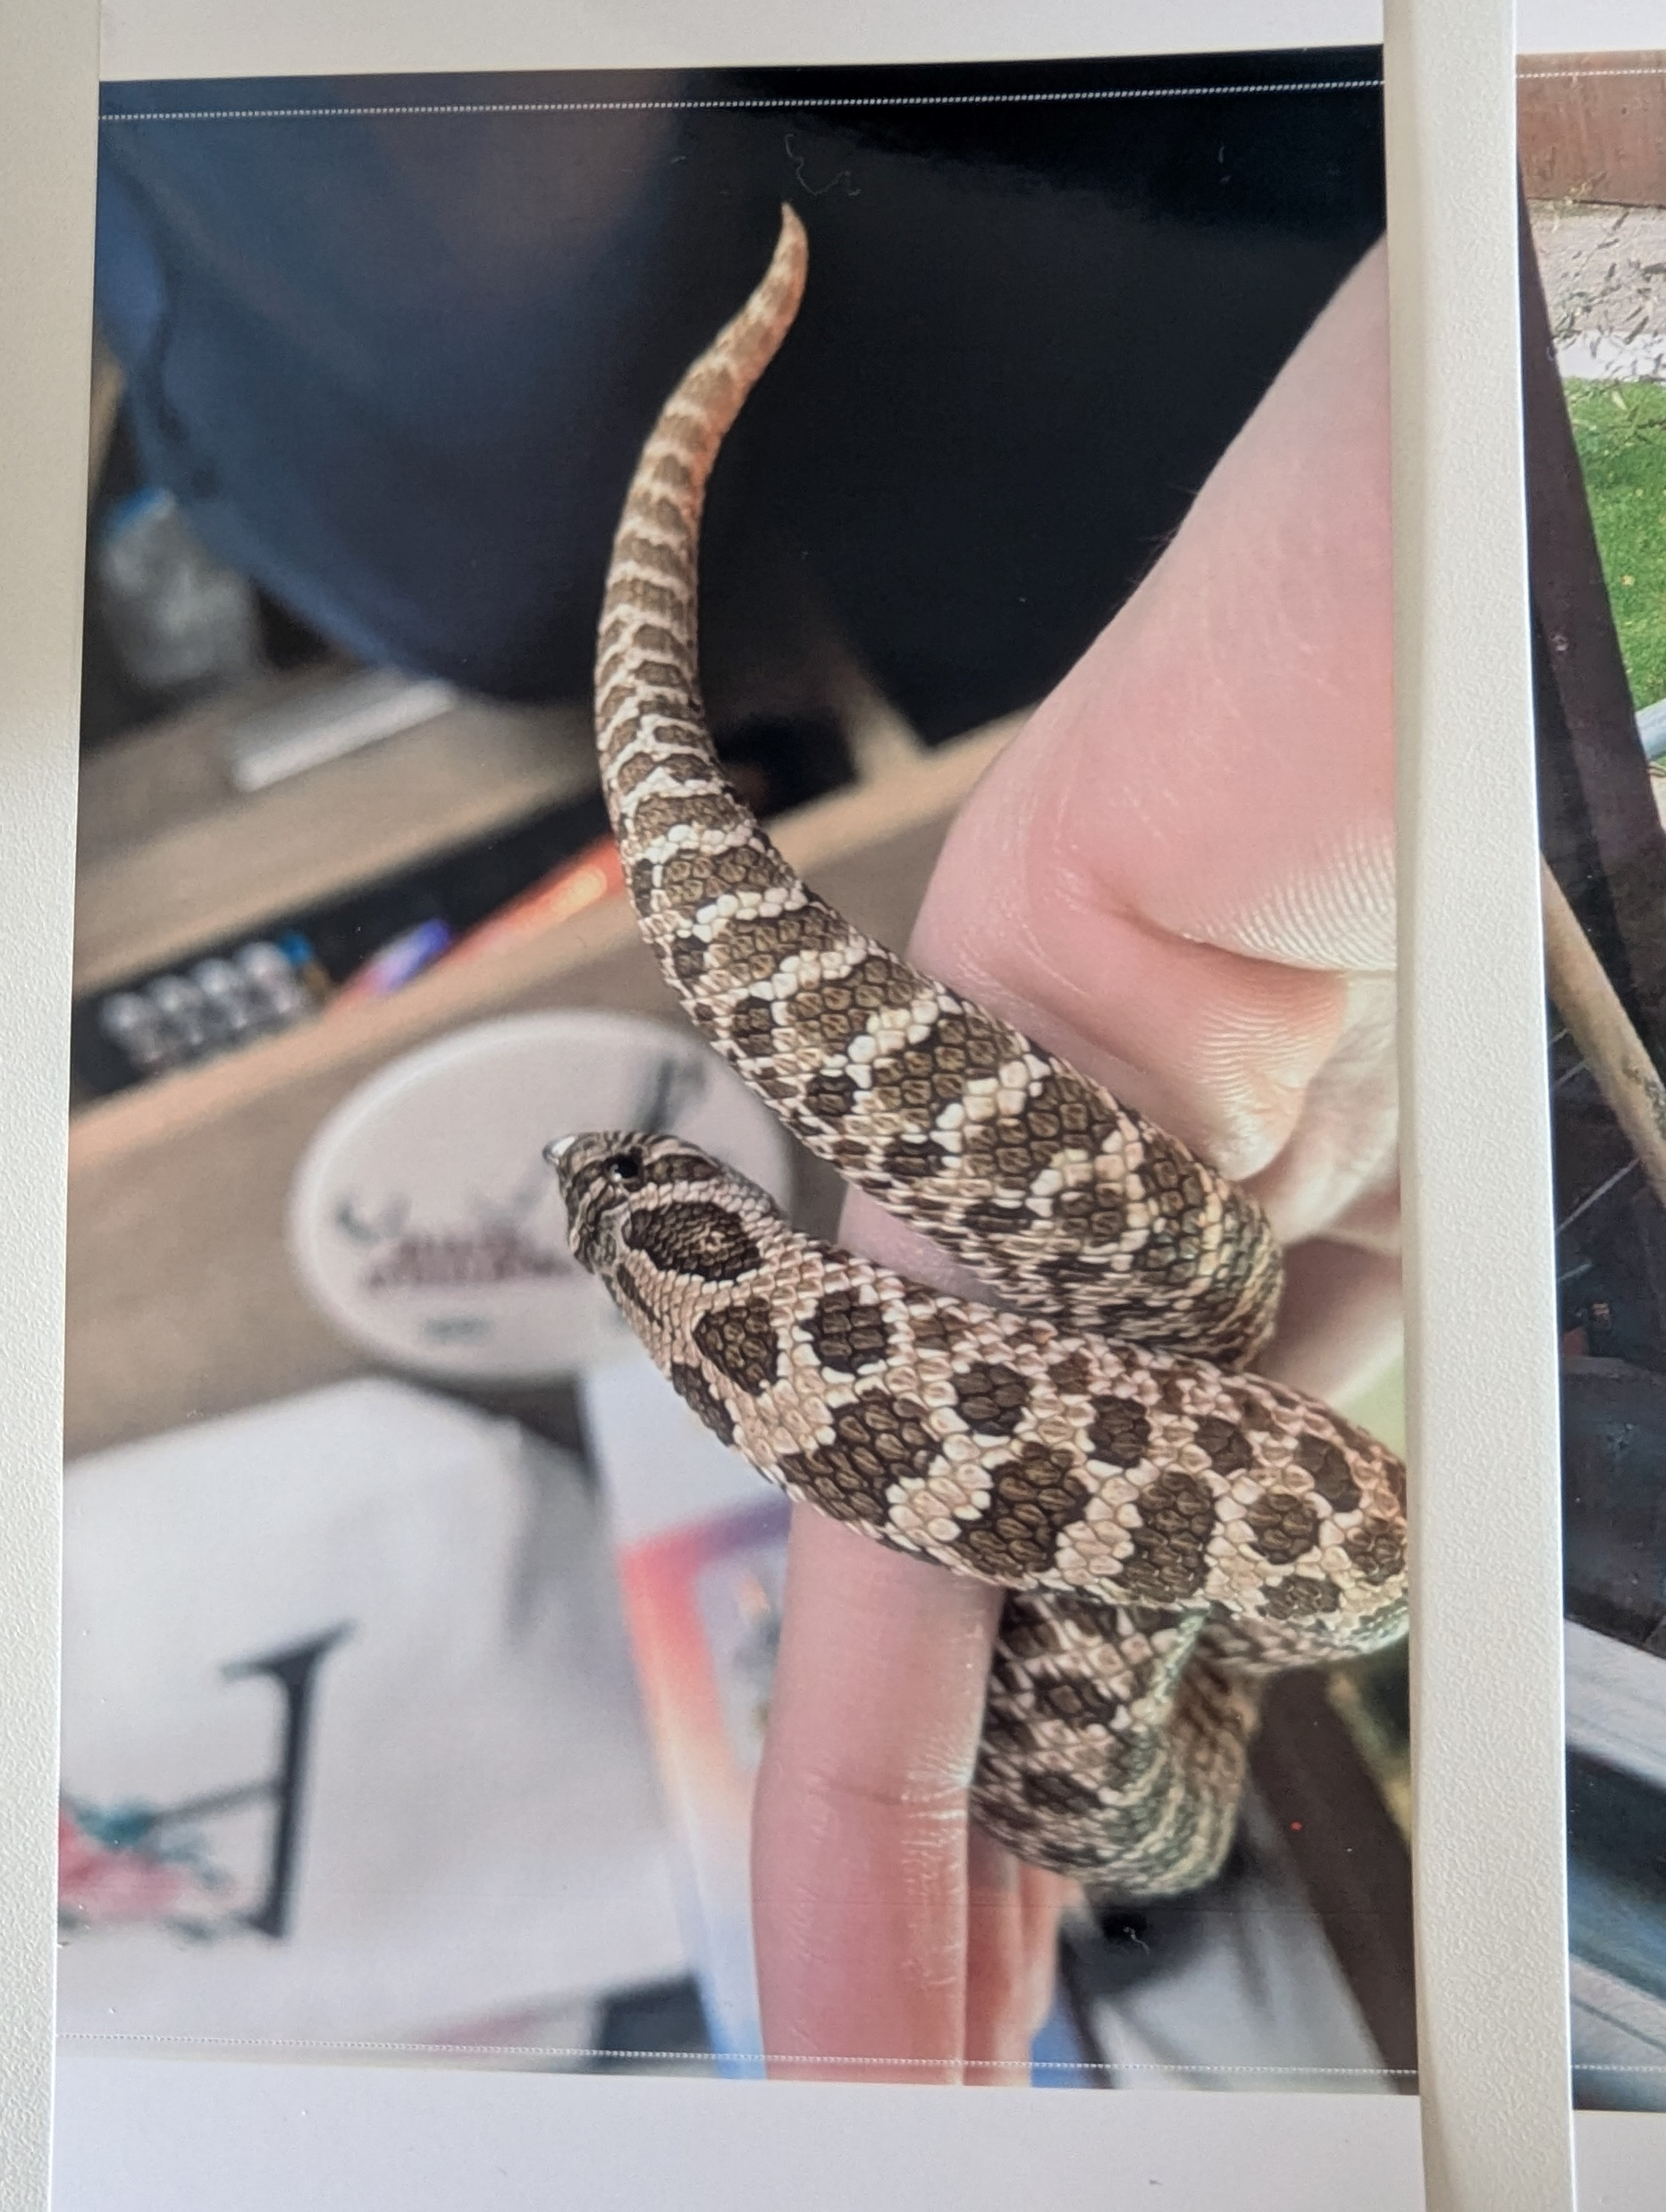
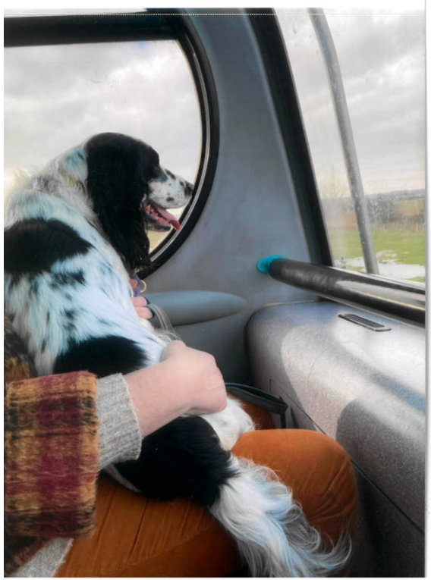
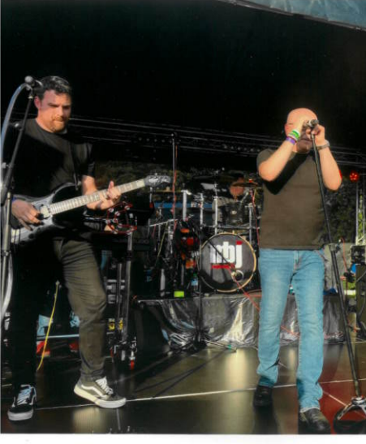
Phase 1: photo elicitation sessions
10 participants took part in 2 group sessions:
8 female; 1 trans male, and 1 did not say
5 aged 16-17, 2 were aged 18-19, 1 aged 24-25, and 1 did not say
All chose to use photos they had already available on their smartphone.
Notes:
Phase 1 was held in July last year. I've included the participant demographics, but we didn’t collect exact age as that would risk making the data more identifiable.
Before the workshop, YACs were sent information about the study, including photo elicitation technique, and were invited to bring a mobile device that can capture digital photographs. We planned for 15 mins at the start of the session for YACs to reflect on their experiences of accessing support and to take some photographs of their surroundings that capture aspects that embody their experiences, however all participants opted to use photos that they had already available on their smartphone, so the 15 mins was instead spent reviewing their photos and picking ones they would like to share for the discussion. Participants were instructed not to use any photographs that capture other people’s identities or contain identifiable information before sharing in the group forum.
Once the group had chosen their photos, participants were prompted to discuss their experiences using their photos. They took turns in displaying the photos to the group (using a projector) and talked about how the photo(s) captured what YAC support means to them. We did not have an explicit schedule of questions/discussion points as we wanted the discussion to be participant–led, however we did use prompts such as “what’s happening in the photo?”, “how does this relate to your experience?” and “what can we (as researchers) do about it?”. We also provided a small photo printer for participants to print out a copy of their photo for themselves, if they desired. At the end of the session, we asked participants if they have any photos that they would like to voluntarily submit to be included in reporting and dissemination.
Here are a collection of photos that were submitted. Interestingly, most participants opted to share photos of pets, and discussed how these animals have supported them in their caring role.

Slide 7
Research priorities identified
School experience
- Identification and recognition in school
- Peer support and opportunities to socialise
- Better teacher and pastoral support
- Flexibility with deadlines and or attendance
Financial support
- Travel: transport for school and YAC related appointments,
- Personal: to pursue hobbies and interest outside of YAC role
- Bills/household: financial support for household bills
Identity beyond YAC role
- The need for space/support to explore own interests and ambitions
- Recognition of individual needs and support
- The role of services in supporting the development of identity
Transition/moving on
- Support to access and stay in further education or apprenticeships
- Support to find employment
- Making workplaces more accessible for those with caring responsibilities
- Support to continue providing care after leaving school
Health and wellbeing
- Better provisions to support and improve physical health
- Better access to support for emotional/ psychological support
- Better ways to improve social support and reduce loneliness.
Notes:
After the workshops, we reviewed the topics of discussion and extracted 5 priorities and the various sub-topics of investigation within these priority areas for ranking during phase 2. They are displayed here in no particular order.
Many of these issues have previously been identified by other researchers (such as identification of YACs, opportunities for peer support, financial support (especially after the pandemic and cost of living crisis), and improving health and wellbeing outcomes, but the fact that they’re coming up again indicates that there is still work required to implement interventions which address these issues.
We also asked participants to provide us anonymous feedback about the session so we could learn what they liked or didn’t like about the session. Feedback showed that they enjoyed the activity, and liked being able to use their own photos to talk about their experiences. Through our own reflections, we noted that providing a space for YACs to freely speak in a participant-led manner did seem to support them to feel more empowered to share their experiences, some even shared verbal feedback to say that it felt good to have that opportunity and were asking for more sessions like this. There were a few things we could improve on to make the activity more accessible and streamlined (e.g. have documents printed on coloured paper, manage the timings better to start and finish on time).

Slide 8
Phase 2: online discussion
5 participants:
3 female; 2 male
2 aged 16-17, 1 aged 18-19, 1 aged 20-21, and 1 aged 23-24
Priorities ranked:
Health and Wellbeing
Financial Support
Identity beyond YAC role
Transition/moving on
School Experience
 | 1 | 2 | 3
Priority 1: Health and Wellbeing | Better access to emotional/ psychological support | Better ways to improve social support and reduce loneliness | Better provisions to support and improve physical health
Priority 2: Financial Support | Bills/household: financial support for household bills | Personal: to pursue hobbies and interests outside of YAC role | Travel: transport for school and YAC related appointments
Priority 3: Identity beyond YAC role | Support/space to explore own interests and ambitions | Recognition of individual needs and support | The role of support services in supporting the development of identity
Notes:
After we identified the priorities that were raised in the photo workshops, we hosted an online event (on Microsoft Teams) with five other YACs. In this meeting, we talked through the priorities, discussed what the YACs thought about these, and then asked them to rank the priorities in order of importance. We did this so we could understand which of these topics are most in need of attention and should be the focus of future research. The second bullet point indicates the ranking of the 5 priorities.
We then asked the YACs to think about the specific topics within the top three priorities, and asked them to rank these in order of importance. The table shows the results of the ratings, the topics in the red box are the highest rated research topics.
Interestingly, school experience was ranked as least important even though it was discussed by many of the participants within the photo elicitation workshops. It might be that those who took part in the online discussion had a more positive experience of support within school settings, which is why it was ranked lower.

Slide 9
Next steps
Analysis and write up of photo elicitation workshops
Bid development
Notes:
We will analyse the discussions in the photo workshops to give us a more in-depth understanding of the current experiences of YACs and will then look to publish these findings in a scientific journal article.
Critically, the main aim of this work was to generate research questions for future research, so we are also planning on applying for some more funding to better understand how to improve these priority issues, and work together with YACs to develop something that works for them. More specifically, Erica has successfully been awarded some funding to undertake a literature review around better financial support for YACs, and we’re currently developing a bid for a realist review around young adult carer services, and another on improving identification of YACs through better integration of health and carer support services.

Slide 10

Thank you! Any questions or comments?
Contact details
Arti Makwana: a.p.makwana-37@kent.ac.uk

Slide 11
References
Di Gessa G, Xue B, Lacey R, McMunn A. Young Adult Carers in the UK—New Evidence from the UK Household Longitudinal Study. Int J Environ Res Public Health. 2022 Jan;19(21):14076.
https://learningandwork.org.uk/what-we-do/social-justice-inclusion/young-adult-carers/
Brimblecombe N, Knapp M, King D, Stevens M, Cartagena Farias J. The high cost of unpaid care by young people:health and economic impacts of providing unpaid care. BMC Public Health. 2020 Aug 5;20(1):1115.
https://carers.org/downloads/being-a-young-carer-is-not-a-choice--its-just-what-we-do---final-uk-report-(english).pdf
https://learningandwork.org.uk/what-we-do/social-justice-inclusion/young-adult-carers/
Levine C, Hunt GG, Halper D, Hart AY, Lautz J, Gould DA. Young Adult Caregivers: A First Look at an Unstudied Population. Am J Public Health. 2005 Nov;95(11):2071–5.
Kent EE. Time to Recognize and Support Emerging Adult Caregivers in Public Health. Am J Public Health. 2020 Dec;110(12):1720–1.
Chevrier B, Lamore K, Untas A, Dorard G. Young adult carers’ identification, characteristics, and support: A systematic review. Front Psychol [Internet]. 2022 Oct 24 [cited 2024 Jun 4];13. Available from: https://www.frontiersin.org/journals/psychology/articles/10.3389/fpsyg.2022.990257/full
Joseph, S., Sempik, J., Leu, A., & Becker, S. (2020). Young carers research, practice and policy: An overview and critical perspective on possible future directions. Adolescent Research Review, 5(1), 77-89.
van der Werf HM, Luttik MLA, de Boer A, Roodbol PF, Paans W. Growing up with a Chronically Ill Family Member—The Impact on and Support Needs of Young Adult Carers: A Scoping Review. Int J Environ Res Public Health. 2022 Jan;19(2):855.

