Slide 1

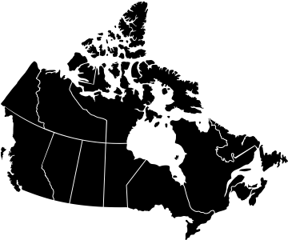

Vanessa Gruben (Ottawa)
Alana Cattapan (Waterloo)
Erin Nelson (Alberta)
Eleanor McGrath (Waterloo)
        Pamela White (Kent)
SURROGATES’
VOICES
Despite the growing use of surrogacy to build families in Canada, little is known about experiences of surrogates themselves.
An online survey was administered between March and August 2022 to people who have been surrogates in Canada since 2004.
174 responses were included in the final dataset. Analysis focused around three questions…
Who are surrogates?
Why do they become surrogates?
Compared with women of a similar age, survey respondents were more likely to be white (93% vs. 68%) and Canadian citizens (98% vs. 86.5%) and less likely to be immigrants to Canada (6% vs. 22%). A majority were heterosexual (74%) and married or in common-law relationships (64%).
Like other Canadian women of similar age, survey respondents reported having post-secondary education (78%), and a median household income between $80,000-$85,000. (Comparison data from the 2021 Census).
86%
Reported wanting to help others
62%
Reported wanting to help strangers become parents
49%
Reported enjoying the experience of being pregnant
12%
Reported wanting the “financial benefits” of surrogacy
Who do they work with?
96%
Reported working with lawyers
This map indicates surrogates’ province of residence at the time of their most recent surrogacy. No respondents reported living in the territories or Prince Edward Island.
92%
Reported working with fertility clinics
86%
Reported working with online support groups/social media
80%
Reported working with counsellors
73%
Reported working with surrogacy agencies
Were surrogates for intended parents living in a different province
20%
Surrogates in Canada reported a range of experiences and do
not generally belong to vulnerable or marginalized populations.
Most have had positive (84%) experiences, although many had recommendations for improvement. These include concerns about agencies and regulation, clarity around
reimbursement, and support during pregnancy, birth
and postpartum.
Were surrogates for intended parents living outside of Canada
7%
21%
1%
40%
1%
1%
54%
9%
3%
1%
Notes:
In 2021, the most recent national data available, Statistics reported that 25% of women giving birth were age 35 years and older. Our study shows that 42% of Canadian surrogates in 2022 were over age 35. https://www150.statcan.gc.ca/n1/daily-quotidien/220928/dq220928d-eng.htm#

