Slide 1
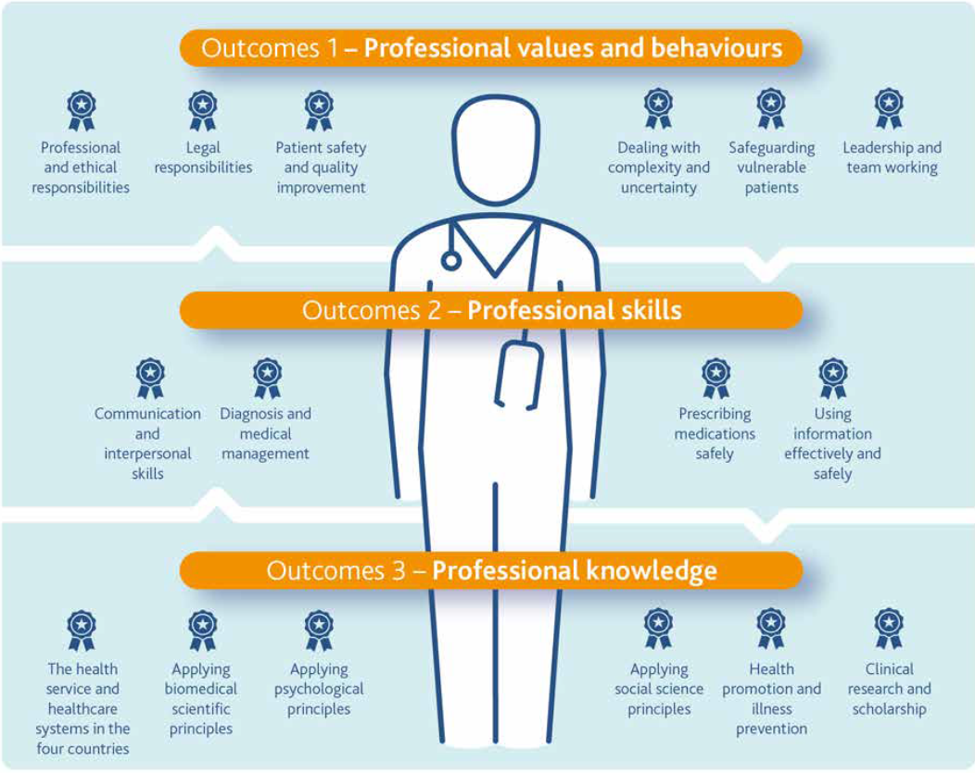
Health and Work in Undergraduate Medical Education
Dr Ferhana Hashem, Sabrena Jaswal, Dr Catherine Marchand, Dr Lindsay Forbes, Dr Naren Srinivasan, Dr Amanda Bates & Professor Stephen Peckham
Centre for Health Services Studies, University of Kent
Mastery
Project Background
Aims and Objectives
Commissioned by Public Health England (PHE) & the joint Work & Health Unit (WHU), which includes Department for Work & Pensions (DWP) & Department of Health & Social Care.
- September 2018 - January 2020
- Outputs: comprehensive set of teaching resources on health & work including:
Slide sets of core topics
Session outline for lecturers
Online resources collection
Using a co-productive approach involving stakeholders & Patient and Public Involvement (PPI).
To design an integrated curriculum for future doctors that addresses how to communicate with patients about staying in and returning to work.
To increase future doctors’ confidence in discussing health and work with patients, having acquired the skills, knowledge, tools and techniques to undertake this activity
To increase the uptake of future doctors broaching the issue of Health & Work in their patient consultations, including giving professionals the capability and confidence to use the fit note as a system for practical advice as well as a process for sickness certification
To increase patients’ experience of feeling more supported by future doctors in the long term
To increase the number of patients understanding the value of work to their own health and well-being, including their expectations of the fit note, by receiving advice from doctors
Why is this important?
Co-Production Approach
Improving Lives. The Work, Health and Disability Green Paper (2017) one of the key aims is to “ensure people are able to access the right employment and health services, at the right time and in a way which is personalised to their circumstances and integrated around their needs”
The report underlines the vicious circle between work and health and the importance of having a unified vision of the relationship between health and work
It highlights the importance to improve work conditions for workers with disabilities and chronic diseases
PHE commissioned an audit report from ICF Consulting Services Ltd with the intention of broadly identifying Health and Work core topics for the current undergraduate medical curriculum
Public Health Physician
GP Clinical Research
Fellow
Patient Experience & Public Involvement Lead
+ academic team members at UofK
External Academic Panel Steering (EX-APS) Group: Engage in partnerships with professionals
Health and Work Curriculum (HaWC) Group: Co-design & Co-create
Central Research Team Hub: University of Kent
2 PPI representative, Occupational Health Physician, GP from PHE, HEE representative, medical sociologist, Medical Schools Council representative & Central Research Team members
Revision
3 PPI representatives, 2 Occupational Health Physicians, Occupational Health Nurse Consultant, GP from DWP & Central Research Team Members
Learning Framework
Project Milestones
Learning Framework and slide sets of core topics are based on the General Medical Council’s (GMC’s) Outcomes for Graduates (2018)
This led to the creation of a list of topics (diagram below) that fit with the GMC Outcomes for Graduates (2018) within a spiral curriculum (diagram on the left).
Curriculum mapping of the medical schools in the UK (5 of which will be starting in 2019 and/or 2020). This included identifying the school’s:
Teaching approach
Type of curriculum (full spiral, partial spiral, none)
Core syllabus topics
Identify where Health and Work topics can be incorporated
Assessment methods
Recent / proposed changes to the curriculum
Creation of slide sets with topics
linked to the GMC’s
Outcomes for Graduates (2018)
Project Timeline:
UofK have built links with selected medical school UG course leads to pilot slide sets in Term 1 of the 2019/2020 academic year
Prepared the piloting tools to gather evaluation & feedback from the learners and the course tutors
Submitted UofK ethics application of the piloting tools
Prepared resources for the pilot & maintained communication with medical schools
Pilot Kick Off
Pilot End Date
Shared the teaching materials & slide sets with the UG medical course tutors and have documented their feedback
Write up final report
New Content

