Slide 1
Open Scholarship / The shape of things to come? 2019
Helen Cooper
ResearchSupport@kent.ac.uk

Slide 2
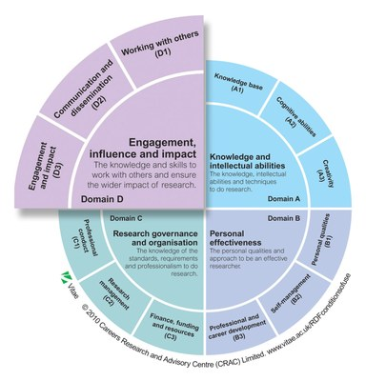
Where does open scholarship fit?

Slide 3
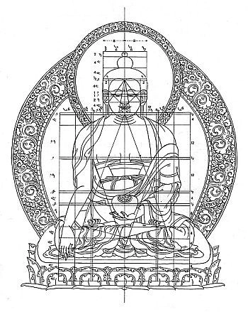
Open Publications
Journals and Science
Books and book chapters
Other forms – Open collaboration
Blurred lines – Is it data? Is it output?
Practice based research

Slide 4
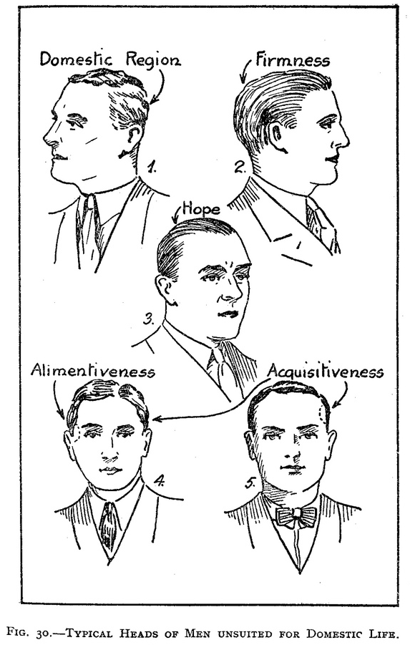
Measuring individuals
Citations
Citation counts for an individual are possible
Not recommended, can be biased by one paper with lots of citations
H-index
This shows not just how many papers someone has written, but how consistent they are.
Balances number of articles against numbers of citations to create a fair measurement.
Can find in:
Scopus
Google Scholar
Web of Science
Notes:
Also known as the Hirsch index or Hirsch number

Slide 5
Measuring individuals - issues
All citations are counted the same –
whether from low-ranking journals or high
positive or negative treatment
includes self-citations
Not so good for early career researchers – can only be as high as the number of articles you’ve published
Hard to compare between disciplines
Different sources have different measures
Notes:
There are all sorts of alternatives to try and get over these obstacles

Slide 6
Whats the good news?
Leiden Manifesto for Research Metrics http://www.leidenmanifesto.org/
San Francisco Declaration on Research Assessment https://sfdora.org/read/
When making resource and staffing decisions make assessments based on scientific content rather than publication metrics.
Cite primary literature rather than reviews in order to give credit where credit is due.
Use a range of metrics and indicators as evidence of the impact of articles
Challenge research assessment practices that rely inappropriately on Journal Impact Factors

Slide 7
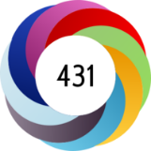
Altmetrics
Measures Social Media sharing – an alternative to bibliometrics
Altmetric collects mentions of scholarly articles from newspapers, blogs, social media etc, and presents as a score. It also gives access to all mentions of the article or book https://kar.kent.ac.uk/55297/
Kudos allows you to annotate your paper for multiple audiences and use tools to promote your work using social media. Integrates data from Altmetric and other sources.
Notes:
The creation and study of metrics based on social elements of the web for analysing, and informing scholarship

Slide 8
Make metrics work for you
Make your work Open Access
Put it in the Kent Academic Repository
Evidence shows OA material gets more citations
https://www.tandfonline.com/toc/rstw20/18/4?nav=tocList
Write for a different audience (non-academics)
The Conversation http://theconversation.com/uk
Keep your profiles up to date
See Research Support Blog post
Use social media
Use blogs, Twitter and other social media
See Scholarly Comms Bloggs Social Media profiles
Get an ORCID
http://orcid.org
Notes:
Is evidence that use of social media can increase your citations. Find reference Is blogging or tweeting about research papers worth it? This, from Melissa Terras, is really worth a look. Increase your citatations – this article is not new, but we’ve become aware of it fairly recently. It reports on a project which found that promoting scholarly journal articles using press releases increases citations.

Slide 9
Tips & Tricks – increase your citations
When writing:
Think about your title, focus on keywords
Repeat keywords in the abstract/summary
Include a “review” element in your article
Refer to other people’s work and they may cite you back in future
There is a correlation between the references you use and the number of citations you receive.
Keep up your profiles
Notes:
Check for ambiguous author entries, get it corrected if necessary. Scientists/Social Scientists: Check your Author ID in Web of Science and Scopus.

Slide 10
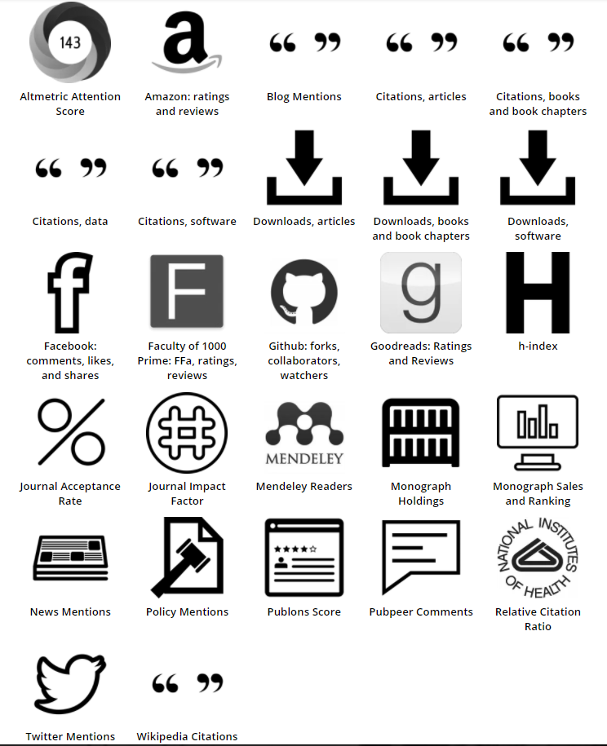
Use your toolkit
http://www.metrics-toolkit.org/

