Slide 1
Dissemination planning
What to be aware of?
Office for Scholarly Communication

Slide 2
“The single biggest problem with communication is the illusion that it has taken place”
George Bernard Shaw
Notes:
What is a dissemination plan? It is a plan of how you will will share all of your research findings, why you are sharing them, who you need to share them with, and how your will reach your target audience.

Slide 3
Plan from the start
Schedule time
Grant applications and budgeting
Know your audience
How and where to disseminate findings
Share the good, and the unexpected
Measuring success

Slide 4
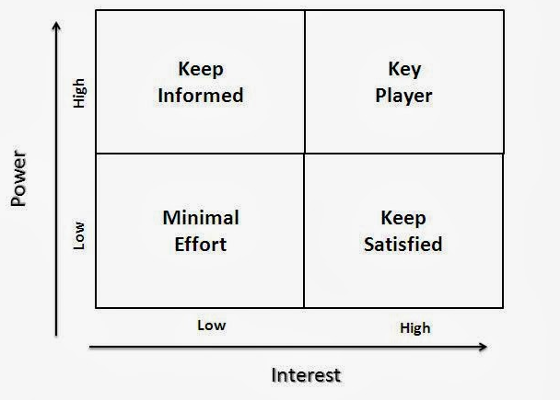
Audience
Who do you need to disseminate
your research to?
Why are they your intended
audience?
What do your audience groups need to know about?

Slide 5
What to disseminate?
Journal articles
Conferences/workshops
Books
Pre-prints & working papers
Non textual, non digital
Data
Media
Website
Social media
User specific? (e.g. arts, enterprise)

Slide 6
Where and why to disseminate?
Are all stakeholder groups reached?
Is it behind a paywall?
Duration?
Institution or other repositories
Distinguish yourself…

Slide 7
ORCiD
What's an ORCID iD for?
Your unique ORCID iD will belong to you throughout your scholarly career. It's a persistent identifier to:
distinguish you from other researchers
ensure consistent, reliable attribution of your work
You can use it for:
collating existing research in one location
submitting to journals
grant applications
professional society membership
linking with other identifiers and profiles
displaying on your CV
web page, social media and more
An ORCID iD is a persistent identifier that allows you to distinguish yourself by tying all your research together in one place.
An example ORCID page:
http://orcid.org/0000-0002-1825-0097
Notes:
An ORCID iD is a unique identifier that allows you to tie all your research together in one place. This allows you to disambiguate, track and share research with one simple URL.
Why do I need one?
More and more funding organisations, professional bodies and publishers are using ORCID iDs, with support from external funding bodies like Jisc and ARMA.
This means you can often use your ORCID iD instead of manually submitting personal and citation information. That makes grant submissions easier and means you don't have to repeatedly enter the same information into various systems.

Slide 8
Scheduling
Deadlines?
During/post project?
Re-use content?
Plan to disseminate....

Slide 9
How to engage your audience
Experience
Networks
Direct Engagement
Maximising stakeholders reach
Institutional expertise
Skills/Training needs
Evidencing....

Slide 10
Broaden the readership of your research
Keep track of all your outreach
Manage all your outputs in one place
Make the most of your time

Slide 11
Find out more…
KUDOS
Kudos Website
How Kudos works
Test your research impact muscles
ORCiD
How ORCiD works
ORCiD Registration
ORCiD Help
Everything else
Creative Commons
Open Access
Paywall: The Business of Scholarship Movie
Scholarly Communications Blog
Find these slides at:
https://kar.kent.ac.uk/72749/

