Slide 1
Something Old, Something New: Rare Books & RDA
Josie Caplehorne & Rachel Dickinson
University of Kent

Slide 2
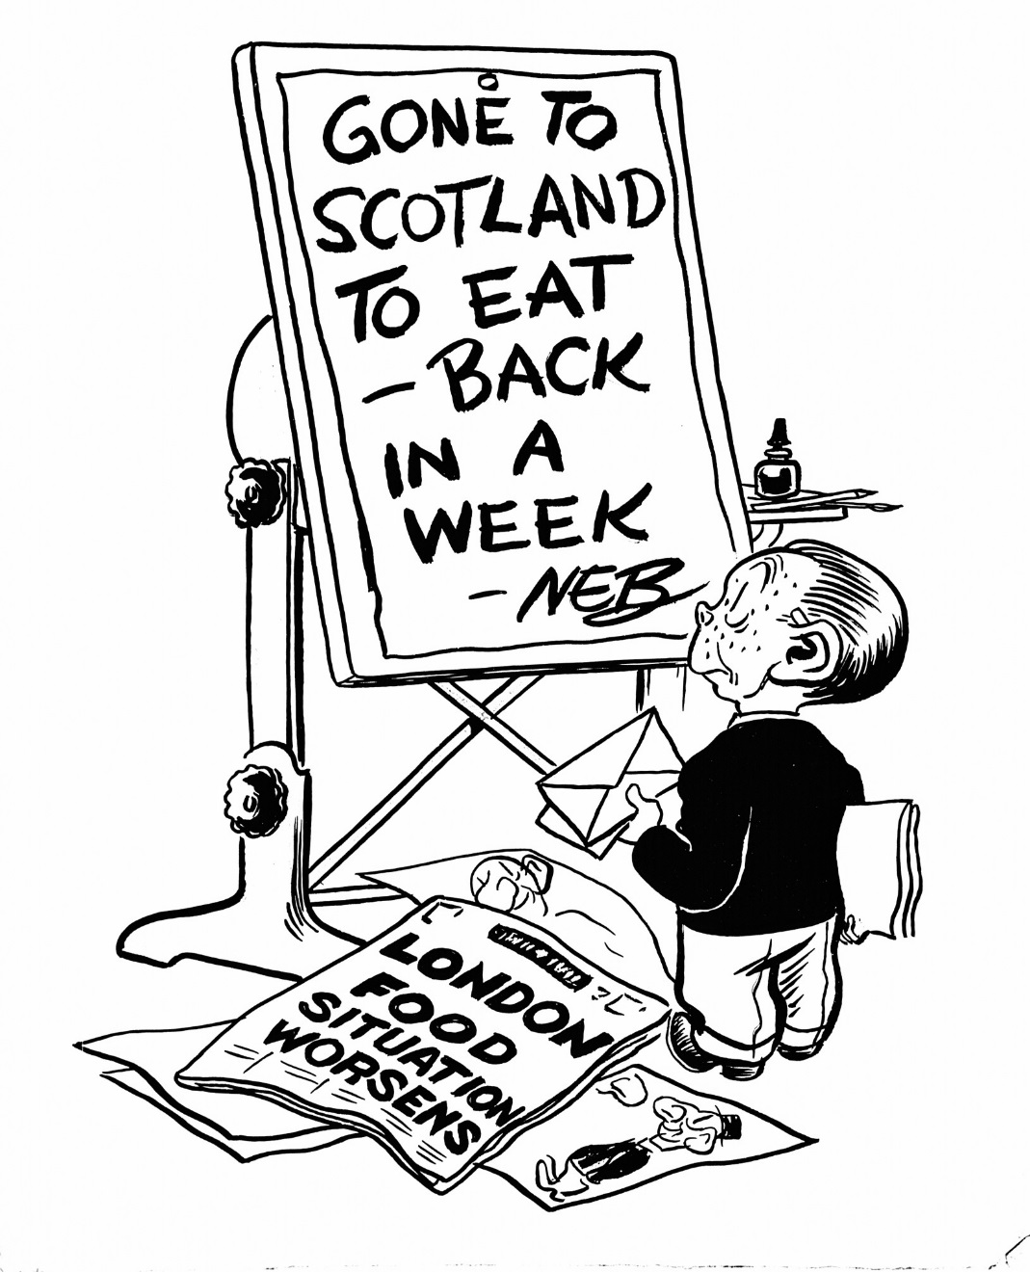
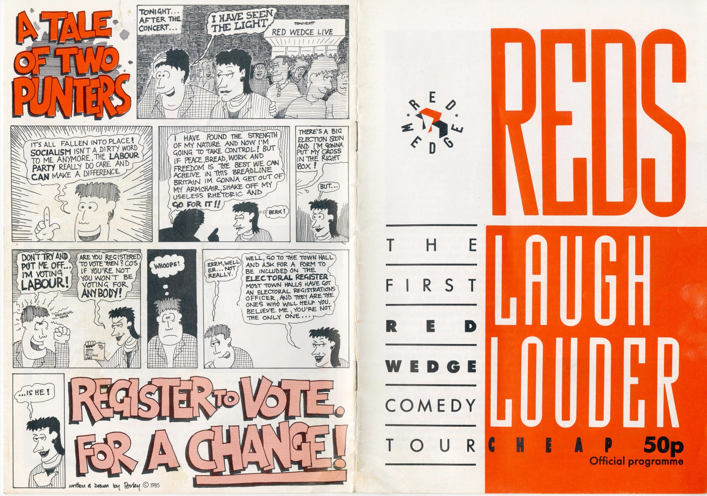
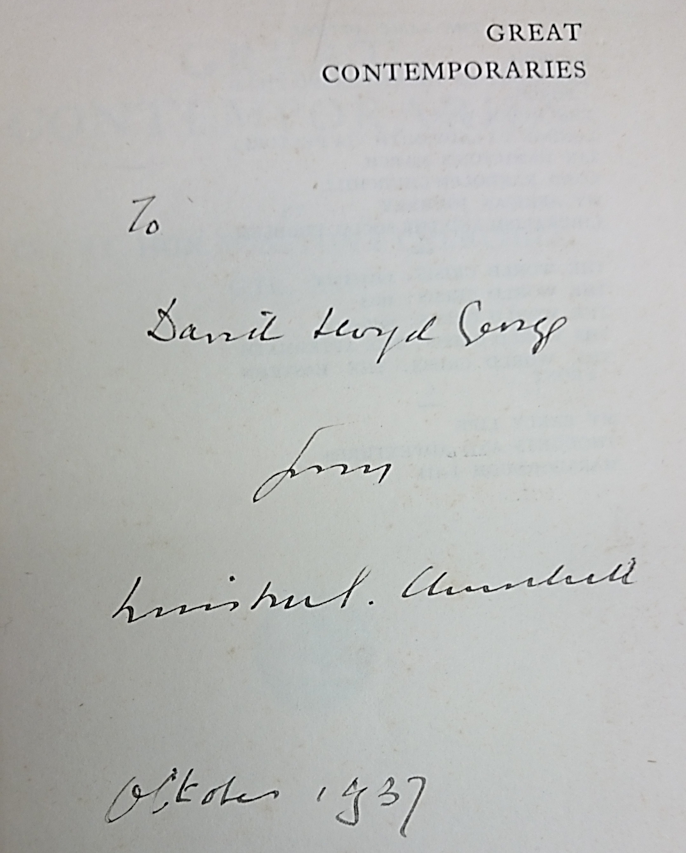
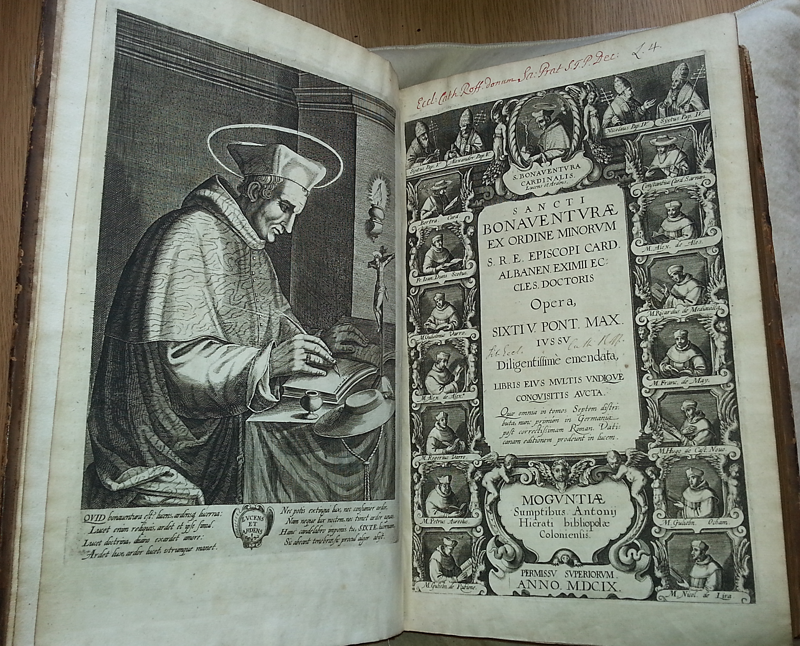
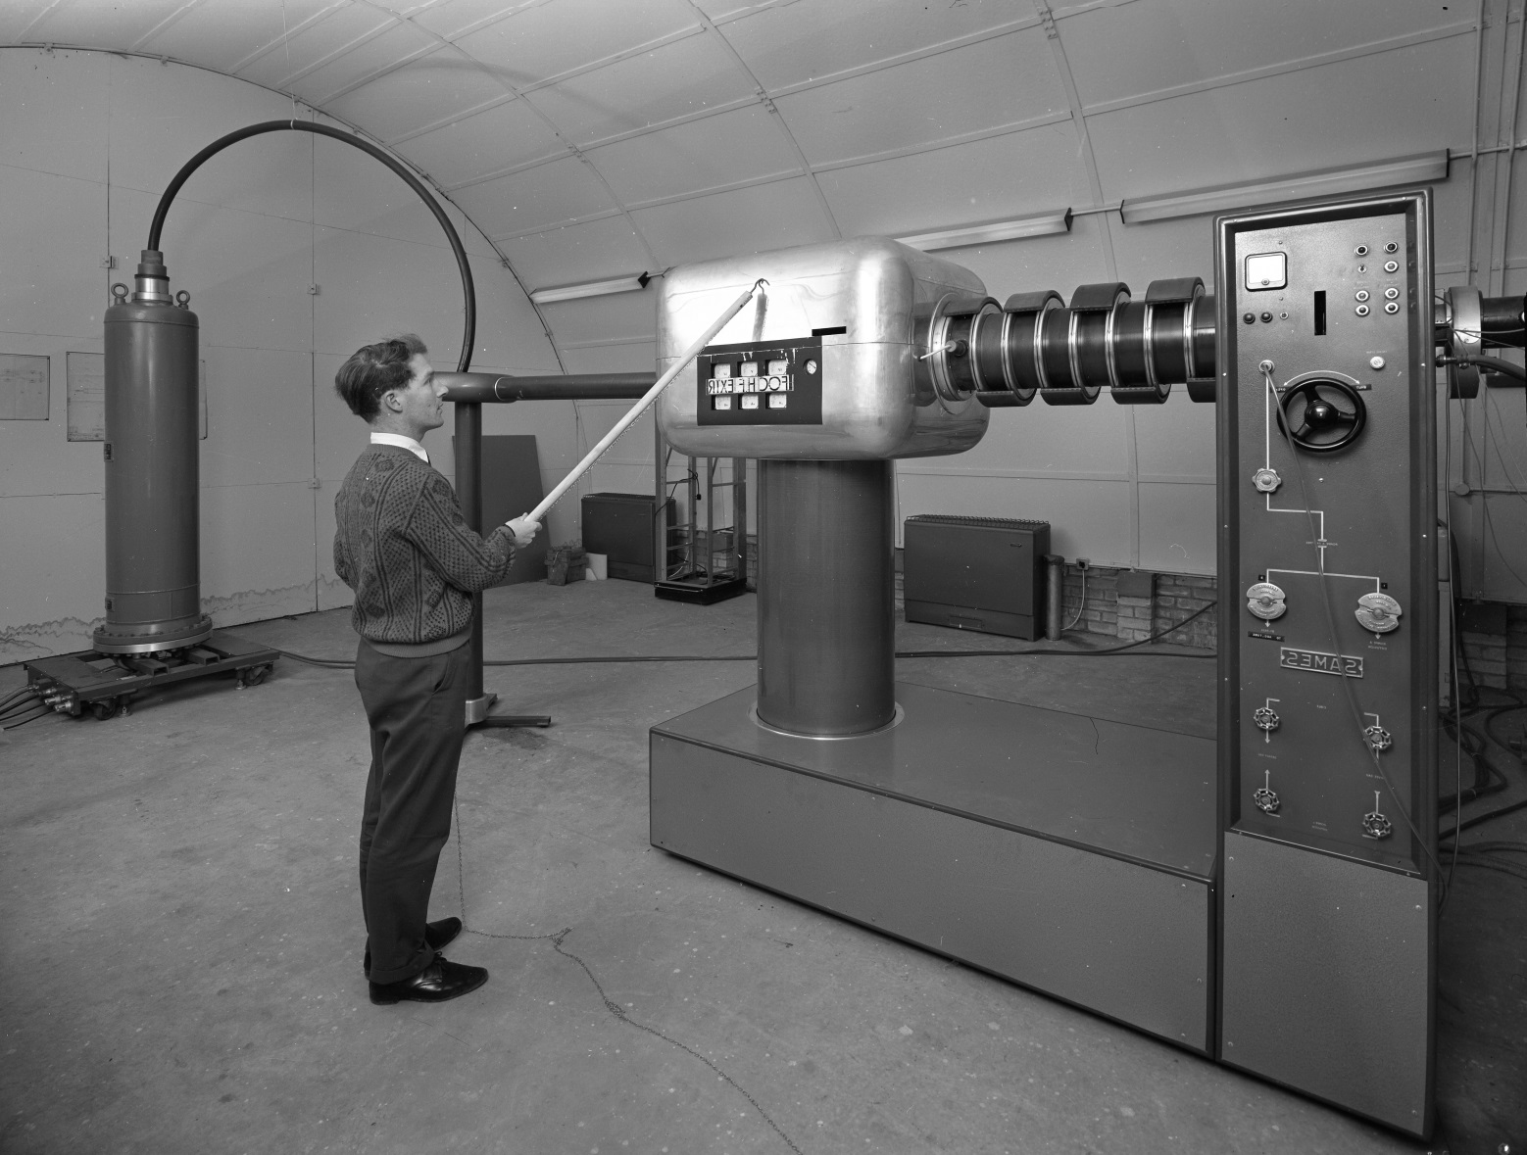
Dedication inscription in Great Contemporaries:
To David Lloyd George
from
Winston Churchill, 1937.
Particle accelerator at the University of Kent
© University of Kent, 1967
© Associated Newspapers Ltd. / Solo Syndication, British Cartoon Archive, University of Kent, NEB, Daily Mail, 10th January 1947
© Josie Caplehorne
Brochure for the first Red Wedge Comedy Tour ‘Reds Laugh Louder.’ Cartoon by Porky the Poet.
© Porky the Poet/Phill Jupitus, 1987.
Notes:
Special Collections and Archives at the University of Kent is made up of a unique selection of locally, nationally and internationally significant collections.
Our British Cartoon Archive is a national collection, predominantly made up of socio-political cartoons from the late 19th century through to present day. It contains over 140,000 pieces of original artwork, as well as books, periodicals and personal items from cartoonists. The Archive is widely used by the media, as well as international researchers, authors, teachers, and students.
The British Stand-Up Comedy Archive was established at the University of Kent just two years ago to celebrate, preserve, and provide access to the archives and records of British stand-up comedy and comedians.
The University of Kent Archive does what it says on the tin. It was established to preserve material that relates to the historical and cultural development of the university, and highlights the environment, governance and vision throughout the university’s existence, as an institutional and community identity.
Special Collections contains a variety of subjects and is largely book based. If what you want ranges from windmills to Victorian melodrama, then these collections are for you. The largest collections cover nineteenth and twentieth century theatre and the history of science, and span the 17th century to modern day. Special Collections & archives also have a close working relationship with Canterbury Cathedral Library, which dates back to the 15th century, and whose collections are included in the university library catalogue.

Slide 3
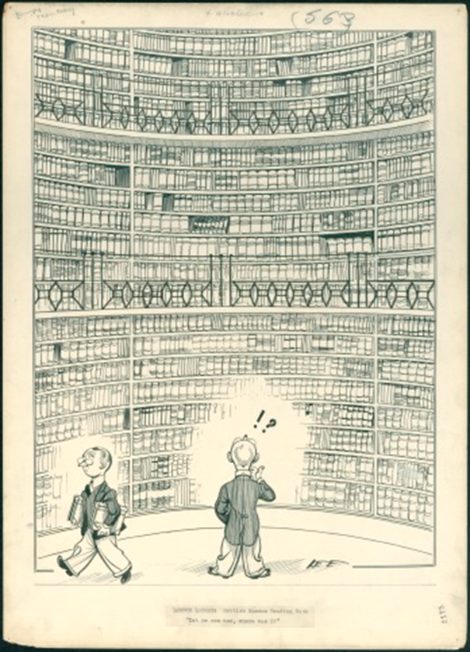
Changing Standards
Kent moved from AACR2 to RDA in 2013.
Partial RDA implementation made to rare book records.
A policy was required to enable full integration of RDA to rare books.
Notes:
In 2013 University of Kent transitioned to RDA from AACR2 across its entire lending collection. Although elements of RDA were introduced to our rare book bib records, such as content, media and carrier fields, as well as the move from the 260 to the 264, they were not fully integrated.
Adapting our existing records and ongoing cataloguing of our standard stock has been straightforward, but implementing this to our rare book cataloguing has been an uphill struggle. The main reason for this is that no real decision has been made in the wider library community about how to move forward with RDA & DCRM(b).
We deliberated for some time as to whether we should create a policy to provide a clear outline of how we would undertake this at Kent, all the while holding off, in the hope that a final decision would be made that would have a wider community impact.

Slide 4
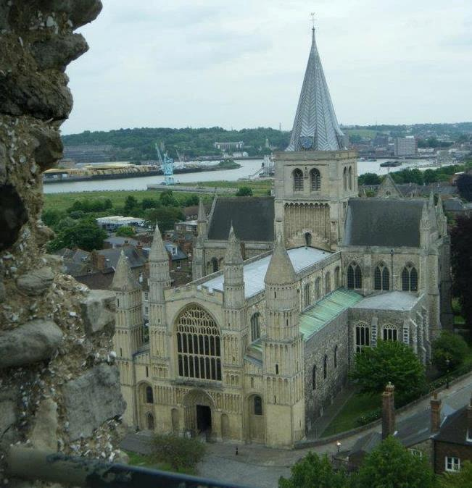
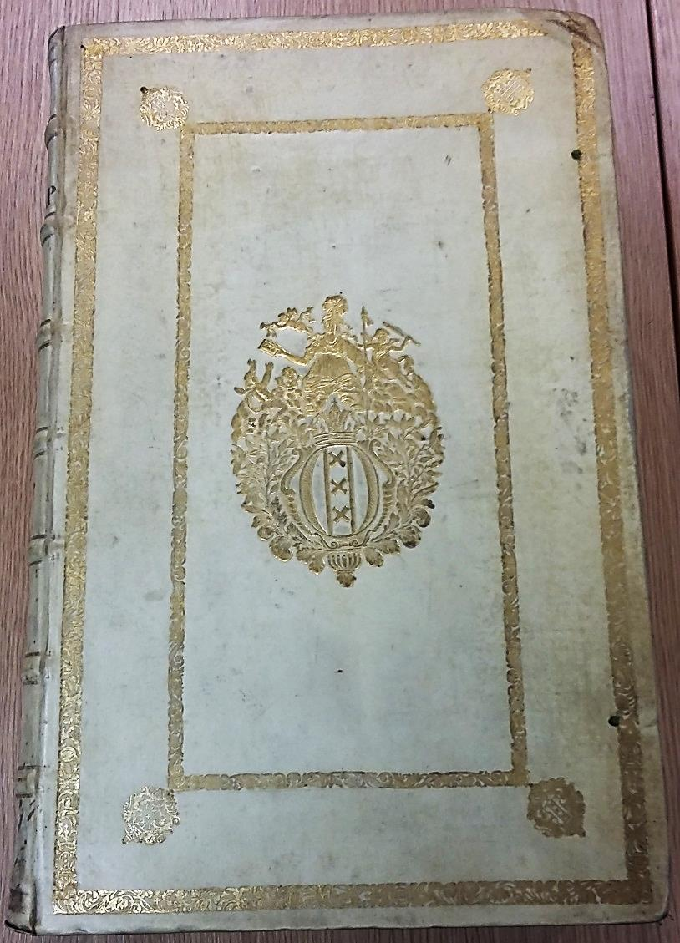
“Hidden Treasures: Fresh Expressions”
Rochester Cathedral was founded in the 7th century AD.
Heritage Lottery Fund grant of £3.55 million for refurbishment and book cataloguing.
Library consists of around 7000 printed volumes, with over 2000 dating from before the 20th century.
Rochester Cathedral from the Castle
© Claire Shaw
18th century Dutch prize binding
© Josie Caplehorne, 2015
Notes:
However, a collaborative project between the University of Kent and Rochester Cathedral was on the horizon, requiring an immediate decision.
In early 2013 the Heritage Lottery Fund awarded the Cathedral a grant of £3.55 million to make its “hidden collections” more accessible to the public and researchers and to refurbish the library.
Rochester Cathedral has a library of around seven thousand printed volumes, which includes roughly two hundred pre-1701 and 2,000 volumes 1701-1901. It has never been catalogued to currently recognised standards.
With part of the deliverables of the project being to create and add catalogue records for over 2000 pre 1901 books using standards MARC21 and RDA, we felt the urgency of such a decision bearing down on us.

Slide 5
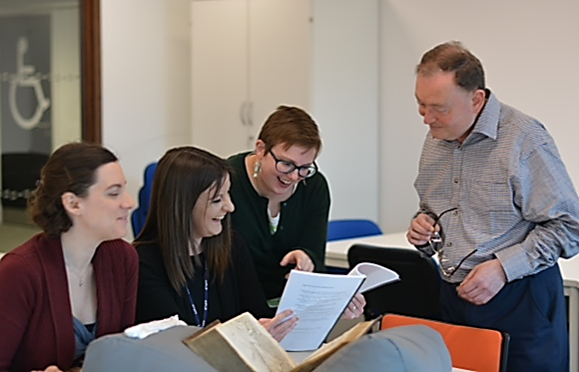
Working Collaboratively
We formed a working group consisting of staff with a range of specialisms from the Metadata and Special Collections & Archives teams.
Discussions focused on potential impact of RDA on rare and special collections, including the Cathedral libraries.
Our working group
© Kirsty Wallis, 2015
Notes:
We formed a working group of participants from across the metadata and special collections and archives teams. We felt this collaborative approach with colleagues was complimentary to this undertaking due to the range of specialisms being brought to the table.
The group consisted of a Senior Library Assistant from Special Collections, who brought with her knowledge of our own collections and broader rare book knowledge; the Senior Library Assistant from Metadata, who contributed cataloguing advice; and Josie and I, who specialise in cataloguing the rare and special book collections here at Kent. Josie is currently a Rochester Cathedral project cataloguer. Finally, the Canterbury Cathedral Librarian lent us her expert knowledge of ecclesiastical collections.
Our discussions initially centred on the impact of RDA across all collections, including affiliated cathedral libraries, and how this would affect the standard of cataloguing required for these, whilst keeping in mind our recent move to the Resource Discovery System Primo, and how this would affect our global discoverability.

Slide 6
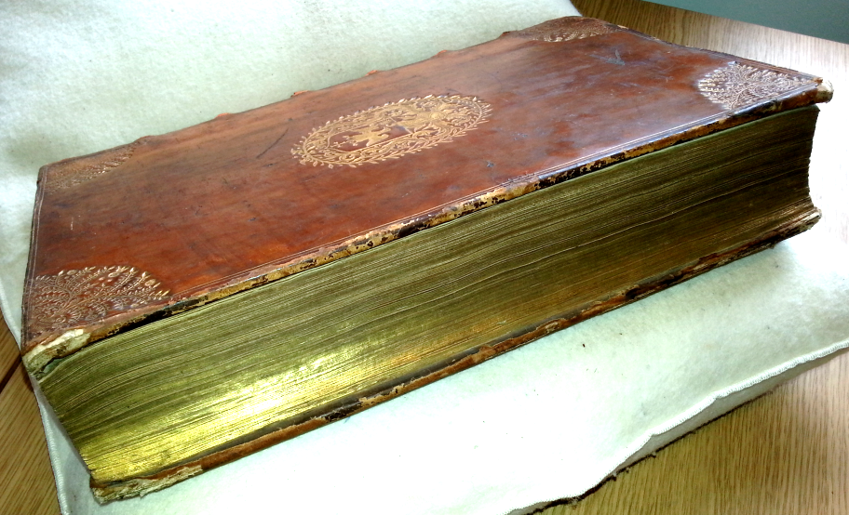
Working to Enable Discovery
The aim: to unify data across our lending and rare book collections.
The task: to study how all MARC21 values could be used for a RDA/DCRM(b) hybrid.
The outcome: a series of guidelines produced by each cataloguer.
‘Sancti Bonaventurae ex Ordine Minorum S.R.E. Episcopi Card. Albinen. Eximii Eccles. Doctoris Opera’ – 1609.
© Josie Caplehorne, 2015
Notes:
The University of Kent has had a new lease of life within its archives, from the inception of our new collections, to our brand new storage and reading room facilities. But discoverability isn’t just about a physical presence; part of enabling discoverability of our collections involves the effective use of RDA. This would also unify the data across our lending and rare book collections for our users.
After much discussion between all those involved, we decided to divide all valid MARC21 values, from the leader, right up to tag field 994, into thirds, sharing bite size chunks of an entire bibliographic record between the three cataloguers. We began to build the ultimate bibliographic record template to cover every eventuality. Every field was studied, dissected and investigated. This helped us to decide whether the field would be necessary, how we could use it to support a hybrid standard, and how to implement this at a practical level so that it would be beneficial to users searching through our specialist material.
The results of this were three separate sets of guidelines for each respective area written by each of us.

Slide 7
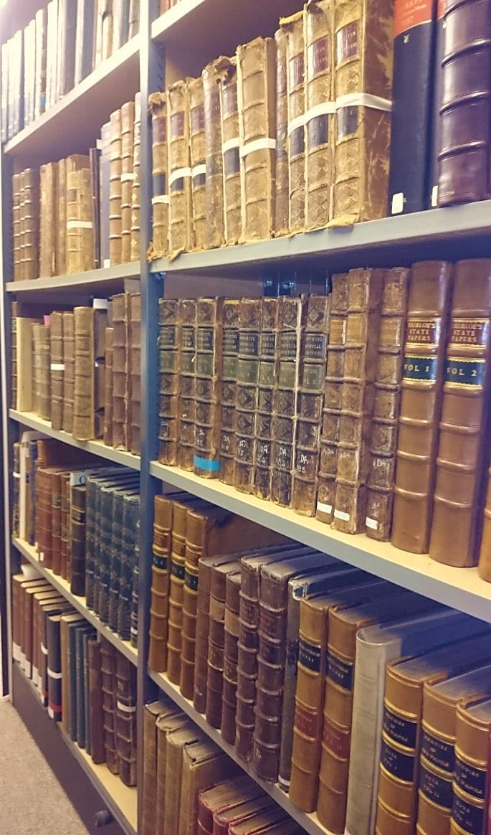
Defining Standards
Re-formed the original working group and invited additional specialists to review our findings.
We sought honest feedback and received positive responses.
A three month process led to a concise set of guidelines.
Part of our store
© Rachel Dickinson, 2015
Notes:
We regrouped with the original task force to present this work, inviting the manager for the Rochester Cathedral Cataloguing Project. We also capitalised on our long established relationship with Canterbury Cathedral, inviting their librarian to join us.
We had faith in our own work, but we asked the group for brutal honesty in order to establish if our guidelines were feasible, particularly bearing in mind the timescale of the Rochester Cathedral project.
The feedback was very positive, and with some minor adaptations, the three sets of guidelines were edited into one staff user manual. This was expanded to include appendices and glossaries to improve understanding of rare book terminology and to support future staff training.
From our initial discussions, through to the last day of editing and printing our guidelines, we spent around three months on the whole process, which was undertaken around all other business.

Slide 8
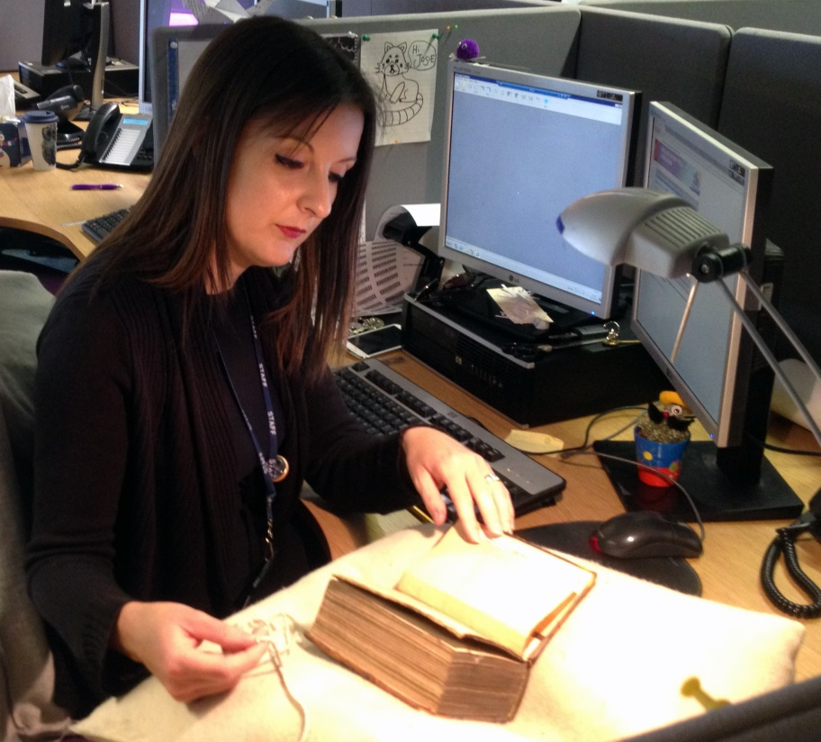
Change for the Better
264 with variables replaced the 260.
Unlimited use of 7XX personal, corporate and meeting name added entries.
Extension of abbreviated terms and replacement of Latin.
© Angela Groth-Seary, University of Kent, 2015
Notes:
We began to implement our decisions into our cataloguing of the David Lloyd George collection, which was partially catalogued some decades ago. It felt like a good place to start because it lacked essential metadata as well as the detail required for rare book cataloguing. We then ran comparisons between what had existed before and the improvements that had been made as a result of this process. Some of the main benefits RDA has brought to this collection are:
Replacing the 260 with the 264, which allows repetition with relevant indicators, has led to clearer labelling of specific elements of the book production process. Used in collaboration with Primo it has allowed our users to better identify the information they need, thus limiting unnecessary handling of the items.
The unlimited use of 700 fields, along with an almost limitless range of relator terms, is a huge benefit for rare book cataloguing. We are able to freely express any relationship to the work from booksellers, printers and binders, to engravers, illustrators and cartographers. A user searching for a specific engraver would not have benefited from previous practice as this would not have been included in the metadata.
The extension of abbreviations as well as replacement of Latin terms such as ‘et al,’ may be contentious. But, thinking in terms of the user experience, this change has been beneficial. In an age of clear and instant information, this element of RDA allows straightforward communication of key facts.
Taking inspiration from RDA, we also made changes to how terms such as ‘polyglot’ were used at Kent. Although we still use these terms, we now expand them to include to the specific languages and how these are structured within the text. This is particularly useful when the 008 language field limits you to specifying only the term ‘multiple languages’ without further clarification.
After implementing this standard to our collections we invited rare book cataloguers from Lambeth Palace Library to meet with us. The aim of this was to share our work and benefit from their experience. Their positive feedback about our improvements was extremely welcome. It is great when, after a period of concentrated effort, the result is ratified.
Suggestions they made have been added to our policy and are now being implemented across all collections, including the Cathedrals.

Slide 9
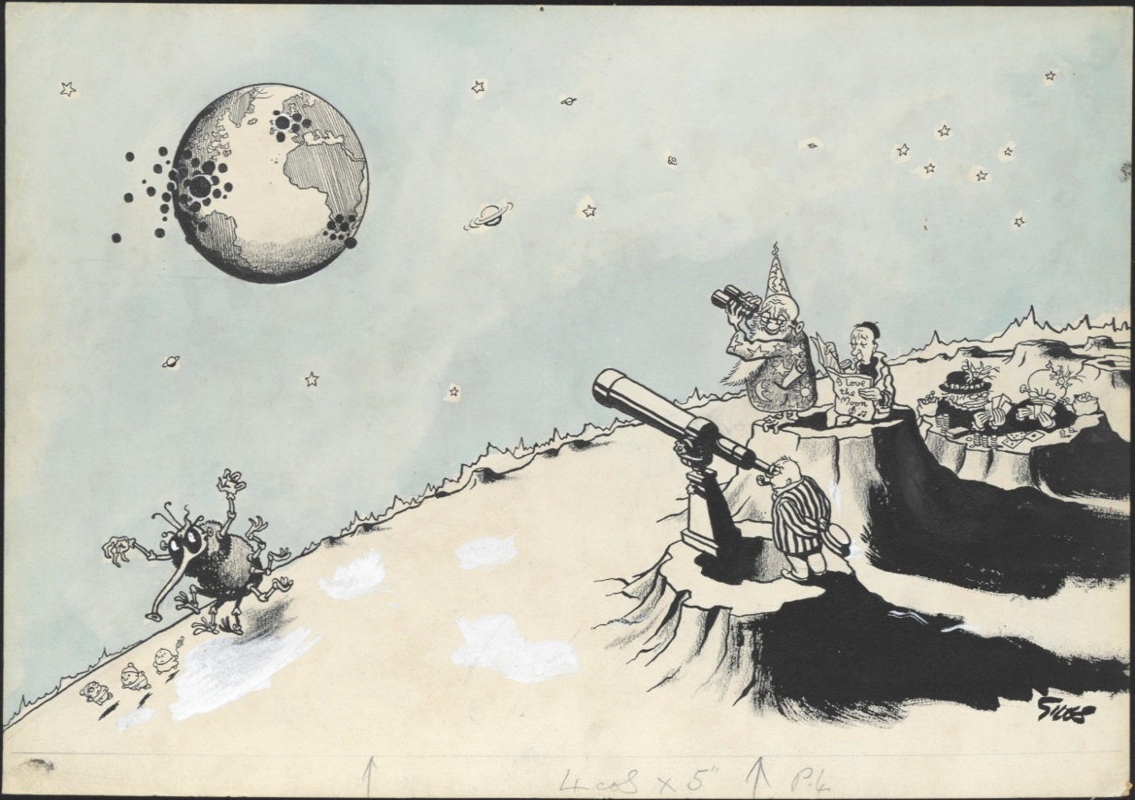
Future Gazing
Improve metadata for users.
Build upon all existing partnerships.
Seek to form new relationships.
Centre for good practice and excellence.
© Express Syndication Ltd, British Cartoon Archive, University of Kent, Giles, Daily Express, 9th April 1953
Notes:
Our vision is ambitious, but why not?
We want to continue to review and improve all metadata, and not rest on how we do things today. We should always be thinking of tomorrow and how the metadata we create will benefit future library users and rare book cataloguers. For instance, we are already reviewing our recent work and are creating a series of wiki pages which allows improved access for staff training and support resources.
We want to continue to build-upon all existing relationships with our partners. The next phase of the Rochester Cataloguing project will see us training volunteers at the Cathedral in basic cataloguing. This is necessary as these volunteers will run the library without the support of an in-house librarian. The end of the project will not signal the end of Kent’s relationship with the Cathedral, we will continue to support the volunteers in their work.
Ultimately, we want to be a centre that’s known for good practice and excellence, a place from which we can reach out and offer support to other institutions, much like the support we have received from Canterbury Cathedral and Lambeth Palace.

Slide 10
How to contact us:
Josie Caplehorne – Rochester Cathedral Cataloguer
J.Caplehorne@kent.ac.uk
Rachel Dickinson – Metadata Assistant
R.Dickinson@kent.ac.uk
Where you can find out more:
University of Kent Special Collections & Archives Blog
http://blogs.kent.ac.uk/specialcollections/
Rochester Cathedral
http://rochestercathedral.org/
Hidden Treasures Fresh Expressions Project
http://rochestercathedral.org/development?catid=0&id=239
Follow Us On Twitter
@UoKSpecialColls
@BritishCartoonA
@unikentstandup
Slides 1-9 background image: Map of Kent, 1827 ©Photograph, University of Kent, 2011.
Slide 10 background: From an edition of “A treatise of Oswaldus Crollius of Signatures of Internal Things…”, 1669. ©Photograph, Jane Gallagher, 2014.

